Slide 1
The Gilded Age
The West: Part 1

Slide 2
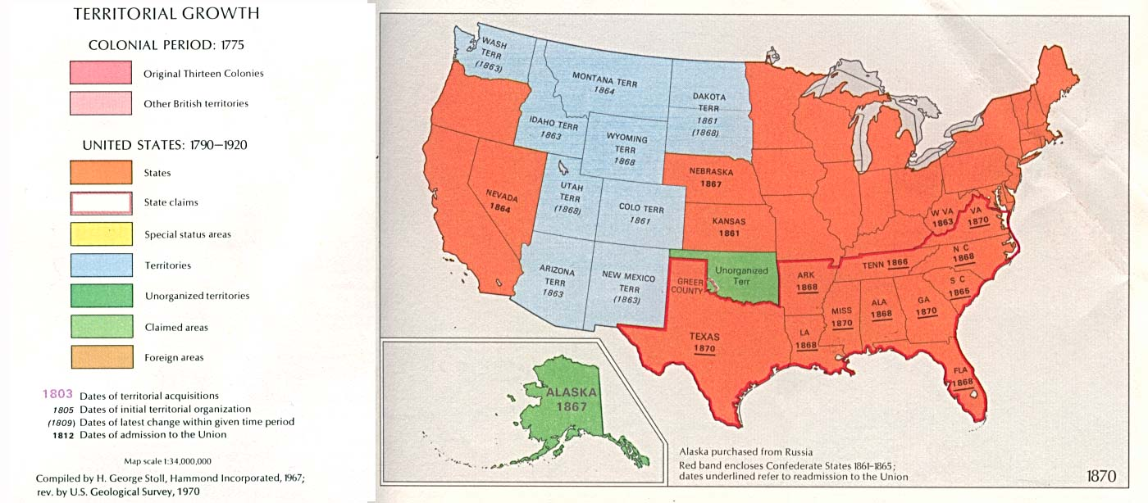
USA in the Gilded Age: 1870-1900
The West:
Farmers began to organize to address their economic problems, giving birth to the Populist movement.
The West:
Farmers, ranchers, & miners closed the last of the frontier.
Settlers pushed west with renewed vigor, sparking conflict with Native American groups.

Slide 3
Native Americans
In 1834 (after the Indian Removal Act), the entire Great Plains had been designated as one large Native American reservation. In 1851, the federal government created the first Indian Appropriations Act, and began to subdivide the land among various Native groups, creating the first Reservations (most continued to hunt and forage on their traditional lands bringing them into conflict with those pushing westward)
The push westward largely disrupted the lives of Great Plains peoples (Sioux, Cheyenne and Arapahoe)
Farmers, ranchers, miners, cattle drovers and the railroads began to encroach increasingly on Native land
Settlers and Native Americans lived vastly different lives with different cultures; coexistence was bound to be complicated. The government supported a policy of Native assimilation or “Americanization”

Slide 4
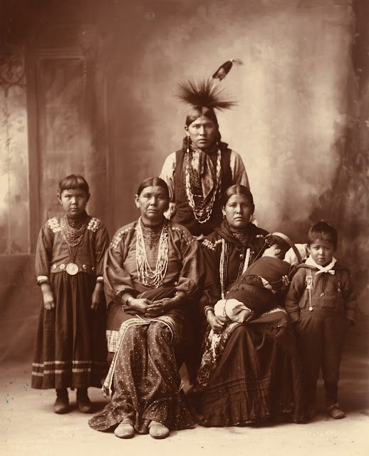
The Policy of Assimilation
Indian Appropriations Acts – part of a concerted government effort to open up Native American land.
1871 – Made Native Americans wards of the state (not sovereign nation and not citizens). Government believed it would now be easier to take their land; now they were no longer recognized as independent nations (invalidating their treaties with the government).
1885 – Allowed Native Americans to sell land they claimed as their own to settlers directly (didn’t work, most refused to sell).
Dawes Act (1887):
Also known as the “General Allotment Act”
Divided up traditional tribal lands into individual “allotments”, with 160 acres of land going to each individual male head of household, and 80 acres to each unmarried adult
The government was supposed to sell the remainder to settlers and transfer the money to the Native Americans
However, by 1932, speculators, companies and settlers had taken about two-thirds of the territory originally designated for Native Americans, who received no money from the sale of these lands
Effects:
Dispossessed Native Americans of their lands without any compensation
Destroyed the tradition of “communal property”, a staple of the Native American way of life
Broke up communities themselves by essentially dismantling reservations, weakening cultural and kinship bonds in the process

Slide 5
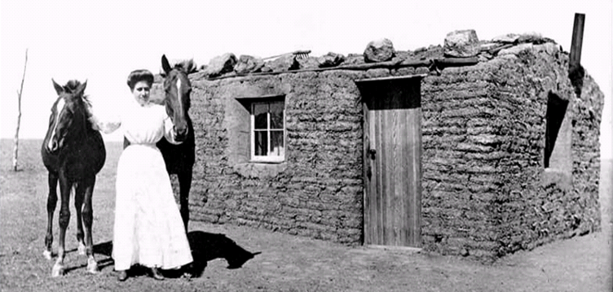
Government supports settlement
In 1862, the U.S. government created the Homestead Act which encouraged farmers to settle in the West by offering 160 acres of land to families who committed to living there for at least 5 years.
A pioneer sod house

Slide 6
“Go west, young man!”
Between 1862 and 1900, about 600,000 families responded to the opportunity offered by the HOMESTEAD ACT.
The West was very diverse. By 1900, between 40% and 50% of settlers were foreign-born (mostly Irish, German, Mexican, Chinese) and western residents included approximately 40,000 EXODUSTERS (black Southerners who left the post-Reconstruction South for Kansas, and later, for the West)
Settlers/farmers, however, faced similar issues that Native Americans did: competition with speculators, companies meant that ultimately, only 10% of the land was actually settled by the families for whom it was intended. Additionally, not all plots were of equal value or quality
1889 – Government strengthened the Homestead Act to try to encourage more family settlement (relaxed restrictions on “sooners”, opened up 2 million acres in Oklahoma territory for settlement). Unfortunately, this land was taken from Native Americans in the Indian Appropriations Act.
Oklahoma Land Rush of 1889: https://www.youtube.com/watch?v=h3BQg9qeT3c
Began at 12 noon on April 22. 50,000 people showed up to claim land!
"At twelve o'clock on Monday, April 22d, the resident population of Guthrie was nothing; before sundown it was at least ten thousand. In that time streets had been laid out, town lots staked off, and steps taken toward the formation of a municipal government.“ -Harper’s Weekly

Slide 7
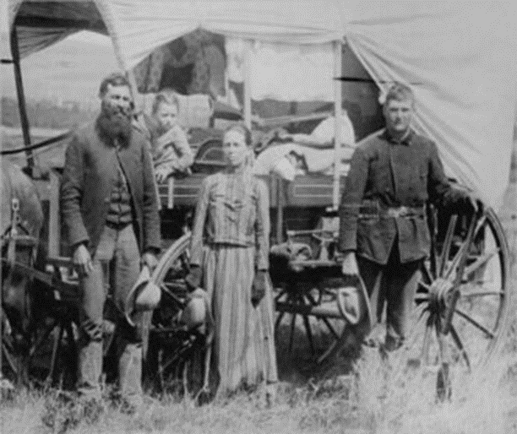
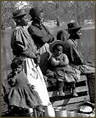
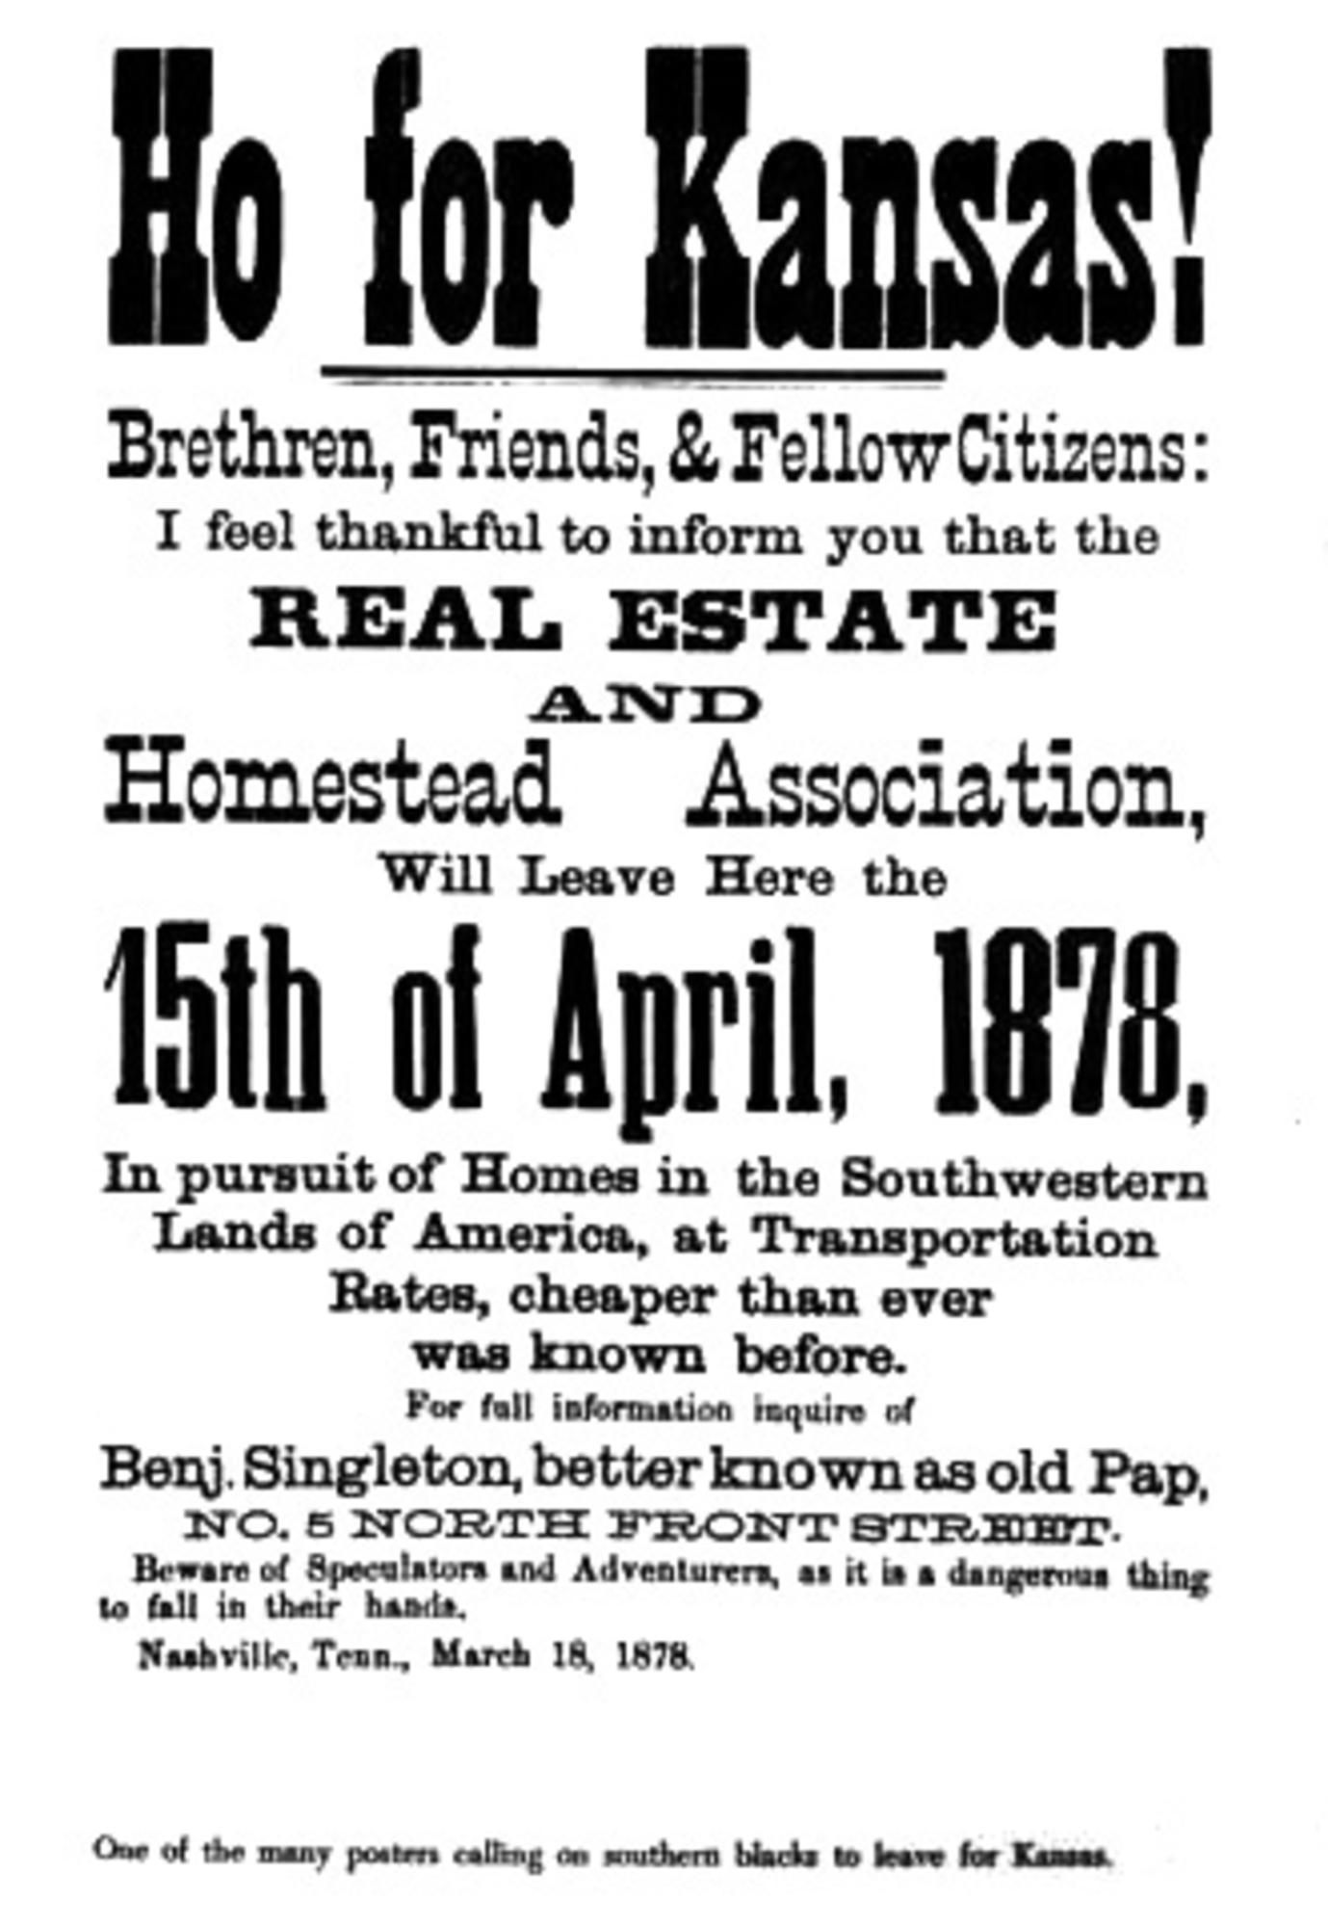
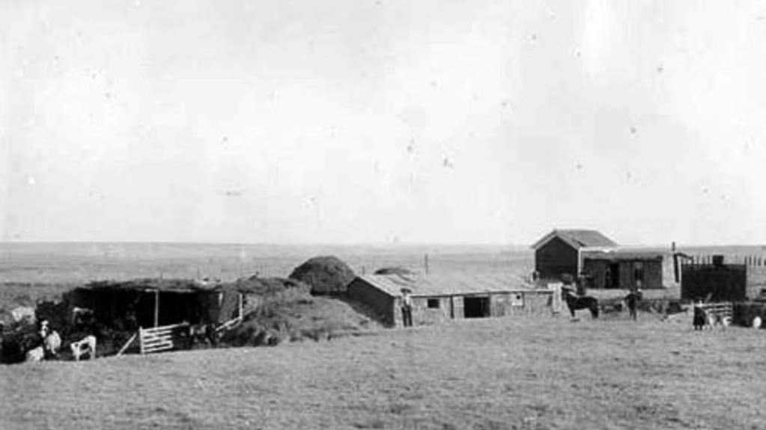

Slide 8
Group Text Activity
Complete the “Change and Agency” worksheet by examining your group’s texts and answering the two questions on the worksheet.
Get together with a group that completed the opposite text and share information in order to complete the other side of the worksheet.

