Slide 1
The Conservative Resurgence: Part 1
The Reagan Years: Politics, Economics, & the End of the Cold War

Slide 2
The Conservative REsurgence
President Ronald Reagan’s election marks a rightward shift in domestic and foreign policy. With the collapse of the Soviet Union, the Cold War ends and the U.S. confronts a host of domestic problems.

Slide 3
A Conservative Movement Emerges
The Conservative Movement Builds
Conservative Issues
• Entitlement programs provide guaranteed benefits to specific groups (such as Social Security and Medicare)
• High cost of programs, stories of fraud upset taxpayers
• Many skeptical of civil rights rulings like busing over long distances
The New Right
• New Right—collection of grass-roots groups promoting single issues (oppose ERA, Roe v. Wade, affirmative action)
• Affirmative action—special consideration for women, minorities
- many say it’s reverse discrimination, favoring one group over others

Slide 4
continued The Conservative Movement Builds
The Conservative Coalition
Business, religious, other groups form a Conservative Coalition in the U.S. Congress that brought together the majority of the Northern Republicans and a conservative, mostly Southern minority of the Democrats)
Conservative periodicals, think tanks discuss, develop policies
Goals are small government, family values, patriotism, business
The Heritage Foundation: Think tank consisting of political, business/industry leaders, economic and social policy experts with a mission to:
"formulate and promote conservative public policies based on the principles of free enterprise, limited government, individual freedom, traditional American values, and a strong national defense.”
The Moral Majority
1970s religious revival uses TV, radio; strong among fundamentalists
Jerry Falwell’s Moral Majority—Christians for traditional morals:
https://vimeo.com/48621151

Slide 5
Conservative Policies Under Reagan
“Reaganomics” Takes Over
Budget Cuts
Maintains entitlement programs that benefit middle class (Medicare, Social Security – old age pensions)
Cuts programs that benefit poor, urban population (Food Stamps, Social Security – welfare, disability, unemployment programs)
Tax Cuts:
Reduces top tax bracket from 70% in 1980 to a final low of 28% by 1988
Eliminated several tax brackets, deductions, thereby increasing the tax burden on the middle class and worsening the economic situation of the poor
Reagan’s Economic Policies
Reagan encourages private investment by cutting federal government services; conservative theory posits that renewed competition in private industry will produce economic growth AND absorb the shortfall in services produced by the cuts
• Reaganomics: budget cuts, tax cuts, increased defense spending

Slide 6
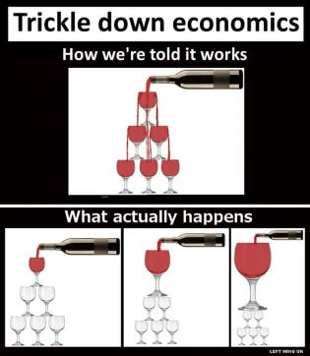
continued “Reaganomics” Takes Over
Tax Cuts
• Supply-side economics, OR, “Trickle-Down” economics, holds that lower taxes result in:
- investment, greater productivity, more supply, lower prices
• Congress decreases taxes by 25% over 3 years

Slide 7
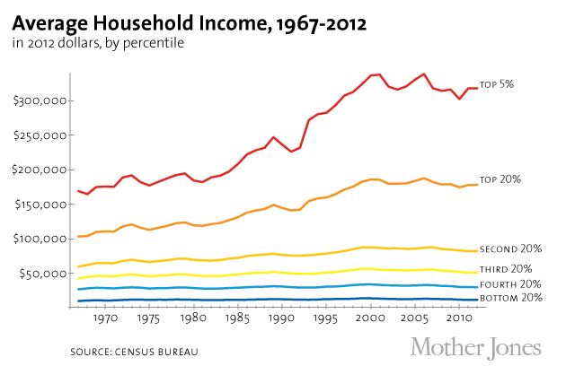
The Long Term Effects of Conservative Economics
Introduced in the 1980s
GDP Growth continues, fairly regular gains over time
Top 1% sees a 72% increase in overall wealth
Middle and working class families stagnate; wages fail to rise to match an increasing cost of living
Bottom 10% sees a 12% decrease in overall wealth

Slide 8
Judicial Power Shifts to the Right
Supreme Court Appointments
Reagan appoints Sandra Day O’Connor first woman justice
Other Reagan, Bush appointments make Court more conservative (incl. Antonin Scalia and Robert Bork – Anthony Kennedy appointed instead)
Court places restrictions on civil rights, abortion (Civil Rights Act 1964, Roe v. Wade)
Makes it easier for states to restrict access to rights guaranteed in these

Slide 9
LiBeral fire-breathers express dismay at the “conservatization” of the federal courts
“Robert Bork's America is a land in which women would be forced into back-alley abortions, blacks would sit at segregated lunch counters, rogue police could break down citizens' doors in midnight raids, schoolchildren could not be taught about evolution, writers and artists could be censored at the whim of the Government, and the doors of the Federal courts would be shut on the fingers of millions of citizens.”
Ted Kennedy

Slide 10
Deregulating the Economy Affects the Environment
Reducing the Size of Government
Reagan reduces government with budget cuts and deregulation of industry (e.g. pollution fines, emissions taxes)
- believe it increases competition, results in lower prices
Cuts budget of Environmental Protection Agency (EPA) by 28%
Interior Dept. permits more oil drilling, lumbering, coal mining
Sells millions of acres of public lands for development

Slide 11
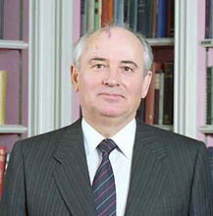
The Cold War Ends
Gorbachev Initiates Reform
• Mikhail Gorbachev—general secretary of Soviet Communist Party
Soviet economy stressed; Reagan’s defense spending adds pressure
Gorbachev adopts glasnost—allows criticism, some freedom of press
Plans perestroika—some private enterprise, moves toward democracy
Wants better relations with U.S. before they cut U.S.S.R. military spending
- arms-control INF Treaty (Intermediate-Range Nuclear Forces Treaty)
https://www.youtube.com/watch?v=sr4t3fme5XA

Slide 12
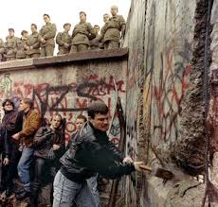
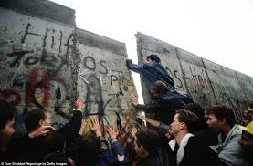
continued The Cold War Ends
http://www.youtube.com/watch?v=zmRPP2WXX0U (berlin wall falls)
The Soviet Union Declines
1991, 14 republics declare independence; Gorbachev forced to resign
Commonwealth of Independent States forms; 1993 START II (Strategic Arms Reduction Treaty) signed
The Collapse of Communist Regimes
Gorbachev reduces Soviet control of Eastern Europe, urges democracy
1989, Berlin Wall torn down; 1990, 2 Germanys reunited
Czechoslovakia, Baltic states, Hungary, Bulgaria, Romania democratic

Slide 13
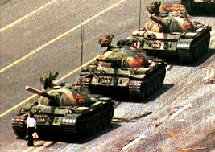
continued The Cold War Ends
Communism Continues in China
1980s, China loosens business restrictions, stops price controls
Students demand free speech, voice in government
1989, demonstrations in Beijing’s Tiananmen Square, other cities
Premier Li Peng orders military to crush protesters
- unarmed students killed
http://www.youtube.com/watch?v=Nnmnq5nFcZw
https://www.youtube.com/watch?v=hooL98OwlMM

