Slide 1
The “other” America
Significant & Widespread Poverty in the 1950s

Slide 2
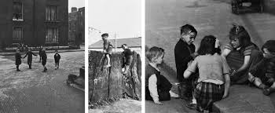
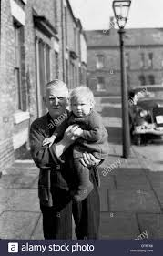
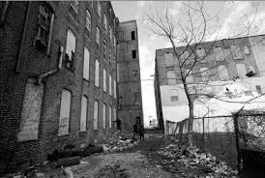
THE OTHER AMERICA
By 1962, nearly one out of every four Americans was living below the poverty level ($2,973 annually for a family of four in 1958; approximately $22,000 annually today)
Many suburban Americans failed to internalize or even notice these problems, refusing to believe that the “richest nation on earth” could possibly have so many people living below the poverty line
A major proportion of these poor were the elderly, single women and their children, immigrants, and people of color. Urban areas began to decay and rural areas stagnated economically

Slide 3
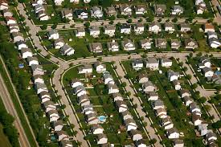
“WHITE FLIGHT”
In the 1950s, millions of middle and working class white Americans left the cities for the suburbs
At the same time millions of rural poor migrated to the cities (fleeing dying towns unconnected to the new nationwide highways)
The so-called “White Flight” drained American cities of valuable financial stimulation by shrinking the tax base dramatically

Slide 4
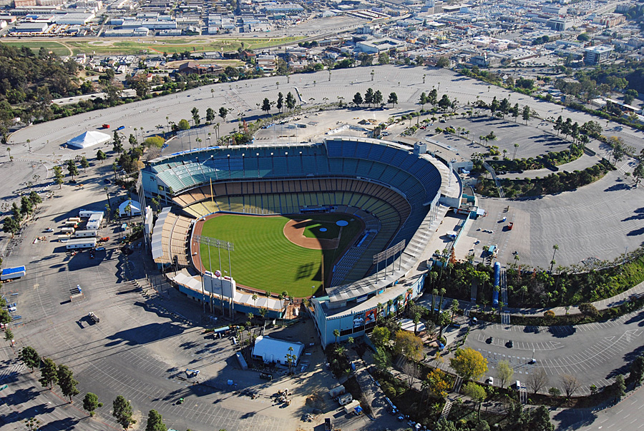
Urban Decay & Urban Renewal
Many people who remained in the inner cities had to live in dirty, crowded slums.
People of color were disproportionately affected by the degeneration of cities because many suburban community boards had policies making it extremely difficult for non-white families to buy homes in those areas
One proposed solution was “urban renewal”. The National Housing Act of 1949 called for the tearing down of run-down neighborhoods and the construction of affordable housing
Although the tearing down and some building of affordable housing did occur, thanks to government stimulus, in many cases, parking lots, shopping centers, highways, parks and factories were constructed on much of the cleared land
In cases like this, urban renewal simply became “urban removal” as many people simply had to move from one low-income area to another.
Dodger Stadium- An example of urban renewal

Slide 5
Oppression Leads to Activism…
Segregation, lynchings, and discrimination in employment and housing were problems faced by many minority groups including African Americans and Latino Americans
“Braceros” who remained in the U.S. illegally to escape poor economic conditions in Mexico soon found prejudice against them rising dramatically, and indeed, against Latinos in general
Lynchings of Latino Americans had a long history in the Southwest U.S. but had become quite rare by the end of the 1920s
School segregation however, remained pervasive (over 80% of Latino and Spanish-speaking students attended segregated schools) until the Brown v. Board of Education decision (1954)
Though the incidences had decreased significantly in recent years, African Americans in the South (particularly young men) remained in danger of lynchings during the 50s
Emmett Till: A 14 year old African American boy from Chicago, visiting his family in Money, Mississippi, was brutally murdered by two white men. The widespread reporting on this crime and Till’s mother’s decision to give him an open-casket funeral sparked nationwide horror and outrage and reinvigorated the civil rights movement
Montgomery Bus Boycott: Led by Rosa Parks and Dr. Martin Luther King Jr., the boycott last one year and ended with a Supreme Court decision which struck down segregated busing

Slide 6
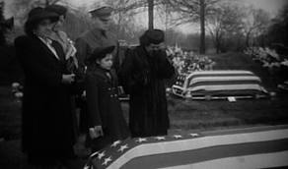
The Longoria Incident
Felix Longoria was a Mexican-American WWII hero who had been killed in the Philippines.
The only undertaker in his Texas hometown refused to provide his family with funeral services
Outraged Mexican Americans stepped up their efforts to stamp out discrimination by creating the G.I. Forum and the Unity League of California
Both were designed to register Mexican American voters and to promote candidates who would represent their interests.

Slide 7
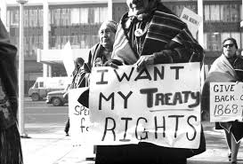
Native Americans Continue Their Struggle…
From 1887 to 1934, the government policy towards Native Americans was one of “Americanization” and assimilation.
In 1953 the federal government announced it would give up its responsibility for Native American tribes.
The new approach, known as the “termination policy” eliminated federal economic support, discontinued the reservation system, and redistributed tribal lands to individual Native Americans.
Native Americans were encouraged to resettle in cities.
The policy was a dismal failure. Most couldn’t find jobs or decent housing because of poor training and racial prejudice. In 1963, the termination policy was abandoned
The 1960s would mark a new beginning for Native American activism

Slide 8
WOMEN’S ROLES IN THE 1950S
During the 1950s, the role of homemaker and mother was glorified in popular magazines, movies and television
This ideal was one which failed to satisfy a great many middle class women, and was wildly unrealistic for many others, who had no choice but to work

Slide 9
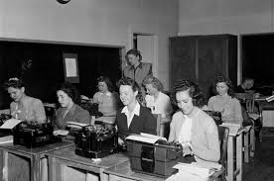
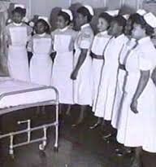
WOMEN AT WORK
Being employed did not necessarily bring happiness or intellectual fulfillment however
Those women who did work were finding job opportunities limited to fields such as nursing, teaching, and office support
Women earned far less than men for comparable jobs (approx. 60 cents for every $1 earned by men)
The gender pay gap would prove to be one of the most important issues on the feminist agenda of the 1960s

