Slide 1
The Harlem Renaissance

Slide 2
The Great Migration
“Push” Factors:
Reduced opportunities for employment, political participation and better quality of life due to Reconstruction failure and 1896 Plessy vs. Ferguson Supreme Court decision
Increased racial violence (1890 – 1920)
Boll weevil infestation devastates the cotton crop, 1915, leading to increasing economic depression.
“Pull” Factors:
Racism still a serious obstacle, but much less brutal up North than in the South
There was violent backlash however; race riots broke out in 36 American cities during the “Red Summer” of 1919
Better access to political participation (not prevented from voting as often)
Education more accessible in some Northern regions
However, Jim Crow-style laws and under-funding of segregated schools was just as prevalent in some areas as in the South)
More varied job opportunities as a result of WWI and massive industrialization
1.6 million African Americans migrated from the South to the North between 1910 and 1940

Slide 3
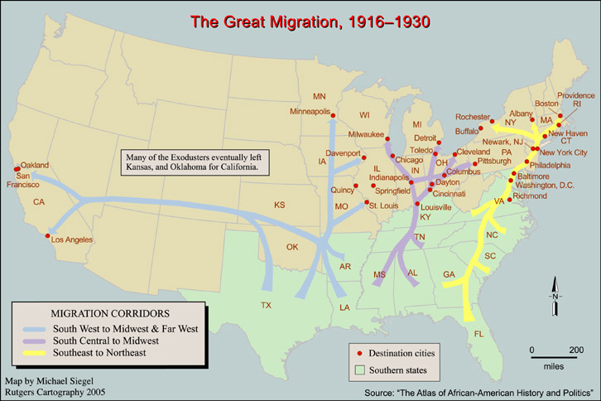

Slide 4
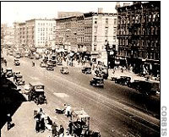
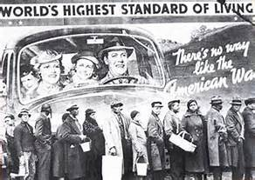
New Jobs, New Communities
Vast majority of African Americans worked in manufacturing, service and clerical positions
1920s saw the beginning of a small, but burgeoning black middle class: lawyers, teachers/professors, entrepreneurs, doctors, nurses
Cities like Detroit, Chicago, Philadelphia and New York gradually developed neighborhoods which became centers of black culture
In Northern black communities, new creative expression in the forms of art, music, poetry and literature gave voice to the struggles of the black experience, and galvanized an entire generation of young African Americans to add their voices to the civil rights movement

Slide 5
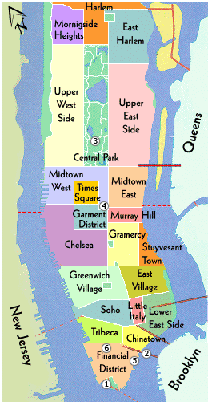
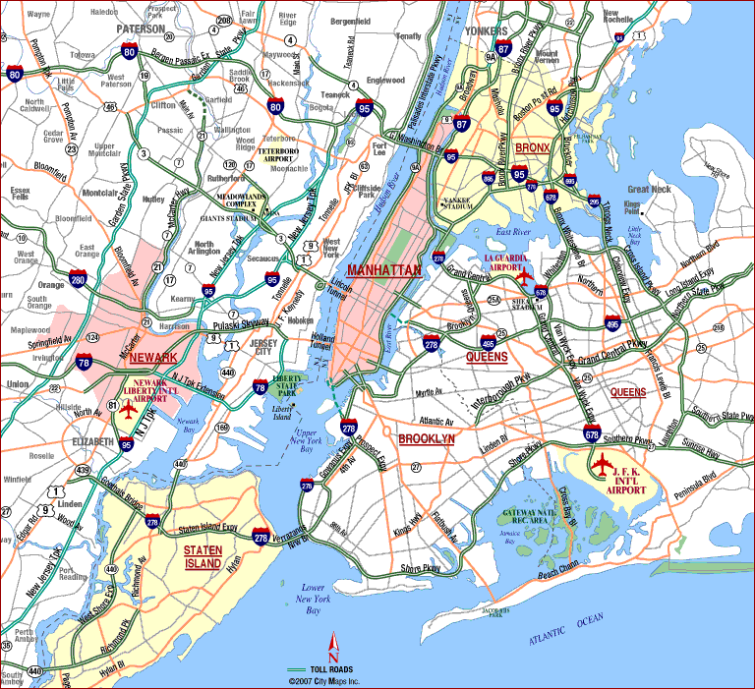
The Beginning of the Harlem Renaissance
Housing executives in the early 20th century planned Harlem for middle class workers who worked in the city, but couldn’t afford city housing prices – originally designed for white professional suburbanites.
Overambitious building outpaced the growth of public transportation in New York and led to a drop in property values. White Harlem landlords began to sell properties to enterprising black real estate developers, and agents, who were more likely to rent property to black tenants.
Meanwhile, gentrification in Midtown Manhattan pushed many low-income African Americans out of the Metropolitan area. With the flourishing of art, literature, music, and black-owned businesses, African Americans began moving to Harlem en masse. The neighborhood’s black population doubled between 1900 and 1920.
Harlem became a bustling, diverse community with people from all over the United States and the Caribbean (Jamaica, Trinidad, Cuba and Puerto Rico)

Slide 6
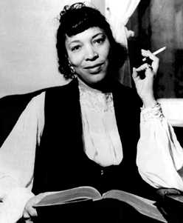
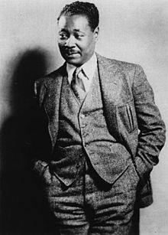
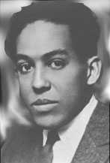
Harlem Renaissance
Explosion and celebration of black culture
Literary, musical, and intellectual movement
Burgeoning black middle class and the first appearance of black millionaires
Center of civil rights activism
“Mecca of Black America”
Zora Neale Hurston
Claude McKay
Langston Hughes

Slide 7
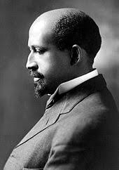
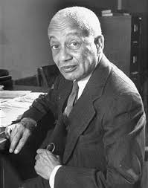
The Intellectual “Fathers” of the Harlem Renaissance
W.E.B. DuBois (Historian, Writer, co-founder NAACP, and editor of “Crisis” magazine)
Alain Locke (Doctor of Philosophy, Writer, Professor, Rhodes scholar and author of “The New Negro”.)

Slide 8
How did the Harlem Renaissance Impact American History?
The Harlem Renaissance helped to redefine how Americans and the world understood African American culture. It helped to begin a more successful integration of black and white cultures, and marked the beginning of a black urban society.
The Harlem Renaissance set the stage for the civil rights movement of the 1950s and 60s. https://www.youtube.com/watch?v=SvqVnSaReP
Watch the video link above: 9:40 – 30:15 and answer the questions on the worksheet provided.

