Slide 1
The Collapse of Reconstruction
The Rise of “Jim Crow” and the “Re-telling” of the American Civil War

Slide 2
Problems with Reconstruction
One of the main goals was to help the South get back on its feet, economically
General Sherman’s Field: “40 acres and a mule”
With this promise unfulfilled, very few African Americans could afford to own their own land (the primary basis of economic success in the South), a situation shared with poor, Southern white Americans
The widespread sharecropping and tenant farming systems was the result – creating something resembling a FEUDAL class of people who labored for survival but found it extraordinarily difficult to get ahead

Slide 3
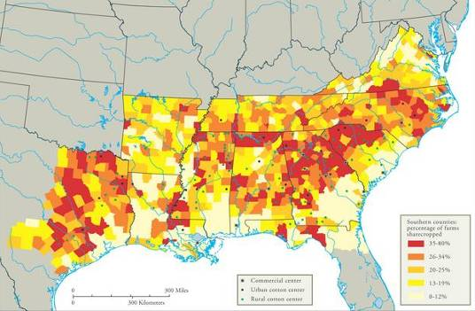
Sharecropping in the Post-Civil War South

Slide 4
Tenancy & the Crop Lien System
Furnishing Merchant | Tenant Farmer | Landowner
Loan tools and seed up to 60% interest to tenant farmer to plant spring crop. Farmer also secures food, clothing, and other necessities on credit from merchant until the harvest. Merchant holds “lien” {mortgage} on part of tenant’s future crops as repayment of debt. | Plants crop, harvests in autumn. Turns over up to ½ of crop to land owner as payment of rent. Tenant gives remainder of crop to merchant in payment of debt. | Rents land to tenant in exchange for ¼ to ½ of tenant farmer’s future crop.

Slide 5
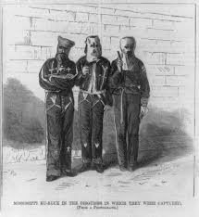
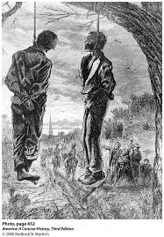
Problems with Reconstruction
Emergence of vigilante/terrorist groups like the Ku Klux Klan (KKK): Responsible for the deaths of literally thousands of people during the Reconstruction period, and beyond.
Goals:
Destroy the Republican party
Throw out the Reconstruction governments
Aid the planter class
Prevent African Americans from exercising their political rights
Congress was forced to pass Enforcement Laws in 1870 and 1871 to curtail Klan violence.
Many other white Southerners unaffiliated with the KKK perpetrated violence against black Southerners as well. Other white Southerners refused to hire or do business with black Southerners who voted Republican (or in some cases voted at all, or did anything white Southerners thought was “above their station in life”.)
“Lynching” or murder by the mob became a regular occurrence across the South beginning in the Jim Crow era, and continuing until the 1960s.
Between 1882 and 1968, there were 4,743 recorded lynchings in the U.S.
72.7% were black Americans
27.3% were white Americans
79% of these murders took place in the South (most frequently in Mississippi, Georgia and Texas)

Slide 6
Support for Reconstruction Fades
As the Reconstruction period continued, the in-fighting in Congress increased
1872 – Congress passed the “Amnesty Act”: returned the right to vote and hold public office to approximately 150,000 former Confederates. That same year, Congress allowed the Freedman’s Bureau to expire. This ensured that Southern Republicans would lose political power and that Southern Democrats would return to political power
Panic of 1873 triggered a 5-year economic depression which distracted Northerners from Reconstruction concerns
With the divisions between the Republican party in the South and the loss of support from moderate Republicans in Congress, Radical Republicans found it very difficult to continue to pursue their Reconstruction program
Democrats “redeem” the South: The deal made during the election of 1876 which gave the presidency to the Republican candidate, Rutherford B. Hayes, resulted in a withdrawal of the military governments in formerly Confederate states, effectively ending Reconstruction in the South (known as the Compromise of 1877)

Slide 7
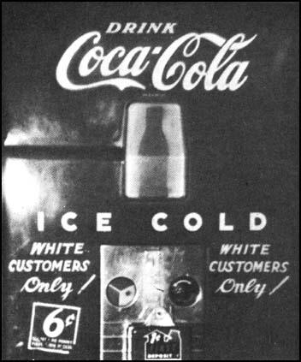
Black Codes or “Jim Crow” Laws
Purpose:
Guarantee stable labor supply now that African Americans (backbone of the pre-Civil War Southern economy) were emancipated.
Restore pre-emancipation system of race relations
Vending Machine in Jackson, Tennessee. (1940s)

Slide 8
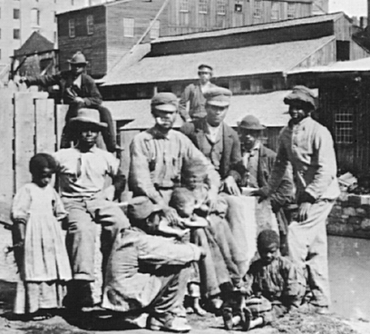
Black Codes or “Jim Crow” Laws
Laws Enacted in Various States:
Segregation laws, later reinforced by Plessy vs. Ferguson (1898)
“Miscegenation” laws forbidding cross-racial relationships and marriages
Voter suppression laws poll tax, literacy test, grandfather clause
Labor and contract laws designed to keep sharecroppers/tenant farmers confined to working for one employer and selling their crops to no one else
Tougher criminal codes for minor crimes vagrancy, violating segregation laws carried harsher sentences
Laws of social control: in some states, African Americans could not buy land in rural areas, gather publicly in large groups, buy liquor, own a firearm, or “show impudence” to a white person

Slide 9
The Lost Cause, or, the “Re-Telling” of the American Civil War
“All wars are fought twice – the first time on the battlefield, and the second time in memory”.
Historian, Viet T. Nguyen

Slide 10
Examples of the “Re-telling” of the American Civil War
Watch the following clips from both films and answer the following question:
In what ways do these narratives distort the truth of the Reconstruction period, the slavery system or race relations in the South?
“Birth of a Nation” (1915)
-https://www.youtube.com/watch?v=nvG0K5AdKiM
“Gone With the Wind” (1939)
-Amazon clip

