Slide 1
The “Classified” Files of WWII
Spies, Code-talkers, Code-breakers, and the Manhattan Project

Slide 2
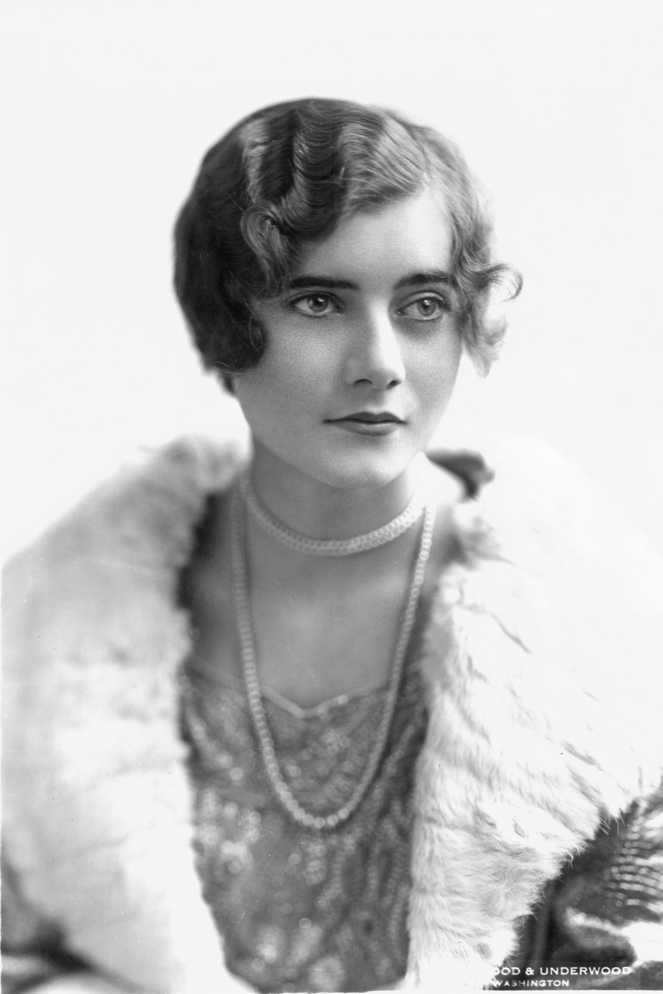
Notable Spies, Daring Espionage, and Missions “Impossible”
Betty Pack: “The Blonde Bond”
Amy Elizabeth Thorpe Pack, aka, Betty Pack. Codename: “Cynthia”
American debutante from Minnesota who became a spy for the Allies during World War II (first for Britain’s MI6, and later, when America joined the war, for the OSS)
Betty’s M.O. was seduction, and the “long game”. In other words, she would be sent in to form personal relationships with Axis-associated diplomats and military officials, gain their trust, and then either “turn” them, or, failing that, steal their secrets.
Her most famous exploit resulted in the successful theft of the German code books from the Vichy French embassy in Washington, D.C. These code books were instrumental to both the Allied victory in North Africa, and in the successful completion of “Operation Ultra”, or the successful “cracking” of the Enigma code.

Slide 3
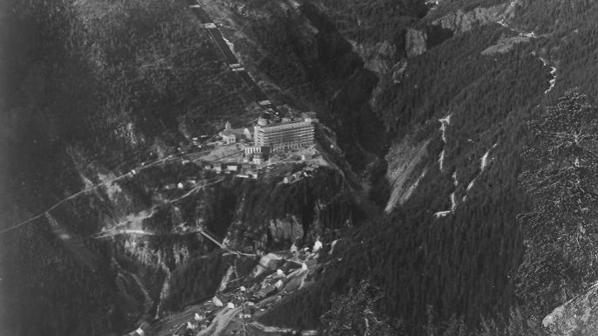
Notable Spies, Daring Espionage, and Missions “Impossible”
Operation Gunnerside: A small group of Norwegian Allied operatives launched a mission to destroy the German heavy water chambers at the Norsk Hydro Vemork Plant in Norway. Heavy water is crucial to the production of atomic weapons.
The Allies were determined that Germany’s efforts to be the first to build an atomic bomb would NOT succeed. Germany controlled the Norsk plant, the only facility on the European continent capable of producing heavy water on a large enough scale to support the creation of an atomic weapon.
The Mission: infiltrate the power plant, undetected, plant timed, explosive charges on the heavy water chambers, and evacuate before the explosions. Before completing this mission successfully, the Gunnerside operatives had to:
Ski toward the site of the power plant
Descend by ropes into a gorge
Climb steep rock faces up to the power plant itself
Bypass minefields and German guards undetected
Enter the power plant through a maintenance duct
Plant the explosives, and make their getaway before the explosion
Mission accomplished!

Slide 4
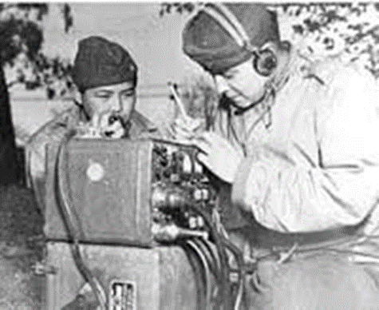
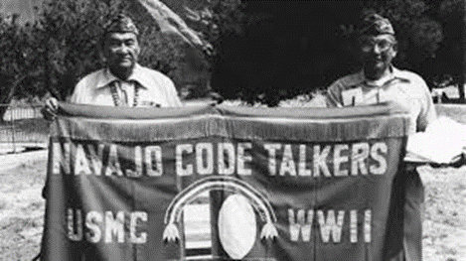
The Navajo “Codetalkers”
The Japanese described the sound as “strange language gurgling”. U.S. military officials believed that a code based on the Navajo language would be secure because:
it has no alphabet or written symbols
there were only a few hundred Navajo left in the United States by the time WWII broke out
Navajo is an absurdly difficult language to learn for those who haven’t heard it spoken around them all their lives.
The U.S. Navy, in partnership with enlisted Navajo volunteers, developed the language for the U.S. naval code – it remained unbroken by the Japanese throughout World War II.
400 Codetalkers finally received national recognition in 1969– one year after their contributions were finally declassified
Click on the following link to see how the Navajo code was constructed:
https://nmai.si.edu/education/codetalkers/html/chapter4.html
“Windtalkers” (2002) https://www.youtube.com/watch?v=zQHhbhtpJ3M

Slide 5
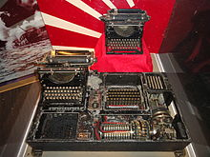
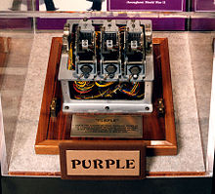
Project “Magic”: The Breaking of the “Purple” and JN-25 Codes
Cryptography had become highly advanced by World War II.
During WWI, direct ciphers with an accompanying codebook had been used, and by 1930, the Japanese had produced their first cryptography machine
The Japanese military codes from WWI were dubbed “Red”, and the codes developed during 1930, “Blue”, so named for the folders in which they were stored in the offices of O.S.S. (Office of Strategic Services) – U.S. Intelligence
The “Purple” machine (a combination of “Red” and “Blue”) had been developed with the German “Enigma” as a blueprint, but proved much more difficult to “crack”, as the Japanese had sent orders to all of it’s embassies in Allied countries to destroy the Purple machines immediately after it had formally severed diplomatic ties with the U.S. (right before the attack on Pearl Harbor). Without an authentic Purple machine to aid Project Magic, the cryptographers had to reverse-engineer one.
Why didn’t Project Magic prevent Pearl Harbor?
Purple was predominantly a diplomatic code rather than a military code, so Magic intercepts informed the codebreakers that the Japanese were severing diplomatic ties, and declaring war, but not that they were going to attack Pearl Harbor. Furthermore, reading a Magic intercept was an involved process which took time. Immediately after Pearl Harbor, Project Magic, formerly one of the most secretive programs in the U.S. during WW2, finally took on more staff including expert civilian contractors.
Process: Decryption, Decoding, Translation, Delivery
The cracking of Purple, and the knowledge gained of patterns in Japanese cryptographic nomenclature, was very valuable in the cracking of the Japanese Naval Code, JN-25, which proved invaluable in the Battle of the Coral Sea, and the Battle of Midway, both of which gave the U.S. a strategic naval advantage in the Pacific.

Slide 6
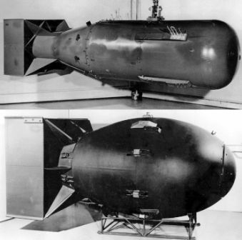
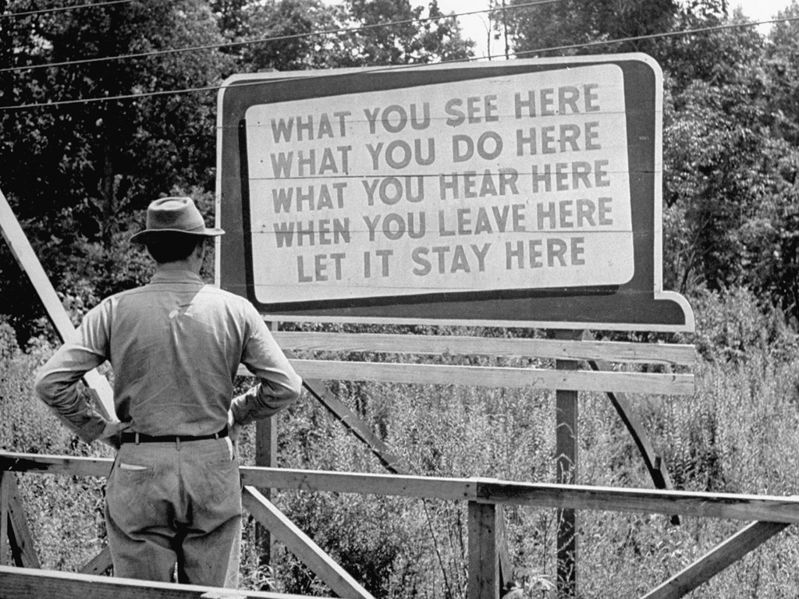
The Manhattan Project: The First Nuclear Weapons
The administrators of the Manhattan Project built the town of Los Alamos, New Mexico in the desert 35 miles north of Santa Fe to house the workers and build the bombs and infrastructure for the nuclear project. The project had two other main locations (Oak Ridge, TN, and Hanford, WA) largely for research and experimentation.
There were three major facets to the project:
Enrichment
Nuclear Physics
Bomb Design and Construction
Key Scientists: J. Robert Oppenheimer, Enrico Fermi, but literally thousands of people from the Allied side of the war, and from all over the world, contributed to different facets of this project (though not all knew exactly what they were contributing to).
The Americans were not the only ones with a nuclear program at the time; the Germans and the British were also trying to develop the atomic bomb.
The use of nuclear weapons set a standard for ultimate destruction, and also, paradoxically, a measure for peace for all time. For once they were used, it became madness to ever think of using them again. And ironically, the more weapons a country amassed, the more secure it seemed to feel (Mutually Assured Destruction).
This anecdote may very well be apocryphal…but rumor has it that before “Trinity”, the first successful nuclear test, was detonated in July of 1945, the resident scientists had a betting pool going between them of how big the explosion might be. One of them had placed a serious bet that “the explosion would burn away the Earth’s atmosphere, and kill every living thing on the planet.”

