Slide 1
The Civil War Part 1

Slide 2
Question of the Day: In what ways did the Civil War change America forever?
MAIN IDEAS: Disagreements over slavery finally led to a breakup of the union. After four long years of struggle, the North finally overcame the Southern Confederacy and won the war. Various technologies, tactics and innovations contributed to the development and modernization of the American military.
WHY IT MATTERS NOW: America’s identity was forged in large part by the Civil War. Sectional and regional divisions remain strong today. The Union victory confirmed the authority of the federal government over the States. The technological and tactical advancement achieved by the Union military during the war would contribute to America’s development as a superpower on the world stage.

Slide 3
Reforming American Society
The mid-19th century was marked by an expanding movement to solve problems and correct inequalities in American society. This reform movement was set against a religious backdrop.
The Second Great Awakening:
Appeared in the first few decades after the Revolution. Some historians point to migration, individualism, dropping church attendance, widespread alcoholism, and the break-up of families and communities to explain this explosion of religious conversion.
emphasized individual responsibility to seek religious salvation and to improve one’s self as well as society (1800 – 1 in 15 belongs to a church, by 1850 – 1 in 6 was a member)
Revivalism (Evangelical Christianity): Bible study, reflection, testifying, preaching, emotional sermons
African American Churches (Baptist, Methodist, Episcopal) – Interpreted sermons and Bible stories differently, emphasizing others they identified with more. Churches were also political, cultural, and social service organizations which provided to the black community what the white community denied them

Slide 4
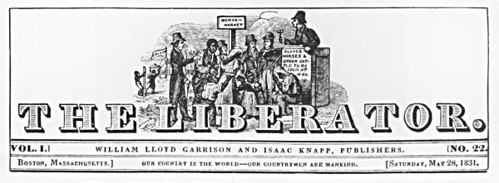
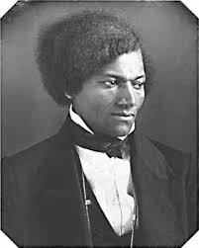
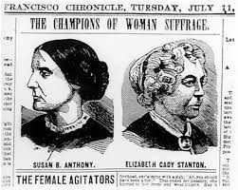
Reforming American Society
Against this backdrop of religious revival, “progressive” social movements developed and gained in strength:
The Abolitionist Cause: those who supported an end to slavery (over 100 anti-slavery societies by 1820)
The Women’s Rights Movement (first-wave feminism): Because of the active role women were already playing in society (missionary and prayer societies, abolition, temperance, prison and hospital reform), many women began to question their social status and demand equal rights (education and the vote)

Slide 5
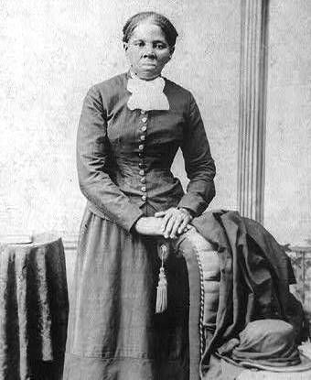
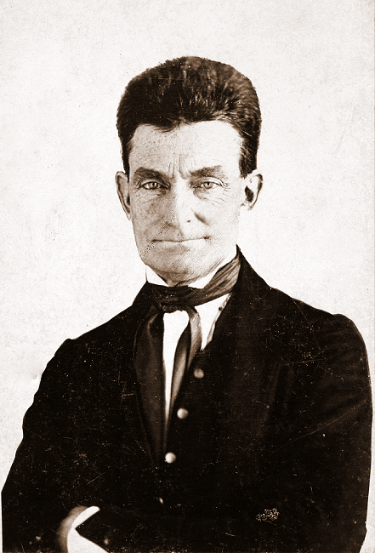
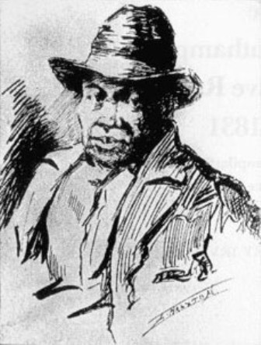
Resistance and Rebellion Intensifies (1830s – 1850s)
There were literally hundreds of rebellions involving 10 or more slaves during the 19th century.
Nat Turner’s Rebellion (1831): A group of 70 African Americans, both enslaved and free, attacked 15 homes in Southampton, Virginia and killed about 60 whites (mostly slave owners and their families).
John Brown’s Rebellion (1859): Brown led a raid on the federal armory at Harper’s Ferry, Virginia, intending to arm as many slaves as possible.
Nonviolent Resistance took several forms; some wrote and spoke publicly, others carried out secret resistance activities.
The Underground Railroad (most active during the 1840s, 1850s): Between 1800 and 1865, approximately 100,000 slaves are believed to escaped to freedom in Canada and Mexico. Harriet Tubman herself personally helped at least 300 slaves escape to freedom.

Slide 6
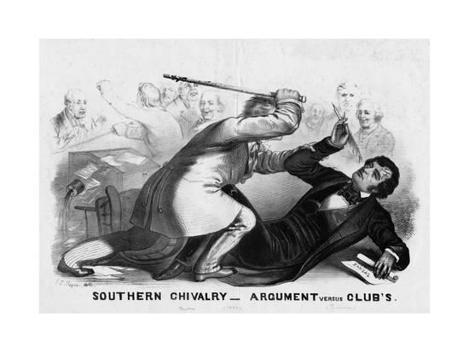
In the midst of rebellion and cries for change, the government continued to “compromise” and to sweep the slavery issue aside….until they could do so no longer.
The Compromise of 1850: California admitted as a free state, popular sovereignty (the right to vote for or against slavery) for New Mexico and Utah territories, harsher fugitive slave law (fine of $1000 and/or up to 6 months imprisonment for harboring a fugitive slave)
Dred Scott vs. Sandford (1857): held that African Americans were not and could never be citizens
Kansas-Nebraska Act (1854): Congressional decision that allowed for popular sovereignty in Kansas and Nebraska territories, in defiance of the Missouri Compromise
Bleeding Kansas: A crooked election gave Kansas a pro-slavery government, leading to violent struggles between pro and anti-slavery groups
Violence in the Senate: Congressman Preston Brooks savagely beat Senator Charles Sumner with a cane after Sumner had spent two days verbally attacking Brooks’ uncle, Senator Andrew Butler, for his pro-slavery beliefs
Old Political Parties Split Over Slavery and A New Party Forms: Anti-slavery Whigs, Free-soilers, and radical abolitionists joined the new Republican Party. Pro-slavery Whigs joined the Democrats.
The election of President Buchanan in 1856 helped to temporarily avert Southern secession, but when Abraham Lincoln, a man whose anti-slavery views were well known, was elected in 1860, southern states began to secede from the Union almost immediately.

Slide 7
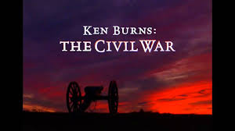
Introduction: “The Civil War”

