Slide 1
The Civil War
Part Three

Slide 2
Battle-Related Casualties Note: Statistics below have recently been challenged and state that the battlefield death toll could have been as high as 850,000

Slide 3
Casualties: Killed, Wounded, Captured or Missing

Slide 4
Why were the casualty numbers so high?
Vastly improved military technology
Industrial advancement
Siege tactics

Slide 5
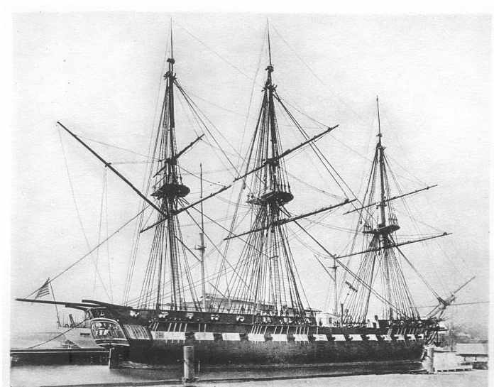
Traditional Wooden Warships VS. Armored Frigates

Slide 6
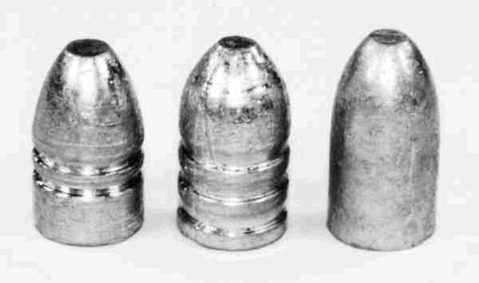
Technology: Round Balls VS Minie Balls

Slide 7
Technology: Industrial Innovation
First instance of factory standardization: began producing and using rifled muskets, Minie balls, machine guns, grenades, land mines, artillery (advanced cannonry)
Resulted in high overall quality of munitions, greater accuracy, greater kill rates, fewer accidents
Example: 1 in 70 rounds fired FOUND THEIR TARGET during the Civil War (estimates for Vietnam range as high as 1 in 50,000). And this was in an war when most troops were poorly trained and frequently aimed to high (either on purpose or due to lack of skill)

Slide 8
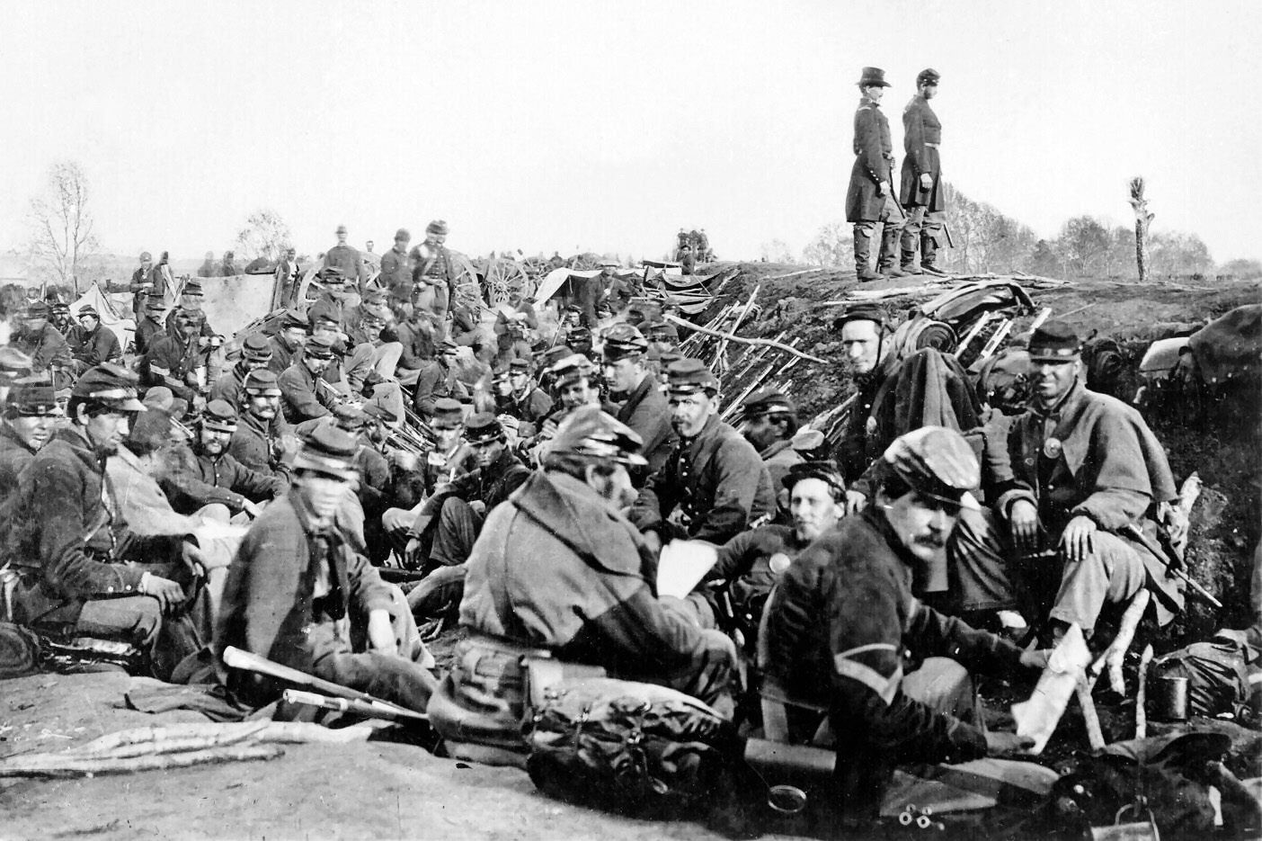
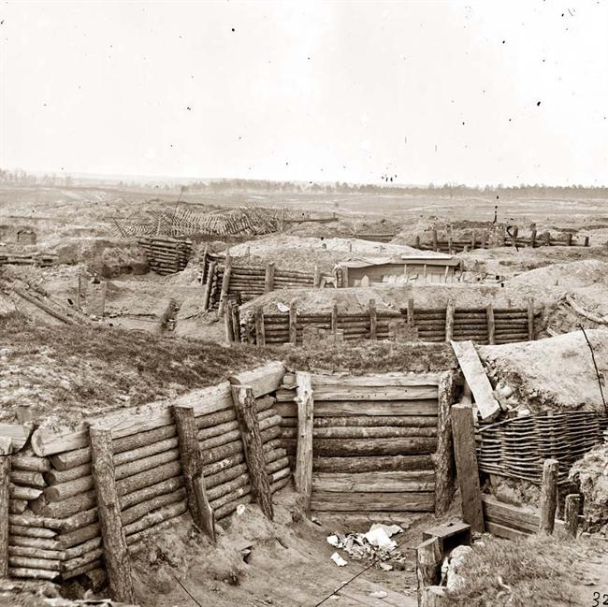
Tactics: Trench Warfare

Slide 9
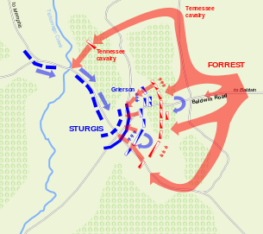
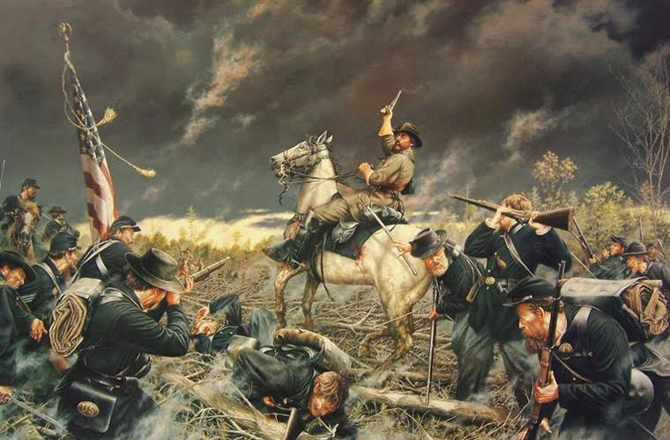
Tactics: Forrest’s Strategy

