Slide 1
The Civil Rights Movement (Part 3)
Latino Americans continue to seek equality in American Society

Slide 2
Latinos and Native Americans Seek Equality
The Latino Presence Grows
Latinos of Varied Origins
1960s Latino population grows from 3 million to 9 million
Mexican Americans largest group, mostly in Southwest, California
By1960, almost 900,000 Puerto Ricans living in U.S., mostly in NYC
Cubans flee communism, form communities in NYC, Miami, NJ
Central Americans, Colombians come to escape civil war, poverty
Many Latinos encounter prejudice, discrimination in jobs, housing
Many live in segregated communities, jobless rate and poverty rate nearly 50% higher than white Americans

Slide 3
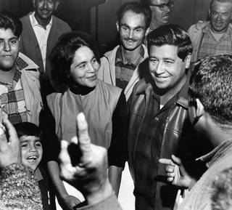
Latinos Fight for Change
The Farm Worker Movement
César Chávez and Dolores Huerta form United Farm Workers Organizing Committee
Farm workers in the southwest U.S. faced poor working conditions
1965: grape growers do not recognize union; Chávez sets up boycott, even goes on a hunger strike
1970: Huerta negotiates contract
“Chicano! The Struggle in the Fields” (PBS doc)
https://www.youtube.com/watch?v=KIHCdjpFPrw
What challenges did the Filipino farm workers face in Delano, California?
Describe a few characteristics of the conflict between the workers and the growers
Describe Bobby Kennedy’s response to the Delano Strike
What role did the arts play in the Farm Worker Movement?
Cultural Pride
Puerto Ricans, Chicanos demand cultural recognition, better schools
1968 Bilingual Education Act funds bilingual, cultural heritage programs
Movement spreads to higher education, students demand and win the establishment of Chicano Studies programs

Slide 4
Young Citizens for Community Action (YCCA) to the Brown Berets
Militant organization formed in 1967; youth from the barrios of Los Angeles
Modeled after the Black Panther Party: Focused on combatting police brutality and racism primarily, but also demanded education, employment and housing equality
Los Angeles police presence and persecution in Chicano communities begins to increase starting in the 1920s, as the influx of immigrants increased and poor working conditions began to lead to union activity (Red Squad Units form)
1930s, study of criminology emerges and local scholars begin to link Chicanos with criminality
Membership spread from California to Colorado, Michigan, Minnesota, new Mexico, Texas and Washington (29 chapters form by 1969)
March 1 – 8, 1968 East Los Angeles Walkouts: Largest mobilization of Chicano youth in L.A. history
1967: Chicano students across the southwest U.S. featured a 60% dropout rate; those who graduated averaged an 8th grade reading level; massive prejudice from fellow students, teachers, administrators; culturally non-inclusive curriculum
Protestors presented list of 39 demands to Los Angeles Country Board of Education; Board agreed with vast majority of grievances (funneling of students into Industrial Arts Programs, little focus on Chicano culture or issues, lack of instruction in Spanish) yet claimed they were unable to spearhead change due to lack of funding
Walkouts empowered and unified the East L.A community, awakening the political consciousness of Latino youth across L.A.

Slide 5
Unfinished Work
Between 2000 and 2014, lethal force by police resulted in the deaths of at least 589 people, according to a report from the Los Angeles Youth Justice Coalition.
Between 2007 and 2014, 53.5% of those killed were Latino, and 28% black. About half of those killed were under the age of 30.
https://talkpoverty.org/basics/ - Compare current statistics

Slide 7
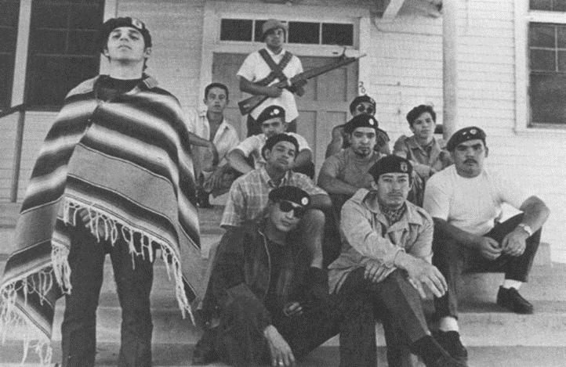
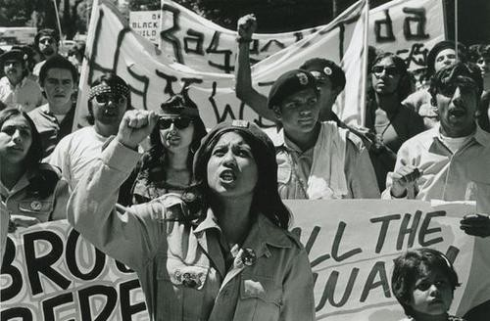
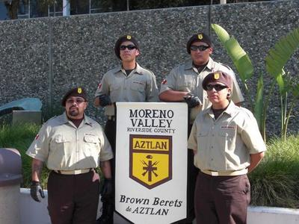
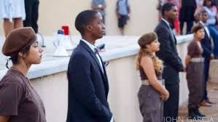

Slide 8
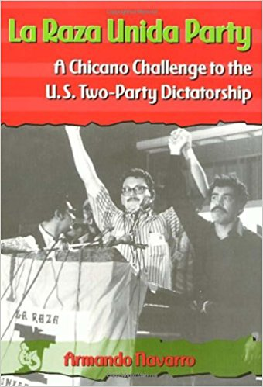
Latinos Fight for Change {continued}
Political Power
Founded by Jose Angel Gutierrez, 1970
Organize community support, grassroots initiatives, help elect Latino candidates from major parties
La Raza Unida worked on independent, Latino political movement first in Texas, then, spreading to most of the American southwest
— ran Latino candidates, very successful in southwest Texas winning local races for mayor, city councils and school boards, dominating local politics until the late 70s
“Chicano! Fighting for Political Power” (PBS doc)
https://www.youtube.com/watch?v=yEqW_IF67pw
What similarities and differences do you see between the African American and Latino civil rights movements?
Describe the action taken by the students at the Crystal City High School and the results.
What led to the ideological split between members of La Raza Unida?

