Slide 1
The Civil Rights Movement
African Americans and Latino Americans continue to seek equality in American society

Slide 2
Latino Americans Seek Equality
The Latino Presence Grows in the U.S
During the1960s, the Latino population in the U.S. grew from 3 million to 9 million
Mexican Americans, or Chicanos, represented the largest group, mostly in the Southwest U.S. Puerto Ricans and Cubans represented large proportions of the population as well.
Central Americans and South Americans from various countries emigrated to the U.S. to escape civil war and poverty
Many Latinos encountered prejudice and discrimination in jobs and housing
Many lived in segregated communities where the jobless rate and poverty rate was nearly 50% higher than for white Americans

Slide 3
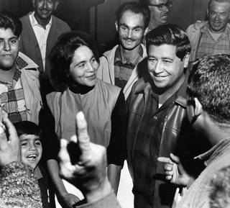
Latinos Fight for Change
The Farm Worker Movement – 1965 – 1970
The California farming industry employed literally hundreds of thousands of underpaid, poorly treated Chicano farm workers – many of whom made only $2 per day and lived and worked in substandard conditions
César Chávez and Dolores Huerta formed the United Farm Workers Organizing Committee
California grape growers refused to recognize unions; UFW set up an incredibly successful worker’s strike and boycott; Chávez himself employed a hunger strike for several weeks in protest
The farm worker movement was strongly influenced by the early 60s African American civil rights movement: religious imagery and nonviolent tactics were major themes
Direct support from attorney general Robert F. Kennedy ensured that the UFW movement met less opposition from local law enforcement
1970: Huerta successfully negotiated fair labor contract standards on behalf of the UFW union

Slide 4
Challenges and Changes in the Movement
Disagreements among civil rights groups, the tragic deaths of several civil rights leaders and supporters, widespread urban neglect, riots, and the rise of “black and brown power” and black nationalism created a more militant period in the fight for civil rights in the later part of the 1960s.

Slide 5
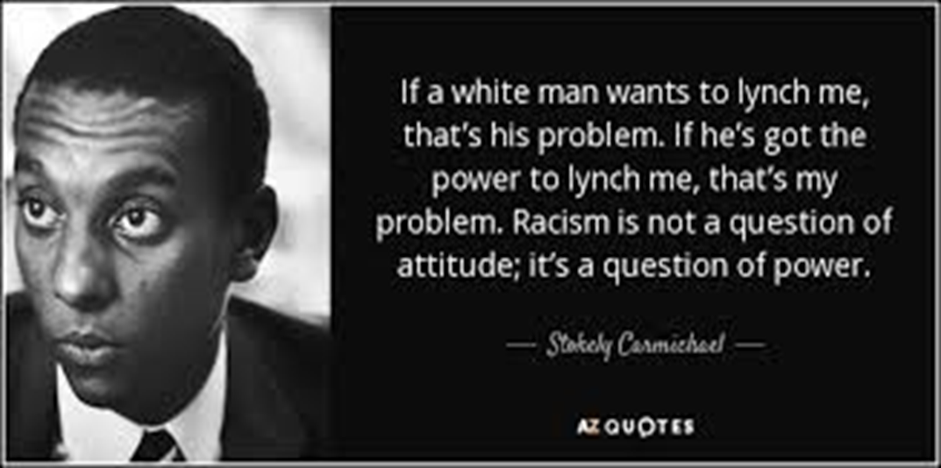
New Leaders Voiced Disagreement With the Goals and Strategies of the Movement
Black Power
New leaders were characterized by a philosophical shift away from integration and non-violence, toward African American self-sufficiency, self-determination, and self-defense.
Some advocated racial separatism, believing that integration would never help achieve equality because the white power structure actively oppressed and disadvantaged the black population
Civil rights groups like CORE and the SNCC became more militant with younger leadership; only the SCLC continued to pursue traditional tactics of non-violence

Slide 6
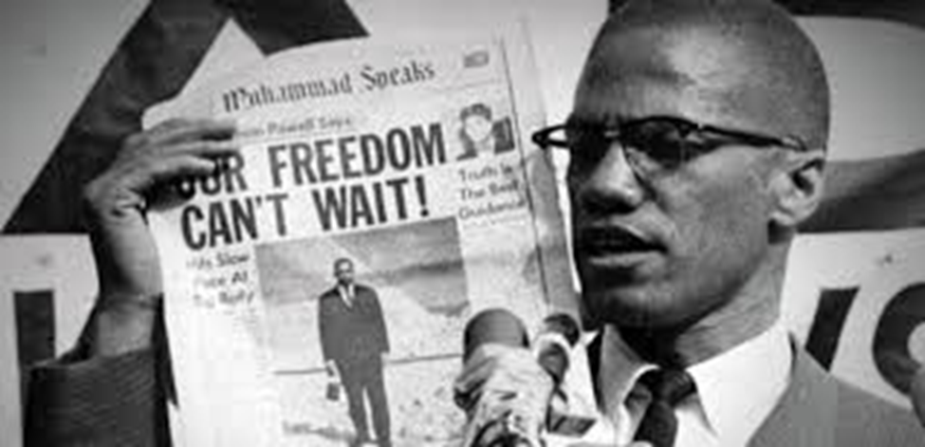
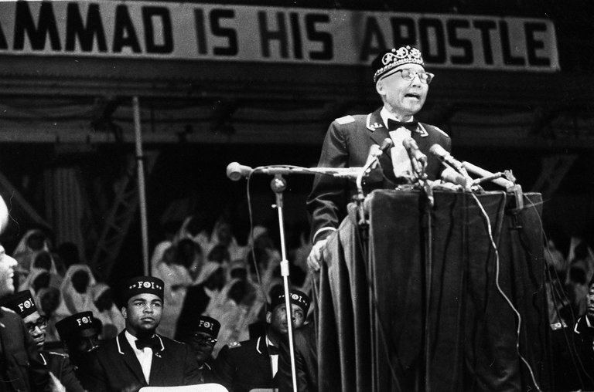
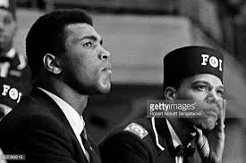
Black Power and Separatism: The Nation of Islam
Nation of Islam: African American Muslims who advocated black separation from white society and the greatest amount of control of their own communities as possible. Led by their own “messenger” or prophet, Elijah Mohammed.
Malcolm X—controversial spokesman for the Nation of Islam. A truly gifted and powerful public speaker, his speeches gained the same kind of unprecedented publicity as Dr. King’s
His rhetoric frightened the white community, and alienated many white liberals from the movement
The Ballot or the Bullet? https://www.youtube.com/watch?v=8zLQLUpNGsc&t=1057s
Pilgrimage to Mecca changed Malcolm X’s attitude toward both whites and his concept of racial separation
While he split with the Nation of Islam for personal reasons, he continued to champion Pan-Africanism, black self-determination, and armed self-defense in the black community
Malcolm X was assassinated in 1965 while giving a speech in New York

Slide 7
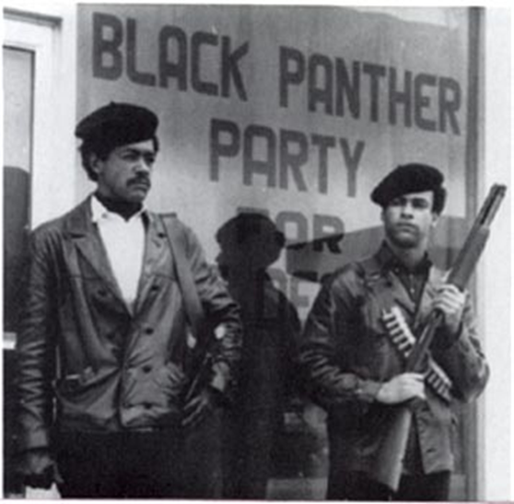
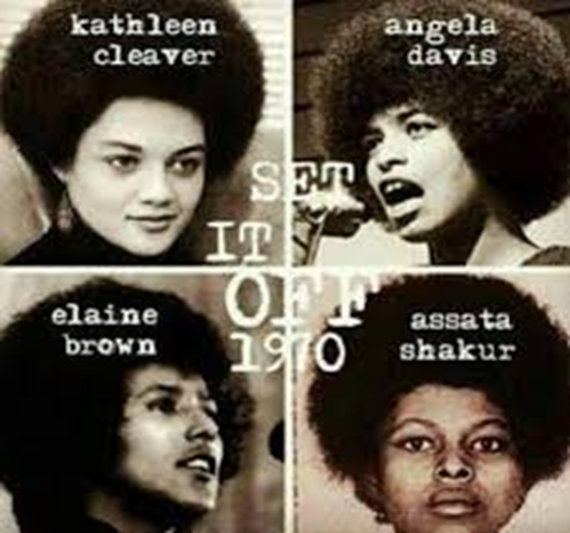
Black Power
The Black Panthers, led by founders Huey Newton and Bobby Seale, fought against police brutality and economic hardship in the black community
Preached the ideas of Mao Zedong and favored a socialist/communist-style economic system for individual black communities
Provided social services in low-income black communities, winning public support (family assistance, legal advocacy, children and youth recreation and social programs, neighborhood breakfast programs).
One of the few civil rights groups that consistently featured women in leadership positions
Some like Fred Hampton championed a “Rainbow Coalition” which would unite oppressed people of all races, genders, and sexual orientations rather than promote separatism
Most heavily targeted group by the FBI

Slide 8
Tumultuous Times
Urban rioting occurred increasingly from 1964 through the end of the decade with massive confrontations over police brutality, race-based violence, urban renewal, and lack of access to employment, education, and housing.
Harlem Riots (1964)
Philadelphia Riots (1964)
Watts Riots (1965)
Newark Riots (1967)
12th St. Riot – Detroit (1967)

Slide 9
1968—A Turning Point in Civil Rights
Dr. King’s Assassination
King publicly objected to the armed self-defense aspect of the Black Power movement, a deep source of grief to his fellow civil rights leaders and activists who had come to disagree with him over the years of the movement
“I’ve been to the Mountaintop” – Dr. King’s last speech. https://www.youtube.com/watch?v=ixfwGLxRJU8
Dr. King was shot and killed by white supremacist, James Earl Ray, on April 4, 1968
Reactions to King’s Death
King’s death led to some of the worst urban rioting in U.S. history
- over 100 cities affected, the largest ones were Chicago, Washington, and Baltimore
Robert Kennedy was assassinated two months later by Palestinian nationalist, Sirhan Sirhan.
Black Power movement continued in force into the early 70s as law enforcement (FBI) stepped up their surveillance of, and conflict with black power groups
COINTELPRO – counter-intelligence program. The FBI began launching spying and sabotage programs on “dangerously subversive” groups as early as the 1950s such as communist, socialist, and union organizations. By the 1960s and 70s, civil rights groups, anti-war groups, feminist groups, and gay rights organizations were being targeted, threatened, oppressed, defamed, sabotaged, even assassinated by J. Edgar Hoover’s FBI.

Slide 10
Civil Rights & Equality Gains After 1968
• Civil Rights Act of 1968 prohibited discrimination in housing
Many more schools and colleges became racially integrated
Greater promotion of pride in racial identity led to Black Studies programs at more and more colleges; black intellectual movement intensified
More African-American participation in mainstream media, movies, and television by the 70s
Dramatically increased voter registration; number of black voters tripled after 1965
More black elected officials and appointees appeared at all levels of government

