Slide 1
The Americas, West Africa and Europe
A Cultural Collision

Slide 2
How to get the most out of a lecture: Tips for efficient note-taking
DO:
Develop your own system of abbreviations (symbols and shortened versions of commonly used words.
Shorten sentences by using mostly “meaning” words (nouns, verbs, adjectives, adverbs) and largely eliminating “function” words (articles, prepositions, conjunctions, auxiliary verbs).
Ensure that you can still make sense of your notes later.
DON’T:
Write down every single word on a lecture slide.

Slide 3
Note-Taking Sample
In recent years, a reduction in overall poverty for Americans across all groups has been observed.
Despite criticism of the cost of Lyndon Johnson’s Great Society programs, his “War on Poverty” proved to have produced lasting results:
21% poverty in 1964
11% by 1974
Poverty rate has fluctuated mildly since then, never exceeding a high of 15% (2010)
Currently, American poverty rate is 13.5 – 14.3%
The reduction in world poverty rates is even more impressive: approx. 9% percent in 2017, way ahead of the projected 15%!!!
Poverty sig. reduced – all Americans
(reference to specific groups and evidence of better quality of life and new economic success)
21% - 1964
11% - 1974
(reference to specific Great Society programs that made the reduction in poverty possible and how)
Fluctuated 11 – 15% since
(reference to specific trends explaining increases and decreases in poverty at certain times)
Current world: 9%
(examples illustrating the reduction in overall world poverty)

Slide 4
Pre-contact and the Age of Exploration, 1400-1700
Main idea: On the eve of their interaction, Native Americans, West Africans and Europeans lived in their own unique and complex societies.
Why it matters now: The interaction of these cultures helped create the present-day culture of the United States.

Slide 5
Ancient Empires in the Americas
Olmec (southern Mexico) 1200 BCE – 400 BCE
Maya (Guatemala & Yucatan Peninsula) 250 CE – 900 CE
Aztec (central Mexico) 1200 CE – 1500s CE
All three empires built great cities, huge palaces and temples, and had a written language.
Whilst the Olmec and Mayan civilizations declined and fell (it is believed) largely due to resource scarcity, the Aztecs were ultimately destroyed by the smallpox virus that was brought by Europeans.

Slide 6
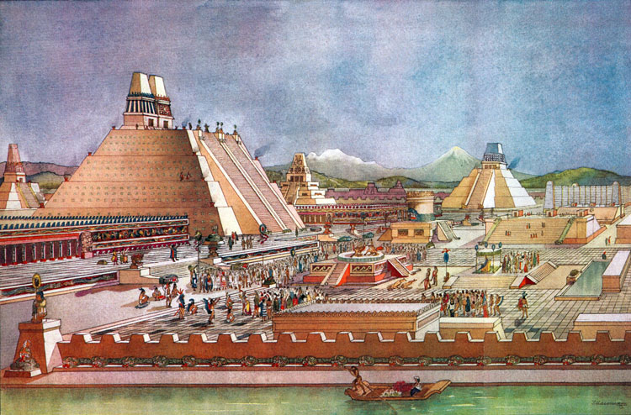
Tenochtitlan: The Aztec CapitaL

Slide 7
Native American Origins
The Native Americans were descendants of central Asian groups which crossed from Siberia into North America via the Bering Straight – then a land bridge – approximately 20,000 years ago and proceeded to fan out throughout the Americas
This does not necessarily indicate that all First Nations people are descended from the same genetic family,...which challenges the Bering Straight theory
“Multiple Origins” theory is becoming more accepted today.
First Nations’ beliefs – “We have always been here.”

Slide 8
Native American Origins
Many Native American groups were hunters and foragers for thousands of years following their migration into the North American continent, but as time went on, most became agricultural as well; the first North American cultivation began in Mexico about 3000 BCE

Slide 9
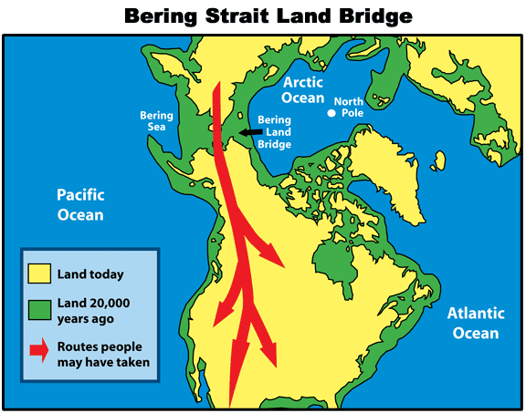
Prevailing academic theory on Native American origins

Slide 10
Text & Diagram Activity
Read the provided text, and then use the Venn Diagram provided to record the similarities and differences between the three cultures.
You should record observations related to religion, culture, social structure and economy.
Highlight and/or take note of any text that could also help you answer the QOTD

