Slide 1
The American Dream
Economic Boom and Prosperity in the 1950s

Slide 2
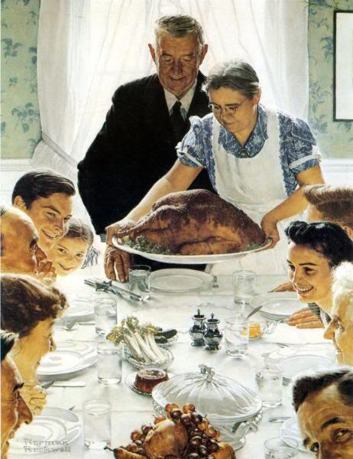
THE AMERICAN DREAM IN THE FIFTIES
After WWII ended, many Americans turned their attention to their families and jobs
New businesses and technology created opportunities for many
By the end of the 1950s, Americans were enjoying the highest standard of living in the world

Slide 3
THE “ORGANIZATION” AND THE “ORGANIZATION MAN”
During the 1950s, businesses expanded rapidly
More and more people held “white-collar” jobs - clerical, management, or professional jobs
The fields of sales, advertising, insurance, and communications exploded
White Collar jobs expanded greatly in the 1950s

Slide 4
SOCIAL CONFORMITY
American workers found themselves becoming standardized
Called the “Organization Man,” the modern worker struggled with a loss of individualism, consistent with the broader culture of social conformity and anti-communism that was characteristic of the early Cold War
Businesses did not want creative thinkers, rebels or anyone that would “rock the boat”

Slide 5
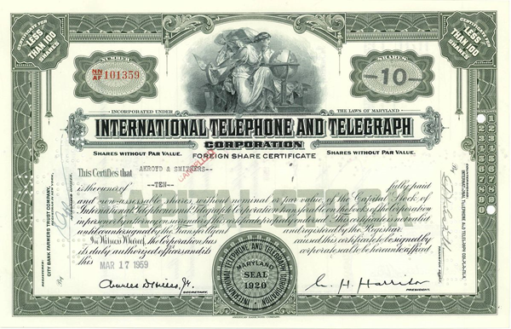
Conglomerates and Franchises Emerge
Franchise: Multiple locations of the same business with the same business model, but independently owned.
McDonald’s is one of America’s earliest, and likely the most successful franchises ever.
Diversification: A business-boosting tactic which ensures that a company is able to profit from multiple industries.
International telephone and telegraph acquired hotel chains and rental car companies as well.

Slide 6
THE SUBURBAN LIFESTYLE
Most Americans worked in cities, but fewer and fewer of them lived there
New highways and the affordability of cars and gasoline made commuting possible
Of the 13 million homes built in the 1950s, 85% were built in suburbs
For many, life in the suburbs was the American Dream
“The Fear and the Dream”
https://www.youtube.com/watch?v=QtPdlAX4K2o
10:30 – 20:40
The American Dream complete with a white picket fence

Slide 7
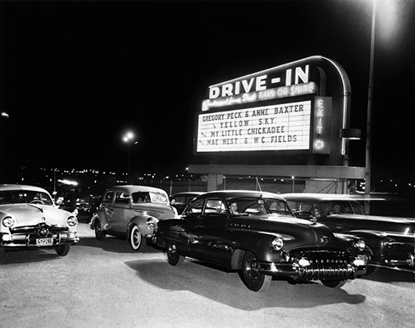
THE AUTOMOBILE CULTURE
After the rationing of WWII, inexpensive, plentiful fuel and easy credit led to 20 million car purchases during the 50s
By 1960, over 60 million Americans owned autos
The “family vacation” was now more affordable and accessible than ever
Young people embraced the American car culture
Drive-in movie theaters
Drive-in restaurants
“Cruising” teenagers
Dating & Cars

Slide 8
INTERSTATE HIGHWAY ACT, 1956
In 1956 Eisenhower authorized a nationwide highway network – 41,000 miles of road linking America

Slide 9
THE INTERSTATE HIGHWAY SYSTEM
While these highways were initially planned as a quick escape from major cities in the context of the nuclear threat of the Cold War, “Automania” also spurred the construction of roads linking major cities while connecting schools, shopping centers and workplaces to residential suburbs

Slide 10
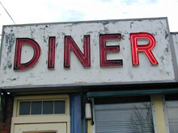
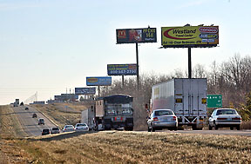
HIGHWAYS “HOMOGENIZE” AMERICA
Another effect of the highway system was that the scenery of America began to look the same
Restaurants, motels, highway billboards, gas stations, etc. all began to look similar
The nation had become “homogenized”
“Our new roads, with their motels, filling stations, and restaurants advertising eats, have made it possible for you to drive from Brooklyn to Los Angeles without a change of diet, scenery, or culture.”
John Keats, The Insolent Chariots,1958
Anytown, USA

Slide 11
DOWNSIDE TO MOBILITY
While the car industry boom stimulated production, jobs, shopping centers, and the restaurant industry, it also had negative effects
Noise
Pollution
Accidents
Traffic Jams
Stress
Decline of public
transportation

Slide 12
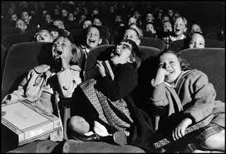
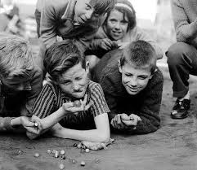
THE BABY BOOM
During the late 1940s and through the early 1960s the birthrate in the U.S. soared
At its height in 1957, a baby was born in America every 7 seconds (over 4.3 million babies in ’57 alone)
Baby boomers represent the largest generation in the nation’s history

Slide 13
What are the official years of the Baby Boom Generation?
1946 - 1964 saw a marked increase in the number of births in North America.
How did the birthrate rise and fall during the baby boom years in the US?
1940 | 2,559,000 births per year
1946 | 3,311,000 births per year
1955 | 4,097,000 births per year
1957 | 4,300,000 births per year
1964 | 4,027,000 births per year
1974 | 3,160,000 births per year

Slide 14
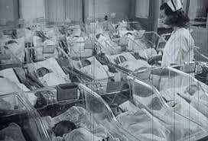
WHY SO MANY BABIES?
Why did the baby boom occur when it did?
Husbands returning from war
Decreasing marriage age
Confidence in economy
Advances in medicine

Slide 15
ADVANCES IN MEDICINE AND CHANGES IN CHILDCARE
Advances in the treatment of childhood diseases included the creation of the polio vaccine (Jonas Salk)
New availability of antibiotics eliminated childhood deaths from bacterial illnesses (pneumonia, croup, scarlet fever, etc)
Pediatrician Dr. Benjamin Spock
Children should be allowed to express themselves and be part of the “democratic” life of the household
Parents should be “friends” with their children
Parents should never physically punish their children
Dr. Spock’s book sold 10 million copies in the 1950s
Dr. Salk was instrumental in the eradication of polio

Slide 16
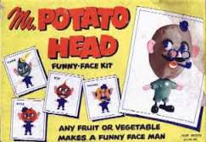
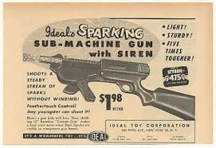
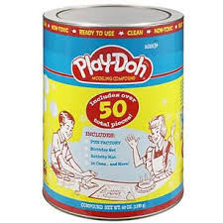
IMPACT OF THE BABY BOOM
As a result of the baby boom 10 million students entered elementary schools in the 1950s
California built a new school every 7 days in the late ’50s
Toy sales reached an all-time high in 1958 when $1.25 billion in toys were sold

Slide 17
RISE OF CONSUMERISM
By the mid-1950s, nearly 60% of Americans were members of the middle class
Consumerism (buying material goods) came to be equated with success and status

Slide 18
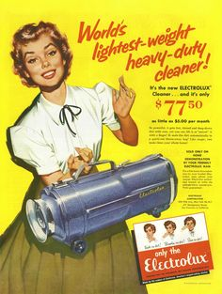
NEW PRODUCTS & METHODS TO MAXIMIZE SALES
One new product after another appeared in the marketplace
Appliances, electronics, and other household goods were especially popular
Planned obsolescence was introduced as a method of inducing customers to purchase more and more products over time
The first credit card (Diner’s Club) appeared in 1950 and American Express was introduced in 1958
Personal debt increased nearly 3x in the 1950s

Slide 19
THE ADVERTISING AGE
The advertising industry capitalized on runaway consumerism by encouraging more spending
Ad agencies increased their spending from 6 billion to 9 billion between 1950 and 1955
Target Markets: Suburban women
“ On May 18, 1956, The New York Times printed a remarkable interview with a young man named Gerald Stahl, executive vice-president of the Package Designers Council. He stated: ‘Psychiatrists say that people have so much to choose from that they want help—they will like the package that hypnotizes them into picking it.’ He urged food packers to put more hypnosis into their package designing, so that the housewife will stick out her hand for it rather than one of many rivals. Mr. Stahl has found that it takes the average woman exactly twenty seconds to cover an aisle in a supermarket if she doesn’t tarry; so a good package design should hypnotize the woman like a flashlight waved in front of her eyes.”
—The Hidden Persuaders
“Teenagers”: a new word, a new target for marketing
Teens were now attending school in record numbers; many worked, but many did not have to. Rising family incomes made weekly allowances more common and companies fell over each other to market to this new group
Advertising is everywhere today in America

