Slide 1
The 1970s
Social Concerns & Civil Rights
Part 1

Slide 2
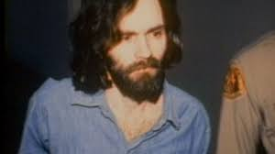
Crimes & Cults in the 70s: Violent Crime Spikes To a New High Each Year
Ironically, Nixon’s “Law & Order Policy” that he campaigned on during the 1968 election actually PRE-DATED an unprecedented violent crime wave in the 70s
Charles Manson (orchestrated the murder of 7 people): “Helter Skelter” – belief that the murders would culminate in a race war which would lead to the Manson Family’s eventual rule over society.
The “Zodiac” Killer: (still unsolved) The first to write to the police describing in detail the murders he committed, and asserting that he would commit more.
John Wayne Gacy: Murdered at least 33 teenage boys and young men
David Berkowitz: The “Son of Sam” or “The 44-Caliber Killer”
Two assassination attempts were made upon President Gerald Ford in the same two-week period: by Lynnette Frohmm and Sara Jane Moore

Slide 3
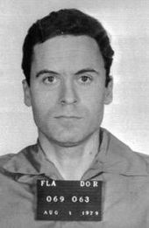
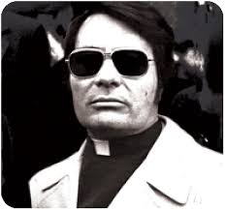
Crimes & Cults Continued..
Ted Bundy (murdered dozens of women, exact number unknown): Defied America’s vision of a serial killer
Jim Jones and “The People’s Church” – lured many who were interested in an integration-focused civil rights movement. Moved from California to Guyana. Initiated mass suicide (910 men, women and children died).
America’s Reaction:
Supreme Court reinstated the death penalty (1977)
Women began to take self-defense classes in greater numbers, and gun ownership increased to an all-time high in response to increased robberies and murders (greater sense of fear)

Slide 4
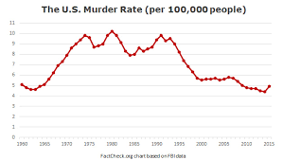
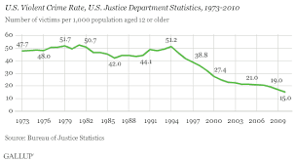
The rise in violent crime was also accompanied by a strange, sensationalized fascination with violence: sensational reporting on “celebrity” serial killers, violence in films increased as entire genres characterized by violence became more and more popular (see “Pop Culture in the 70s & 80s”)

