Slide 1
The 1970s
Social Concerns & Civil Rights
Part 2

Slide 2
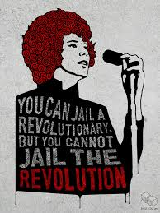
Equality Movements Split & Radicalize
The urban crisis continued to worsen in America and police brutality continued and escalated, leading many civil rights leaders and activists to reject the idea that nonviolence and civil disobedience was at all effective. Some of these groups also begin to embrace the idea that racism, sexism, and economic inequality were tied to capitalism and imperialism, and dedicated themselves to destroying all of the above by any means necessary.
Black Panther Party suffered an ideological split with the development of much more militant faction: the Black Liberation Army, led by Assata Shakur and Eldridge Cleaver
Elaine Brown became the new leader of the Black Panthers in 1974 – turning the group in a much more political and intellectual direction
Weather Underground: militant wing of SDS, communist, pro-black power, dedicated to toppling the U.S. government, offered their support to the BLA.

Slide 3
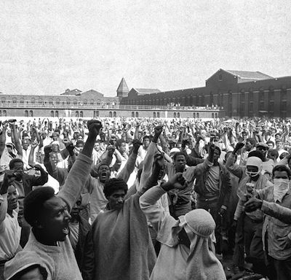
Radicalization Continues & Armed Resistance Increases
Attica Prison Riots: Two weeks after the killing of imprisoned activist and Black Panther party-member, George Jackson by San Quentin prison guards in California, the most deadly prison riot in U.S. history occurred in New York.
Some groups began to actively assassinate police officers in retaliation for officer-involved shootings, plan and execute bombings, rob banks, and engage in kidnapping and ransom to fund their activities and revolutionary programs.
Many historians point to increased violence toward activist communities by law enforcement (police, FBI) as the primary reason for radicalization of some of these groups.

Slide 4
Native Americans Fight For Equality: Rise of the “Red Power” Movement
“Mainstream American society is nothing more than ice cream bars, heart trouble and getting up at six o’clock in the morning to mow your lawn in the suburbs.”
Vine Deloria Jr. (Activist)
Many Native Americans in the late 60s and 70s continued to live in voluntary isolation from American society, clinging to their cultural traditions and refusing to assimilate.

Slide 5
Native Americans Fight For Equality, Continued
1968 – American Indian Movement (AIM) forms. Led by Russel Means, initially formed to protect the rights of urban Native Americans (political and social service organization)
1970 – Termination Policy finally ends as Nixon, in a special message to Congress, denounces Eisenhower’s policy and proposes one of Native American self-determination
1971 – U.S. settles Alaska Native land claims with 40 million acres and $462 million

Slide 6
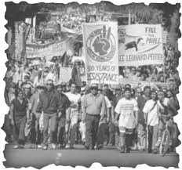
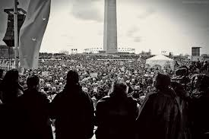
Native Americans Fight For Equality, Continued
1969-1971 - “Indians of All Tribes: Occupation of Alcatraz island” For nineteen months, Native American activists occupied Alcatraz as reclaimed territory under the 1868 Treaty of Fort Laramie until they were forcibly removed by federal troops
1972 – “Trail of Broken Treaties”: Various Native American and First Nations Canadian groups organized a cross-country protest, starting on the west coast and finishing in Washington, D.C.
Followed soon after by the Indian Education Act which empowered Native parents in the face of B.I.A. officials and funded Native-controlled student programs on reservations

Slide 7
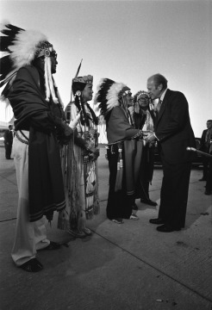
Native Americans Fight For Equality, Continued
1975 – Ford administration passes the “Indian Self-Determination and Education Assistance Act” empowering tribes to exercise sovereignty over their own affairs on reservations, and to once again make treaties on an equal footing with the federal government
1976 – “Indian Health Care Improvement Act” authorizing Indian Health Service to bill Medicare and Medicaid for health services to reservation residents
1978 – Indian Child Welfare Act sought to keep Native American children in Native families
1979 – The Longest Walk, a five-month march from San Francisco to Washington, D.C. and the last major event of the 70s Red Power Movement, drew attention to tribal sovereignty and environmental protection on reservations (particularly where drinking water was concerned)

Slide 8
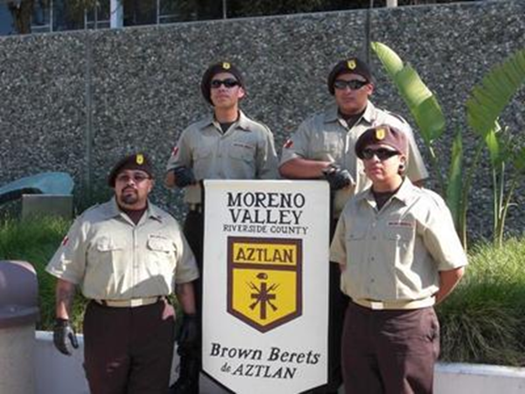
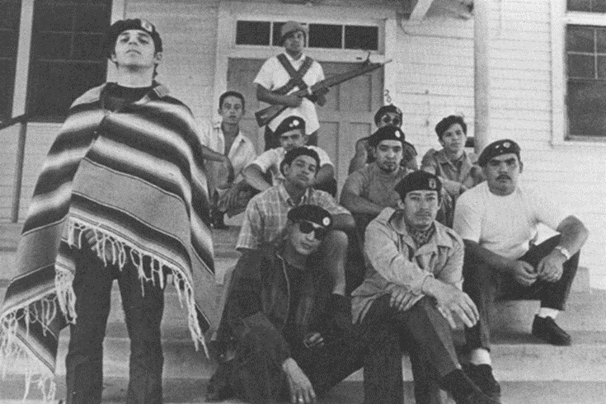
Young Citizens for Community Action (YCCA) “Brown Berets”
Militant organization formed in 1967; youth from the barrios of Los Angeles
Modeled after the Black Panther Party: Focused on combatting police brutality and racism primarily, but also demanded equality in education, employment, housing, and legal treatment
Los Angeles police presence and persecution in Chicano communities began to increase starting in the 1920s, as the influx of immigrants increased and poor working conditions began to lead to union activity (Red Squad Units form within the LAPD)
1930s, study of criminology emerges and local scholars begin to link Chicanos with criminality

Slide 9
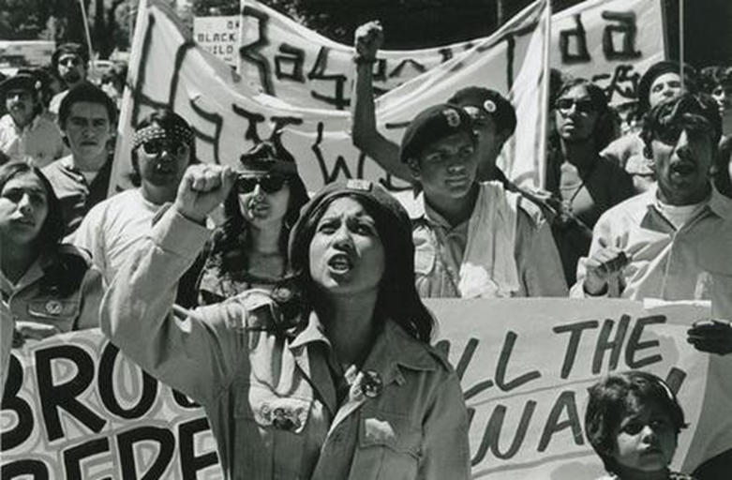
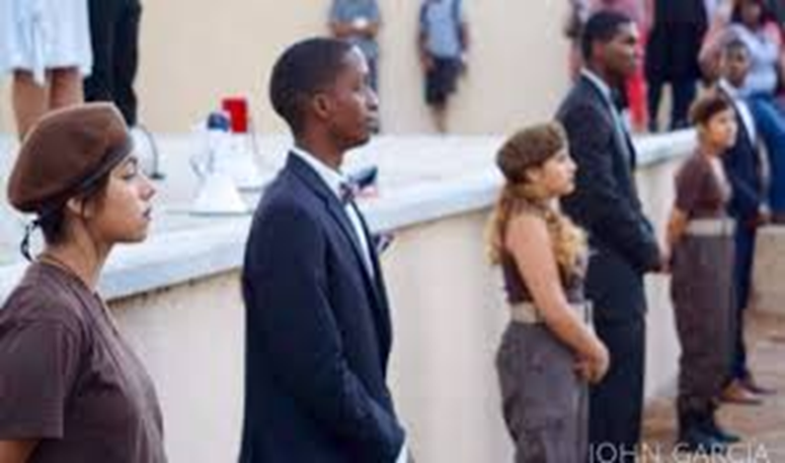
Young Citizens for Community Action (YCCA) “Brown Berets”
Membership spread from California to Colorado, Michigan, Minnesota, New Mexico, Texas and Washington (29 chapters formed nationwide by 1969)

Slide 10
The East L.A. Walkouts
March 1st, 1968: Over 15,000 Chicanos, students, faculty, and community members, walk out of seven East L.A. high schools. Those schools included: Garfield, Roosevelt, Lincoln, Belmont, Wilson, Venice, and Jefferson High School
The protesters formed a committee to present their demands to the L.A. County Board of Education, who refused everything they asked for: greater representation, smaller class sizes, more counselors, Spanish language and cultural heritage programs
The walkout’s organizers, who became known as the “East L.A. 13”, were soon arrested for inciting the walkout, but were soon released in response to overwhelming protest surrounding police stations
These events helped awaken and shape the larger political and social consciousness and activism of Latino youth in L.A. during the late 60s and early 70s

Slide 11
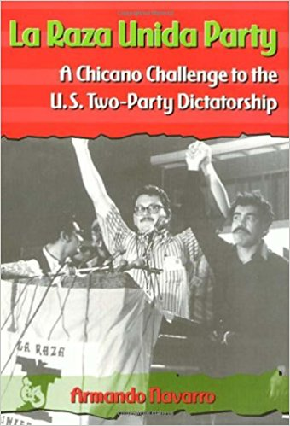
Latinos Fight for Change
“Chicano! Fighting for Political Power” (PBS doc)
https://www.youtube.com/watch?v=yEqW_IF67pw
1) What challenges were faced by Latinos living in the Southwest United States?
2) Describe the actions of La Raza Unida in pursuit of Latino-American equality.
3) Describe the action taken by the students at the Crystal City High School and the results.
4) What led to the ideological split between the members of La Raza Unida?

Slide 12
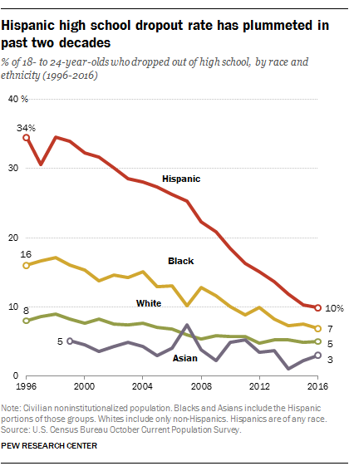

Slide 13
Unfinished Work
School busing programs, militancy, and riots reduced white liberal support for the movement in the late 60s and early 70s. At the same time, white support from the “New Left” rose (White Panthers, Students for a Democratic Society, radical feminists, and gay rights activists)
Ongoing “white flight” reversed much of the progress toward school integration resulting in “de facto” rather than “de jure” segregation
Unemployment and poverty continued to be significantly higher for African Americans and Latinos than for whites
• Affirmative action—extra effort to hire and enroll discriminated groups in educational programs
1960s, colleges and companies doing government business adopted the policy. By the late 1970s, some people were criticizing this policy as “reverse discrimination”.
During the mid-1970s, the “mass incarceration” of people of color began as various subsequent U.S. presidents took a “tough on crime” stance which, while it resonated strongly with the rising “New Right”, also systemically targeted people of color.

