Slide 1
Post-WWII America
New social, political and economic realities

Slide 2
After WWII…
After WWII, returning vets faced a severe housing shortage
In response to the crisis, developers used assembly-line methods to mass-produce houses
Developer William Levitt bragged that his company could build a home in 16 minutes for under $7,000
Suburbs were born
…But they weren’t available to everyone; many homeowner’s associations prohibited the selling of suburban homes to people of color
With the help of low-interest loans from the GI Bill, many veterans moved into suburbs like “Levittown”.

Slide 3
REDEFINING THE FAMILY
A return to traditional roles after the war was the norm (similar to the end of WWI)
Men were expected to work, while women were expected to stay home and care for the children
During WWII, 8 million women entered the workforce, 6 million of whom were married. Conflict emerged as many women wanted to stay in the workforce
Divorce rates surged even though they were highly frowned upon (over a million divorces between 1945 and 1950)

Slide 4
Economic Readjustment
Within 10 days of Japan’s surrender, 1 million American defense workers were laid off
By March 1946, 3 million were unemployed
Wartime price controls were abolished; the price of
goods soared 25%, and continued to rise for two
years until the supply of goods caught up with demand
Workers were earning less; to halt inflation, the government was forced to re-institute temporary price controls on goods, wages, and rents

Slide 5
REMARKABLE ECONOMIC RECOVERY
Experts who predicted a long-term, post-war depression were proven wrong as they failed to consider the $135 billion in savings Americans had accumulated from defense work, service pay, and investments in war bonds
Americans were ready to buy affordable consumer goods, homes and cars.

Slide 6
A Dynamic Economy
Between 1950 and 1960, America became one of the world’s wealthiest countries
10 million new homeowners (23m – 33m by 1960)
20 million new car registrations (40m – 60m by 1960)
$25,000 increase in average family income ($33k in 1950, $58k in 1960)
$22.5 billion increase in personal savings by 1962 (2.5 billion in 1950, 25 billion in 1962)

Slide 7
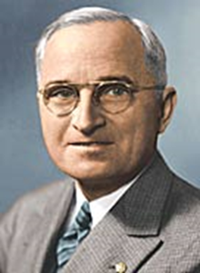
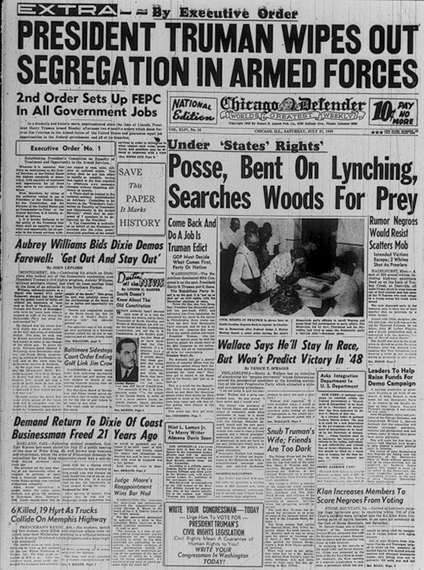
Truman Supports Civil Rights
“I am asking for equality of opportunity for all human beings. . . and if that ends up in my failure to be reelected, that failure will be in a good cause.”
-Harry Truman
1946: Supreme Court rules that lower courts cannot bar African Americans from any residential neighborhoods
1947: Truman created the President’s Commission on Civil Rights
Following the group’s recommendations, Truman asked Congress for:
Federal anti-lynching law
Ban on the poll tax as a voting requirement
Permanent federal civil rights commission
Congress refused to pass these measures, so Truman himself took action…
Executive order 9981: provided for the desegregation of the armed forces, which, in time, would lead to desegregation in all of the U.S. government services. Moreover, this order called for "equality of treatment and opportunity for all persons in the armed services without regard to race, color, religion or national origin."
These actions represent the first clear federal commitment to dealing with the effects of racism in America.

Slide 8
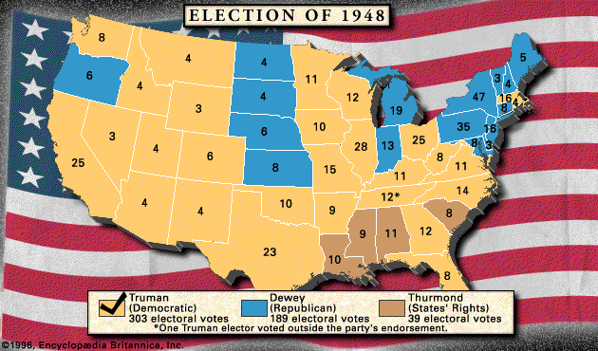
To protest Truman’s emphasis on Civil Rights, Southern Democrats, or “Dixiecrats”, opted to run a third candidate, South Carolina Governor Strom Thurmond

Slide 9
Truman’s “Fair Deal”
Truman introduced an ambitious economic program- it was supposed to be an extension of FDR’s “New Deal”
The Fair Deal:
A nationwide system of compulsory health insurance – Did not pass Congress
Raising the minimum wage (40 cents to 75 cents)
Extending Social Security to more people (10 mil)
Initiating flood control and irrigation projects
Secured federal funding for low-income housing (810,000 new units)

Slide 10
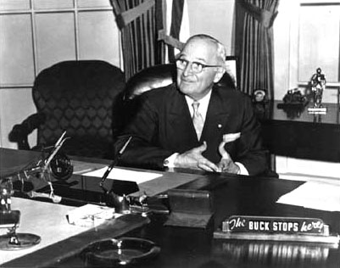
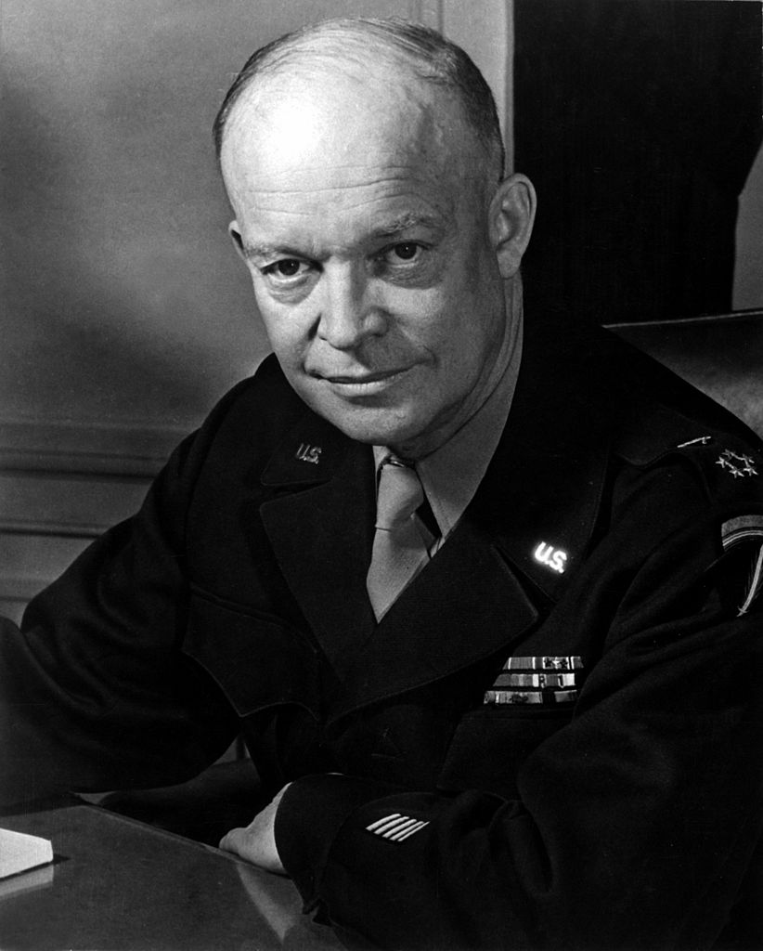
REPUBLICANS PLAN FOR 1952 ELECTION
By 1951 Truman’s approval rating sank to an all-time low of just 23%
Why?
Korean War
fired MacArthur
first “non-win” in an American war
high human and financial cost
Rising tide of McCarthyism
Anyone perceived to be at all “soft on communism” was unpopular
Truman decided not to run again

Slide 11
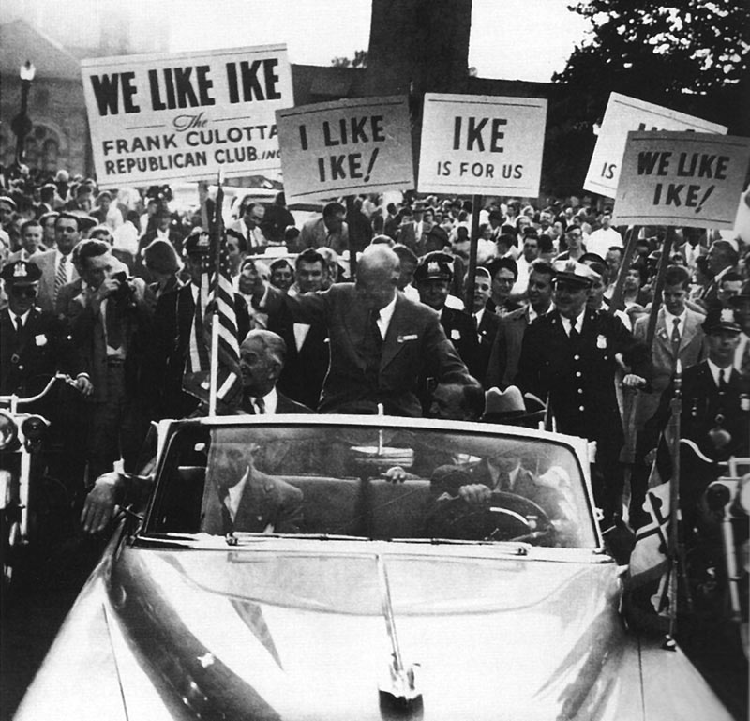
“I LIKE IKE”
Eisenhower used the slogan, “I Like Ike” for his presidential campaign
Republicans used Ike’s strong military background to emphasize his ability to combat Communism worldwide

Slide 12
IKE’S VP SLIP-UP
One potential disaster for Ike was his running mate’s alleged “slush fund”
Richard Nixon responded by going on T.V. and delivering an emotional speech denying charges but admitting to accepting one gift for his children – a dog named Checkers
The “Checkers speech” saved the ticket; notice the power of TV!
60 million Americans were watching or listening
Over the next week, the Republican National Committee received an outpouring of support in letters and phone calls urging them to keep Nixon on the ticket
https://www.youtube.com/watch?v=JpWwgwytdzk
(17:50)
Nixon and his dog Checkers

Slide 13
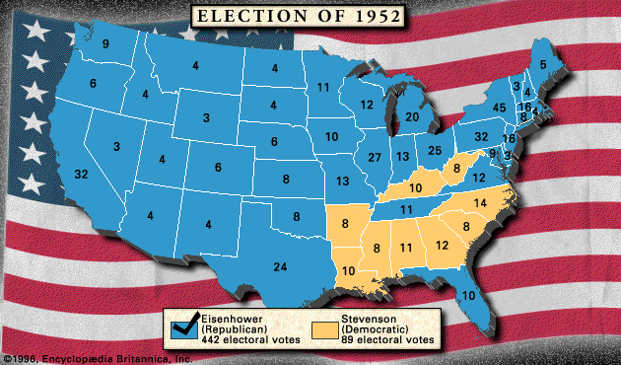
IKE WINS 1952 ELECTION

Slide 14
Ike’s Hits and Misses…
Pressed hard to bring about a balanced budget and tax cuts
Raised the minimum wage to $1/hr
Extended Social Security and unemployment benefits
Increased funding for public housing
Backed the creation of the Interstate Highway System
Warned against the overdevelopment of the military/industrial complex
Tried to avoid controversy
Brown v. Board of Education ruling took place in 1954
Rosa Parks/Montgomery Bus Boycott in 1955
While he upheld the Constitutionality of the “Brown” ruling during the Little Rock Crisis in 1957, Ike did not press for an end to segregation

Slide 15
Ike Tries To Walk the Middle of the Road…
Ike’s approach to politics - “Dynamic Conservatism” (known today as moderate Republicanism)
He wanted government to be “conservative when it comes to money and liberal when it comes to human beings.”

