Slide 1
Popular Culture in the 1920s

Slide 2
Income Taxes Help to Expand Public Education
By 1926, available funding for public education reached $2.7 billion, and over 4 million students nationwide were now enrolled in high school.
High schools were “streamed”: after what was called “grammar school” (kindergarten to grade 8) students were either placed in either a college-bound or vocational stream, with courses tailored to their goals, interests, and abilities.
The expansion of public education resulted in widespread literacy (94%) and thus the opportunity for Americans to participate in a broad, shared, popular culture

Slide 3
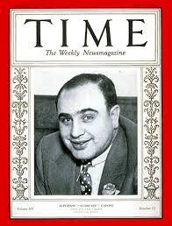
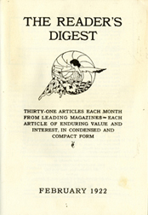
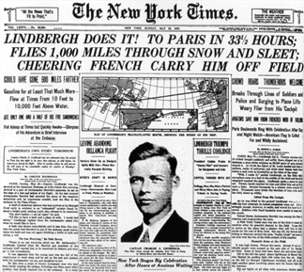
Print Media
Americans read a diverse array of newspapers and magazines beginning in the mid to late 19th century, but during the 1920s, many local and regional newspapers and magazines were “bought out” by larger, more well-funded publications (in many cases, large urban ones)
Between 1920 and 1929, approximately 600 publications were absorbed by larger ones, who in turn, expanded their distribution areas. Eventually, Americans were all reading very similar news and topics of interest on a daily basis. Most widely circulated newspapers nationally tended to be New York-based publications
Popular magazines: Time, Reader’s Digest, True Detective Mysteries

Slide 4
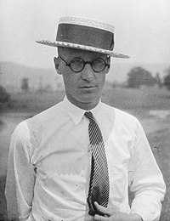
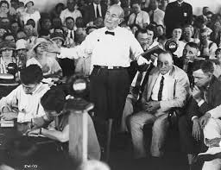
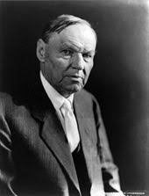
Educational and Social Paradigms Challenged in Schools
State of Tennessee v. John Thomas Scopes (1925) or, popularly known as “The Scopes Monkey Trial”.
Tennessee legislators had passed the Butler Act earlier that year, prohibiting the teaching of human evolution in any state-funded school. The ACLU (American Civil Liberties Union) offered to cover the legal expenses for any teacher willing to accept the role of defendant.
The trial was largely staged, but enormously significant; it forced people to confront their doubts about the old comforting familiarity of religion and the findings of modern science which often contradicted those cherished beliefs.
The trial was one of the most highly publicized and sensationalized events of the entire decade.

Slide 5
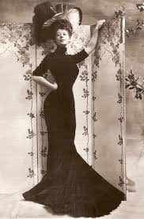
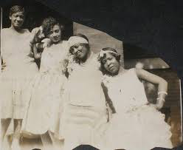
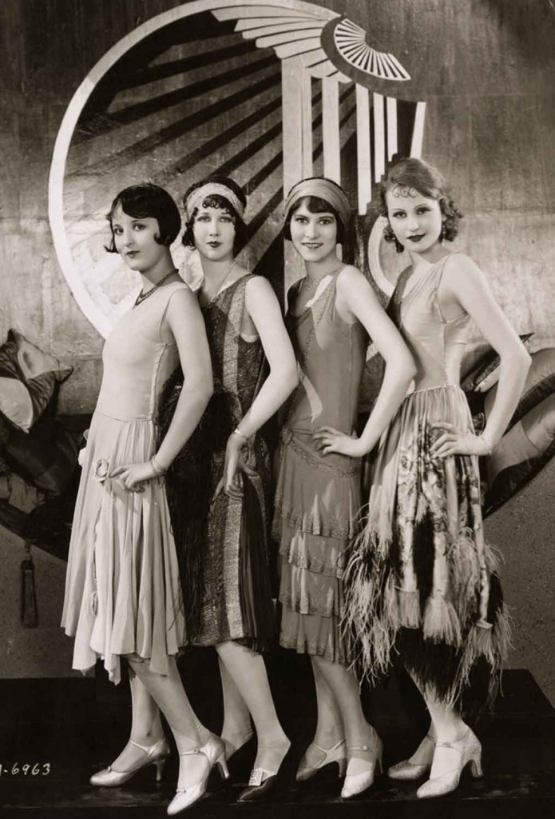
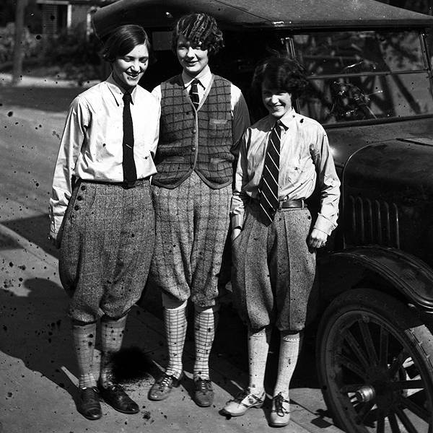
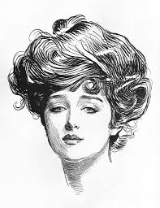
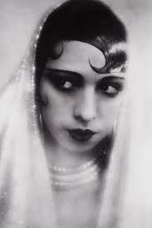
1920s Fashion
Women:
Waistless or drop-waist dresses (no more corsets)
Short skirts
Short hair (no more long hair or “cottage roll” hair styles like the 19th century “Gibson Girl”)
Short pants and knickerbockers
Mary Janes and kitten heels
Cloche hats, headbands and fascinators
Flappers and Vamps wore much heavier makeup than ever before
The “S” silhouette of the Victorian/Edwardian era fell out of fashion and the ideal female silhouette was now much more straight, with little to no accentuation of curves

Slide 6
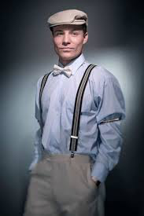
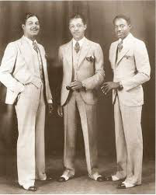
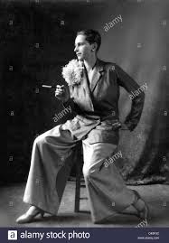
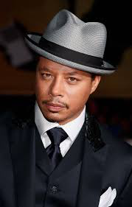
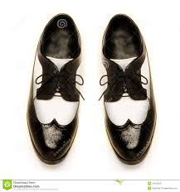
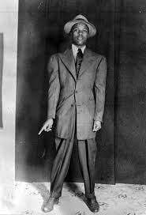
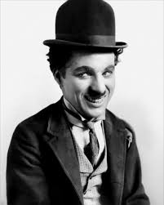
1920s Fashion
Men
Oxford bags (hugely flared pants)
Zoot suits (suits with long jackets and extra-wide lapels)
Suspenders
Neck ties, bow ties
Two-toned shoes
Bowler hats, fedoras, newsboy caps
“Patent leather” hair (parted in the middle or on the side and slicked down close to the head)

Slide 7
Radio
Radio programs were extremely popular:
News, Mystery Programs, Live sporting events,
Comedies, Music (classical, standards, jazz, blues
country music).
Marketing/advertising industry became involved almost immediately due to the far reach of radio waves
Examples: The Standard Hour, General Motors Concerts
San Francisco stations could be heard all up and down the west coast, even as far as Hawaii and Alaska, and Chicago stations could be heard all over the Midwest and in southern Ontario, Canada.
First commercial radio broadcast – 1920 election returns (KDKA – Pittsburgh). Sponsored and launched by Westinghouse in a bid to sell more radios.
https://www.youtube.com/watch?v=dMujQke4mMo

Slide 8
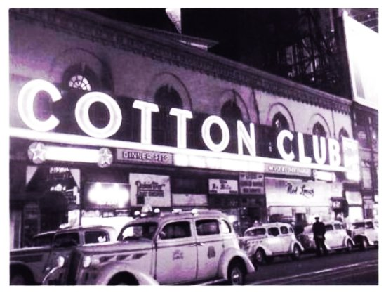
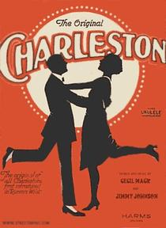
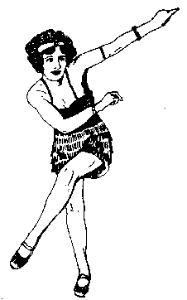
Dance Craze
The jazz dance craze was seen in nightclubs, dance halls and private homes. The house party became much more common.
Dance Marathons: Also called “bunion derbies” or “corn & callus carnivals”. Competitors would dance for literally hundreds of hours, for days or even weeks!
Dances: The Lindy Hop, The Charleston, The Black Bottom, The Shimmy, The Fox Trot, The Quick Step….
https://www.youtube.com/watch?v=WTctqB-co4k

Slide 9
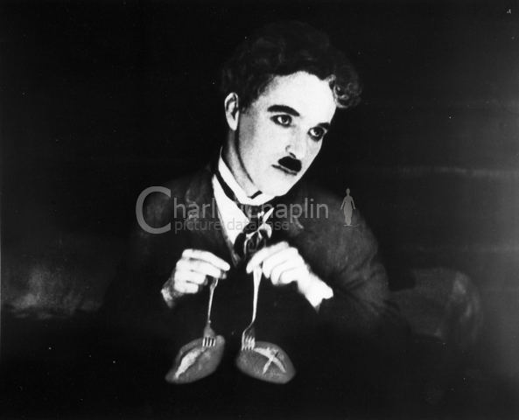
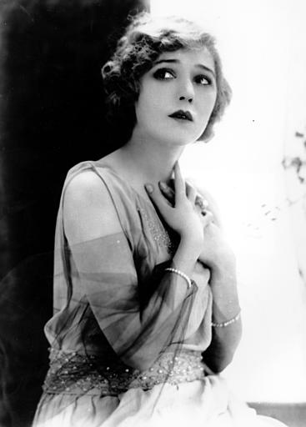
Movies
Silent films had been produced and screened since 1891, but continued to be made into the early 30s
1920s saw an explosion of both new movies and larger audiences, as movie-going became more affordable: classics, horror, science fiction, comedies, dramas
By the end of the 20s, there were 20 active Hollywood studios
The first Academy Awards (Oscars) were held in 1927
First “talkie” – The Jazz Singer, starring Al Jolson was released the same year.
The first “pictures” to win Best Film were Wings (1927) and The Broadway Melody (1928).
https://www.youtube.com/watch?v=4DLdMa98JdM
https://www.youtube.com/watch?v=OxWVH28E1KY

Slide 10
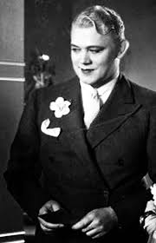
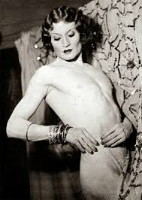
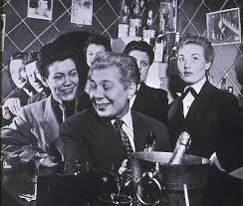
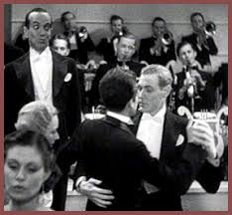
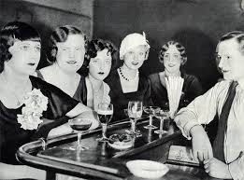
The “Gay Villages” of Los Angeles, San Francisco and New York
A new culture of urban nightlife and entertainment sprang up in these vibrant communities:
Top right: Jean Malin, nightclub emcee
Bottom right: Vander Clyde (aka “Barbette”), high-wire performer and trapeze artist

Slide 11
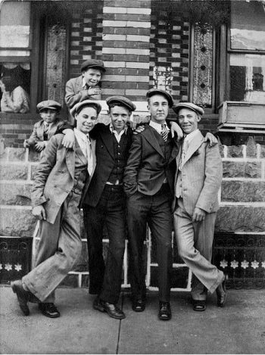
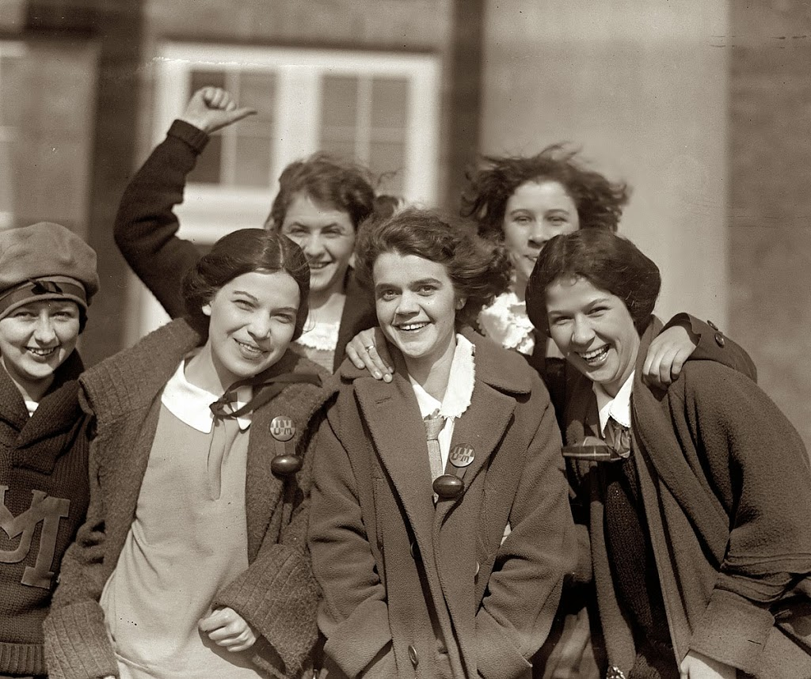
A New Youth Culture is Born
Young people now spent more time in school or socializing with their peers than they spent with their families
The liberated, tradition-smashing spirit of the 1920s which combined with the mass media and consumer culture began to define the lifestyle of the “teenager” – a term which would not be coined until the 1950s, but one that would begin to define itself in the 20s
Prior to the 1920s, no young person would ever have “courted” anyone they did not intend to marry; the 20s young people were the first to date casually in significant numbers
Public drinking and smoking became more common for girls as well as boys
Favorite Activities for 20s Urban Teens:
Radio dance parties
Car trips
“Window shopping”
Going to the “cinema” or “pictures”

Slide 12
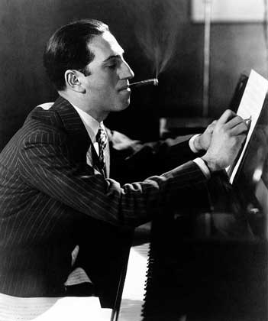
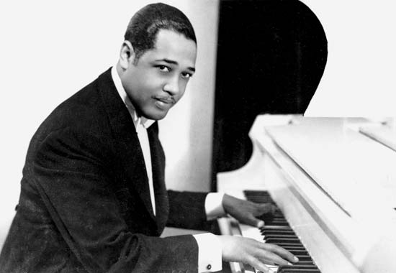
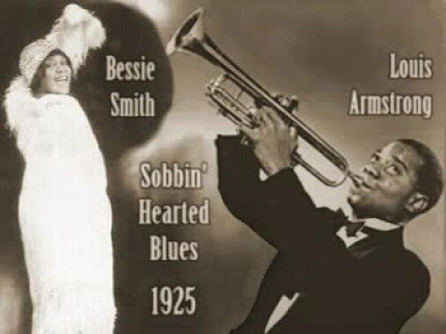
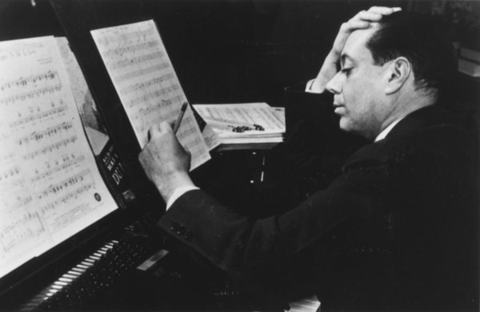
Music While classical music, folk, country, and standards were very widely listened to in the 1920s…
Jazz was by far the most popular genre of music among young people, of all walks of life
Channeled all of the energy of urban life and the spirit of youthful rebellion in the 20s

Slide 13
Homework Assignment: 1920s Music Review
Your Task:
Using Youtube, or any music service you currently subscribe to, research, listen to, and write a brief review of FOUR songs from the 1920s.
Song Title & Artist | Description | Context (how does it fit into the 1920s? Can you hear any influences that would impact later 20th century music?) | Your personal review (did you like it? Why? Why not?)

