Slide 1
Pop Culture in the 1950s
Mass Media, Music and Entertainment Both Deny AND Reflect the Realities of the 1950s

Slide 2
Mass Media Emerges
A new era of mass media led by television emerged in the 1950s
In 1948, only 9% of homes had T.V
In 1950, 55% of homes had T.V.
By 1960, 90% of American homes had T.V.

Slide 3
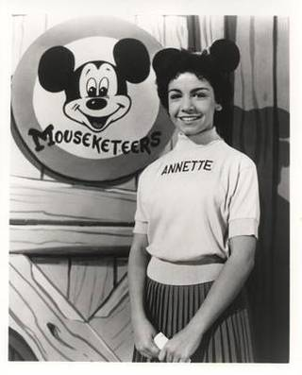
TELEVISION EXPERIMENTS WITH VARIOUS FORMATS
The FCC (Federal Communications Commission) did its best to regulate television and radio
Television innovations like live news reporting, interviews, westerns, sitcoms, quiz shows and sporting events offered the viewer a variety of shows
Kids’ shows like The Howdy Doody Show and The Mickey Mouse Club were extremely popular

Slide 4
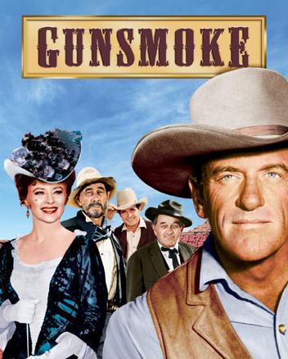
Criticisms of 1950s Television
Critics objected to its effects on children (exposure to violence)
Women appeared in stereotypical roles
Male characters outnumbered female by 3 to 1
People of color rarely appeared in television programs at all (with the exception of “American Bandstand”)
1950s television portrayed an idealized white America, with no references to poverty, diversity or contemporary conflicts

Slide 5
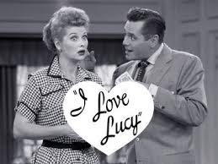
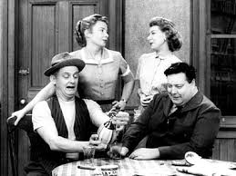
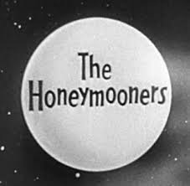
Popular T.V. Shows of the 1950s What aspects of 1950s values and norms are evident to you from watching these clips?
“The Honeymooners”
https://www.youtube.com/watch?v=_-FhWB1POWQ
“I Love Lucy”
https://www.youtube.com/watch?v=oOfuoA146Y0&index=13&list=RDsu3goJ7unCs

Slide 6
Would the Birth of Television Lead to the Death of Radio and the Movies?
In 1948, 90 million people went to the movies weekly. By the mid-50s this had decreased by 50%. Radio and movies survived because they adapted and evolved.
Radio stations now offered local news, weather, community events and more importantly- rock n’ roll.
Movie theatres also had some advantages over TV - size, color, and sound (even Smell-O-Vision and 3D!)
James Dean, a teen film idol, died at
the age of 24 in a car accident.

Slide 7
A SUBCULTURE EMERGES
Although mass media and television were wildly popular in the 1950s, dissenting voices emerged
The “Beat Movement” in literature, art and poetry celebrated a nonconformist lifestyle and attitude
Allan Ginsberg, “Howl” (1956)
Jack Kerouac, “On the Road” (1957)

Slide 8
BEATNIKS FOLLOW THEIR OWN PATH
Centered in San Francisco, L.A. and New York’s Greenwich Village, the Beat Movement expressed social nonconformity (own style of dress, refused to live in suburbs, “lived together” rather than married)
Followers, called “beatniks”, tended to shun conventional work and career paths and sought understanding through Zen Buddhism, contemplative music (early folk), and sometimes recreational drugs
Beatniks often performed poetry or music in coffeehouses or bars

Slide 9
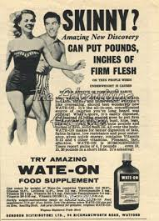
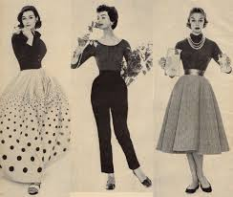
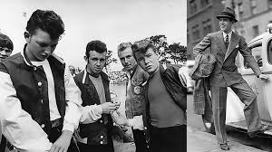
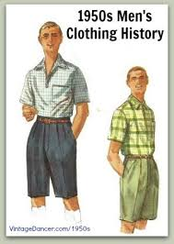
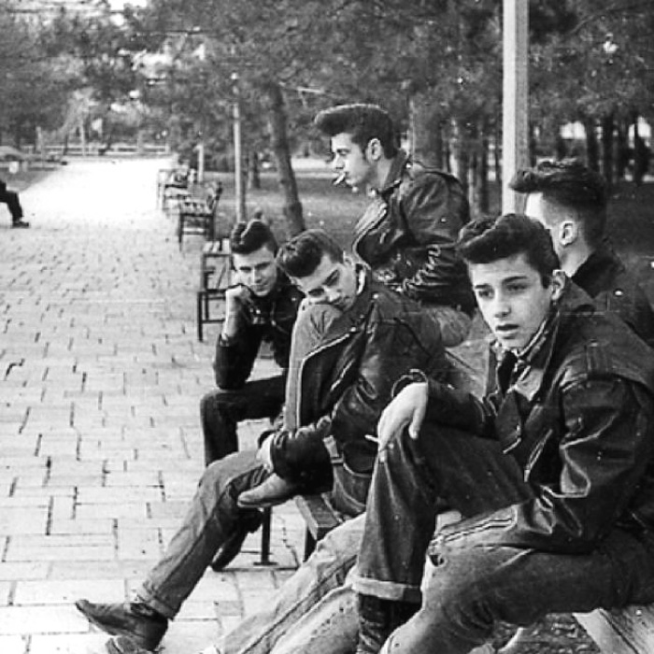
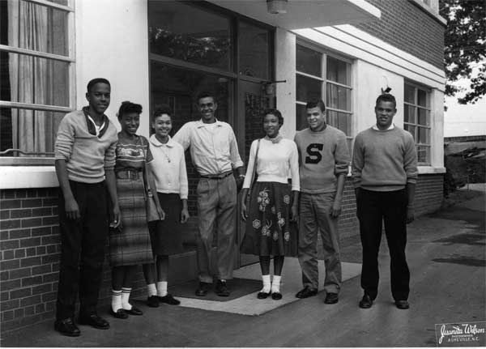
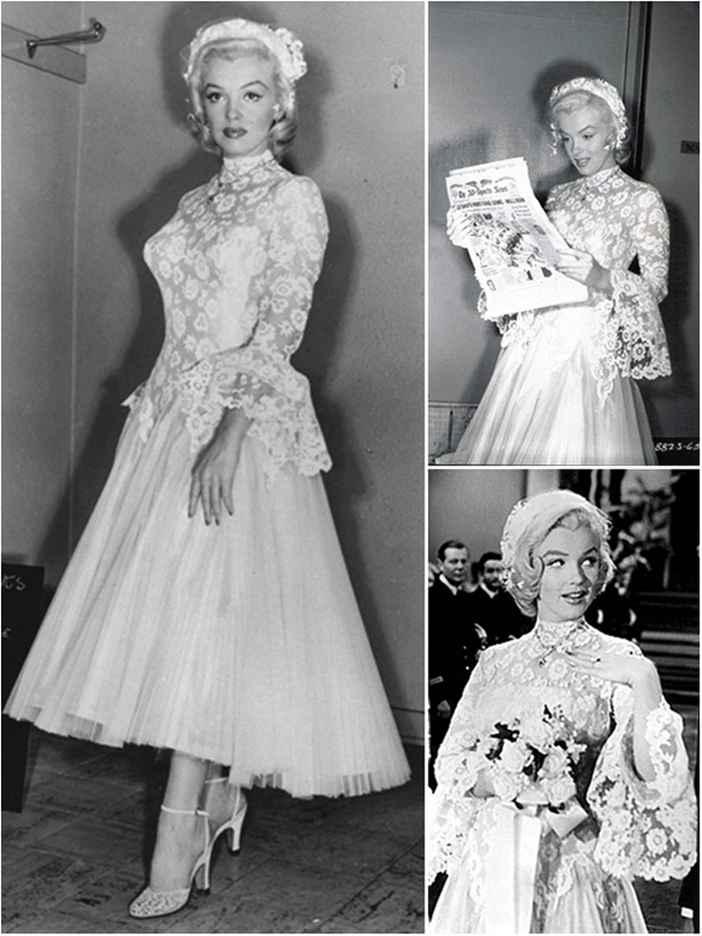
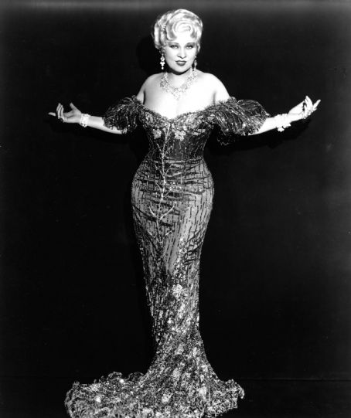
Fashion and Body Image
While traditional values and conservatism were stressed in much of mainstream media, the 50s had it’s share of “bad” girl and boys
Teenagers and other young people would cultivate their own style and pioneer new trends, as always
During the 50s and early 60s, a much curvier female ideal was presented in popular culture (“hourglass figure”; decade when “Barbie” was first introduced)

Slide 10
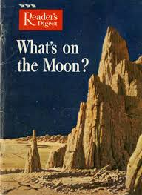
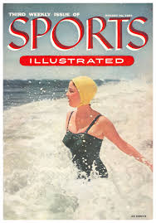
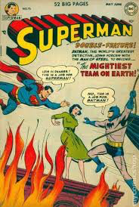
Literature
Over 95% literacy in the U.S. by the end of the 50s
Sales of paperback novels doubled during the decade
Most popular magazines: Reader’s Digest, Sports Illustrated
Comic book sales peaked during the 1950s (sci-fi craze in film and comic books fueled by the Cold War)

Slide 11
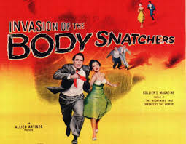
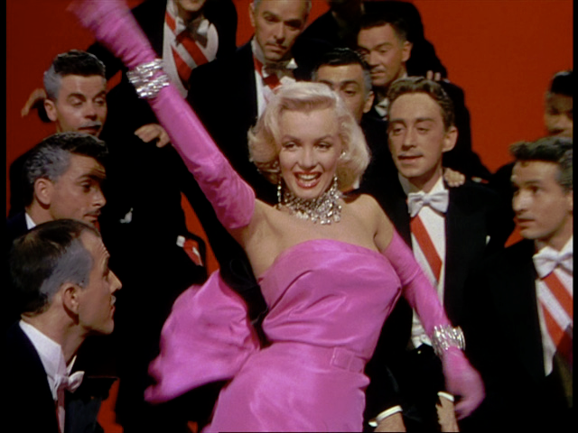
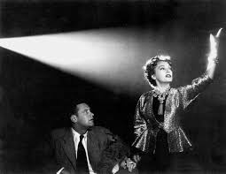
Movies in the 1950s
Popular Genres & Films:
-Science Fiction/Horror: “Invasion of the Body Snatchers”, “The Blob”
https://www.youtube.com/watch?v=TdUsyXQ8Wrs
-Musicals: “Singin’ in the Rain”, “Gentlemen Prefer Blondes”
https://www.youtube.com/watch?v=GB2yiIoEtXw
-Dramas: “On the Waterfront”, “Rebel Without a Cause”
https://www.youtube.com/watch?v=wXRgAXU1-T4
-Mystery/Suspense: “Rear Window”, “Sunset Boulevard”
https://www.youtube.com/watch?v=6kCcZCMYw38
-Action/Adventure: “North by Northwest”
https://www.youtube.com/watch?v=sIY7BQkbIT8
*Alfred Hitchcock (Rear Window, North by Northwest) was one of the most innovative and prolific directors of the 1950s and 60s

Slide 12
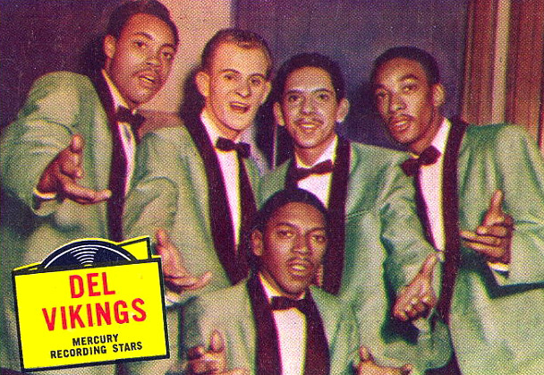
Music in the 1950s
Evolution of Jazz
Swing music continued to develop in the “big band” tradition
“Lounge” tradition emerges
Frank Sinatra and the “Rat Pack”
Nat King Cole
Lena Horne
Experimental jazz
Miles Davis
Thelonius Monk
Evolution of Blues
Blues groups with a minimal instrumental focus and multiple singers began to innovate a new style of music known as “doo wop” (named for nonsense syllables used by back-up singers)
The Spaniels “Goodnight Sweetheart, Goodnight” (first recorded doo-wop song, 1954)
https://www.youtube.com/watch?v=egX9N8yOgaU
The Dell Vikings (first racially integrated music group) “Come Go With Me” (1956)
https://www.youtube.com/watch?v=P1eU_lDQaVM

Slide 13
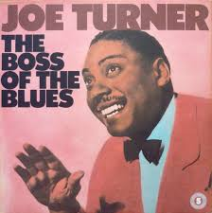
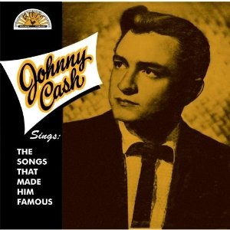
MUSIC IN THE 1950s
Musicians in the 1950s added electronic instruments to traditional blues, creating rhythm and blues. With the addition of classic country elements, something entirely new was created
Cleveland DJ, Alan Freed, was the first to play this music in 1951– he called it “rock n roll”
First called “race music”- the early performers were mostly black, but a huge chunk of the audience was white (similar to the music of the Harlem Renaissance)
Listen to the following tracks to hear how classic blues and country influenced rock n roll music
Classic Blues
“I Know You Love Me Baby” – Joe Turner
https://www.youtube.com/watch?v=WIUcO8DxP40
Country Music
“Folsom Prison Blues” – Johnny Cash
https://www.youtube.com/watch?v=6ZPToXstS8M
FREED

Slide 14
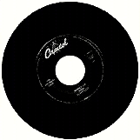
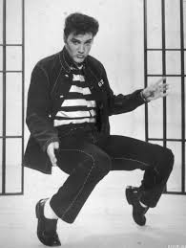
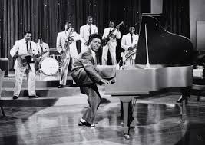
ROCK N’ ROLL
In the early and mid-fifties, Richard Penniman, Chuck Berry, Bill Haley and the Comets, and Elvis Presley brought rock and roll to the forefront
The driving rhythm and lyrics featuring love, fast cars, and the problems of being young captivated teenagers across the country.
“Good Golly Miss Molly” Little Richard - https://www.youtube.com/watch?v=C5VkTcmQxD8
“Jailhouse Rock” Elvis Presley - https://www.youtube.com/watch?v=qka6JrKUM5U

