Slide 1
Politics in the 1920s
A society in Conflict

Slide 2
Major Themes
While the 1920s are typically thought of as a carefree, hopeful and prosperous time, there was an underside characterized by:
Government Corruption
Labor unrest
Prohibition-related rise in crime
Anti-Immigrant Sentiment
Racial Violence

Slide 3
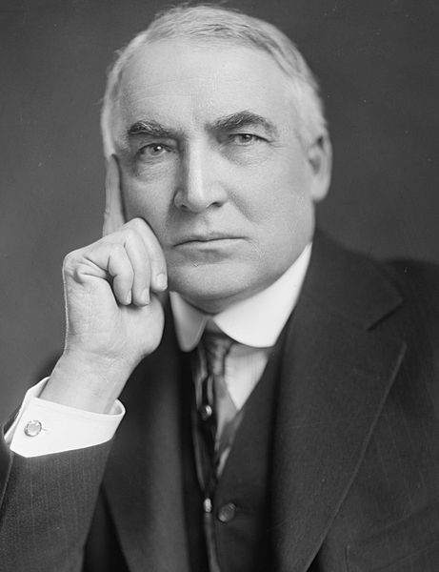
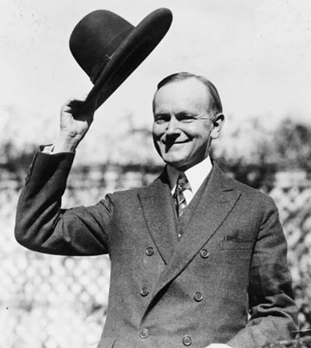
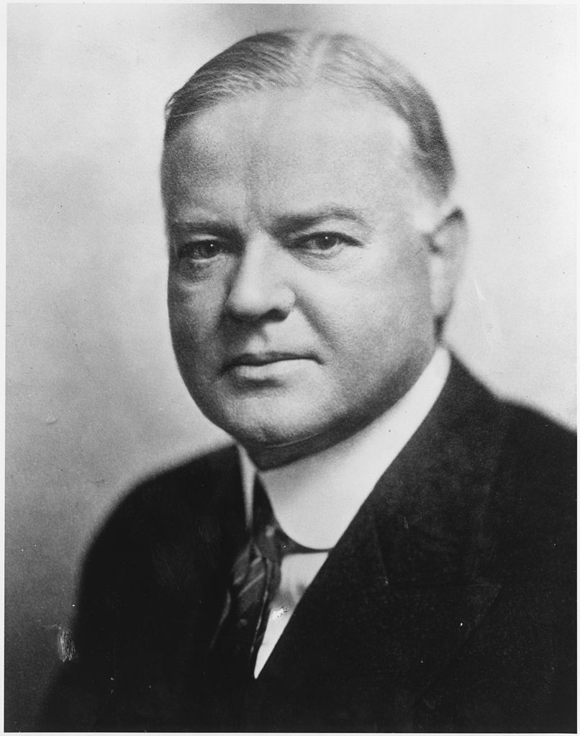
A conservative Decade
The three men who served as President of the United States during the 1920s were all conservative Republicans.
Warren G. Harding
Calvin Coolidge
Herbert Hoover

Slide 4
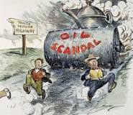
“A Return to Normalcy” –Harding’s campaign motto when he won the 1920 election: promises to get America back to normal after the war and to run a government less involved in business and foreign affairs (wants to end the postwar recession)
Fordney McCumber Tariff (1922): raised American tariffs on many imported goods to protect factories and farms.
At the same time, they promoted foreign trade through providing huge loans to European countries which, in turn, bought more US goods
President Warren Harding
(1920-1923)
Harding’s Presidency is most remembered for it’s scandals:
Teapot Dome Scandal: Secretary of the Interior, Albert Fall accepted bribes from oil executives ($400,000 in exchange for government oil fields in Teapot Dome, Wyoming)

