Slide 1
Media, Music and Movies in the 1920s

Slide 2
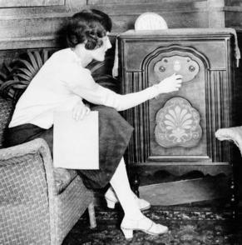
Radio
Radio programs were extremely popular:
News, Mystery Programs, Live sporting events,
Comedies, Music (classical, standards, jazz, blues
country music).
Marketing/advertising industry became involved almost immediately due to the far reach of radio waves
Examples: The Standard Hour, General Motors Concerts
San Francisco stations could be heard all up and down the west coast, even as far as Hawaii and Alaska, and Chicago stations could be heard all over the Midwest and in southern Ontario, Canada.

Slide 3
Music While classical music and standards were very widely listened to in the 1920s…
Jazz was by far the most popular genre of music among young people, of all walks of life
Channeled all of the energy of urban life in the 20s and the spirit of youthful rebellion

Slide 4
Dance Craze
The jazz dance craze was seen in nightclubs, dance halls and private homes. The house party became much more common.
Dances: The Lindy Hop, The Charleston, The Black Bottom, The Shimmy, The Fox Trot, The Quick Step….
https://www.youtube.com/watch?v=s58iTzznkp0&index=1&list=PL2WKZaMt021Ry9XIiciHUYVTfm84GfZ9N

Slide 5
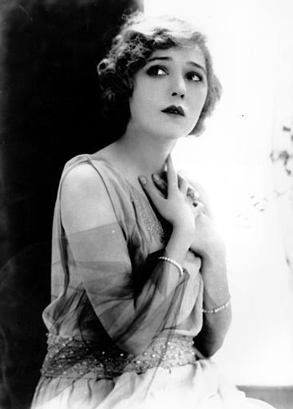
Movies
Silent films had been produced and screened since 1891, but continued to be made into the early 30s
1920s saw an explosion of both new movies and larger audiences, as movie-going became more affordable: classics, horror, science fiction, comedies, dramas
By the end of the 20s, there were 20 active Hollywood studios
The first Academy Awards (Oscars) were held in 1927
First “talkie” – The Jazz Singer, starring Al Jolson was released the same year.
The first “pictures” to win Best Film were Wings (1927) and The Broadway Melody (1928).
https://www.youtube.com/watch?v=4DLdMa98JdM
https://vimeo.com/81593297
https://www.youtube.com/watch?v=1pzVm6nm4xM

Slide 6
Discussion Questions:
Based on your observations of 1920s media (the music review assignment, the videos from today’s class..), what elements do you recognize as having influenced trends in the later 20th century?
What aspects of 1920s media, music and dance have you enjoyed, if any?

