Slide 1
Growth of a Young Nation
The first 60 years

Slide 2
Question of the Day: Did life get “better” for Americans between the Revolution and the Civil War? Explain using specific details and examples
Main Idea: During the first few decades of the nation’s history, America expanded her territory, influence and the power of the federal government. The criticism of inequalities gradually became louder over time.
Why It Matters Now: The United States emerged as a world power during the 19th century, and continues to be so today. In addition, the struggle to realize the values of both the Declaration of Independence and the Constitution also continues today.

Slide 3
Washington and Adams: The First Two Presidencies Help Shape The New Government
Judiciary Act of 1789: created the Supreme Court and federal circuit and district courts. State decisions could now be appealed at a higher level; strengthened federal law.
Two-Party System Evolves: Major conflict between the members of the first cabinet (primarily Hamilton & Jefferson) caused individuals to polarize themselves behind either the “Federalists” or the “Democratic Republicans”
Struggle For Power Between Federal & State Governments: The Alien & Sedition Acts → Nullification
Foreign & Domestic Challenges: Tensions with France and Britain; Whisky Rebellion

Slide 4
The Jeffersonian Era
The concept of “Manifest Destiny” (which has it’s roots in the colonial period) began to develop.
Louisiana Purchase: Doubled the size of the U.S. – the former Louisiana Territory constitutes the middle 1/3 of the lower 48 states today; Jefferson purchased this territory for $15 million, or about 3 cents per acre ($233 million today, or 43 cents per acre). Precipitated the exploration of lands formerly belonging to Spain, or, apportioned to Native Americans.
War of 1812 (1812 – 1815): Often called “The Second American Revolution”. Fought primarily on the Canadian/U.S border, on the Great Lakes, in the Atlantic and in the southern Louisiana territory. Ended with the Treaty of Ghent, 1815.
Monroe Doctrine: “No European power should interfere any further with affairs in the Western Hemisphere. They should not create any NEW colonies or seek to overthrow any newly independent Republics.”

Slide 5
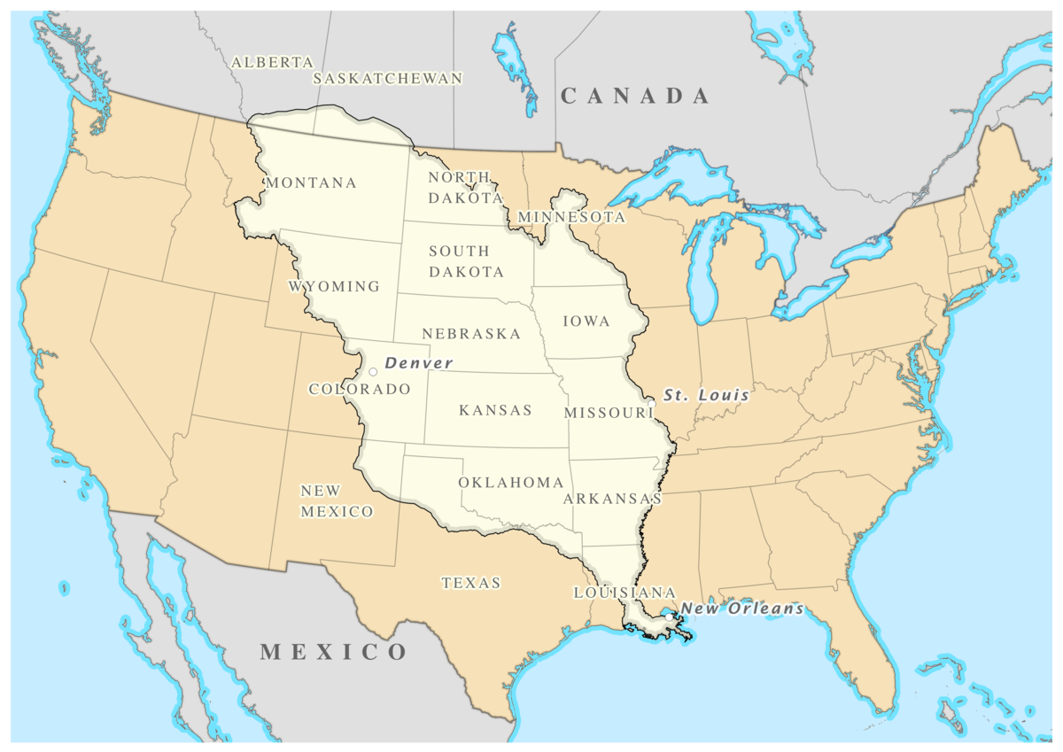
The Louisiana Purchase (1804)

Slide 6
How do the following two text samples report one of the causes of the War of 1812 differently?
“One of the causes of the war was the British policy of impressment, the practice of seizing Americans at sea and “impressing” or drafting them into the British navy. Americans grew even angrier after learning that British Canada was supplying arms to Northwest Native Americans to aid their fight against American settlers.”
“Meanwhile the British were harassing American shipping headed to France…to starve France of imports. As well, they were looking for British sailors who jumped ship to American vessels. There were plenty (who did not want to fight in the Napoleonic conflict anymore) and it provided an excuse for the British to seize American ships.”

Slide 7
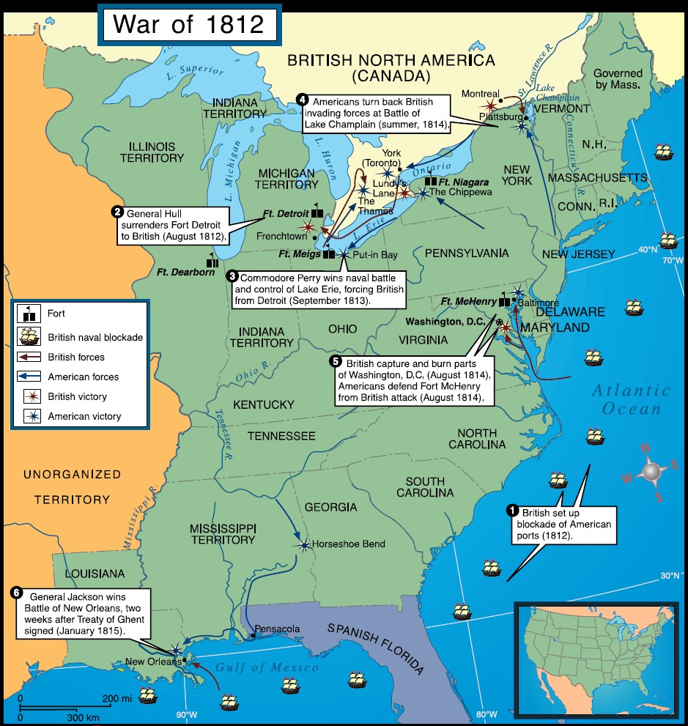

Slide 8
Balancing Nationalism & Sectionalism
Despite growing differences between the economies and societies of North & South, the nation’s political leaders managed to keep the union in one piece through the first few decades of the 19th century.
Henry Clay’s “American System”: 1815 - 1816 (North and Federalists supported, South, West, and Democratic Republicans tolerated)
Establishing a protective tariff on imports (20 -25%)
Re-chartering the national bank (20 year renewal + unified national currency)
Creating national transportation infrastructure
The Missouri Compromise (1820): controversy over whether Missouri would be admitted as a slave state or a free state (Missouri – slave, Maine-free) Established a “slavery line” 36/30 north latitude, above which slavery would not be permitted.
Slavery and it’s potential abolition went largely undiscussed by both the new “Democrats” and the “Whigs” throughout the next three decades, despite massive increases in the slave population in the South, the number of abolitionists becoming vocal, and the increasing number of slave uprisings.

Slide 9
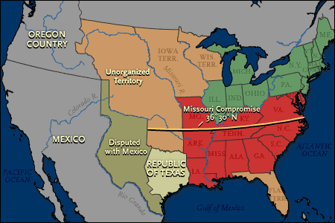

Slide 10
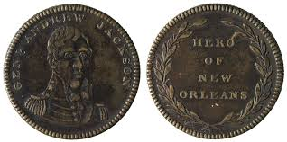
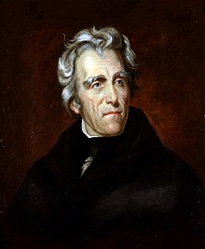
The Age of Jackson: (1828 – 1850) A new era of popular democracy
Expanded suffrage (white males only)
Manifest Destiny (free soil Jacksonians supported; Whigs opposed it saying cities should be built up instead)
Rotating Patronage Positions (political appointees periodically move in and out of bureaucratic positions)
Strict Constructionism (favoring a close, literal interpretation of the Constitution and maintaining a limit of federal power)
Laissez-faire economics (hands-off approach, opposed to modernization, railroads and centralized banking)
Generally supported by the rural poor, small farmers, the white working class, with a huge proportion of Irish immigrants

Slide 11
The Age of Jackson:
Expansion of Presidential Powers
Southern Nullification → Tariffs of 1824 (35%) and 1828 (50%) and 1832 (65%). Jackson/Clay – “Force” bill and gradual lowering of tariffs over ten years
Indian Removal Act of 1830: Jackson enforced the removal of 50,000+ Native Americans from the Southeast with military might in spite of the Supreme Court declaring the act unconstitutional. The Cherokee nation who took their complaint to the Supreme Court, were the last to walk the “Trail of Tears”. About 25% died on the long march to the new “Indian Territory”.
Jackson’s Bank War: In this area, Jackson still wanted to see a limit to federal power, but clearly not executive power. Saw the bank as largely an agent of the wealthy elites. Withdrew all federal deposits and placed them into smaller, state-based “pet” banks loyal to the Democratic party – making the Bank of the United States just another bank.
“Wildcat” banks
Printed money in excess of what they had in their vaults in gold and silver
Once customers began to try to redeem their paper money for “hard currency”, many banks soon had to stop accepting paper money
“Panic of 1837”: Jackson leaves an economic mess for Martin Van Buren to take the blame for. Banks closed, the credit system collapsed, individuals and businesses were bankrupted, and 1/3 of the working public lost their jobs

Slide 12
Indian Removal Act

Slide 13
The Age of Jackson
A New Era of Political Engagement
Politicians since Jackson have often appealed more to passion and emotion than to reason, courting public popularity
Political speeches became more dramatic, becoming forms of mass entertainment

