Slide 1
Japanese Internment & the US Constitution Part 2

Slide 2
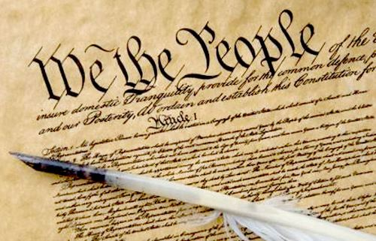
The 4th and 5th Amendments
How do these Constitutional amendments protect Americans?

Slide 3
-4th Amendment to the U.s. Constitution
“The right of the people to be secure in their persons, houses, papers, and effects, against unreasonable searches and seizures, shall not be violated, and no Warrants shall issue, but upon probable cause, supported by Oath or affirmation, and particularly describing the place to be searched, and the persons or things to be seized.”

Slide 4
5th Amendment to the constitution
No person shall be held to answer for a capital, or otherwise infamous crime, unless on a presentment or indictment of a Grand Jury, except in cases arising in the land or naval forces, or in the Militia, when in actual service in time of War or public danger; nor shall any person be subject for the same offence to be twice put in jeopardy of life or limb; nor shall be compelled in any criminal case to be a witness against himself, nor be deprived of life, liberty, or property, without due process of law; nor shall private property be taken for public use, without just compensation.

Slide 5
The text of the 4th amendment basically states that without a court-ordered warrant, no officer of the law or government can seize or conduct a search on your:
Person
House
Car
Possessions/property
Devices
The highlighted text of the 5th amendment basically states that your natural rights to life, liberty, and ownership of property cannot be violated unless you are duly and legitimately convicted of a crime.

Slide 6
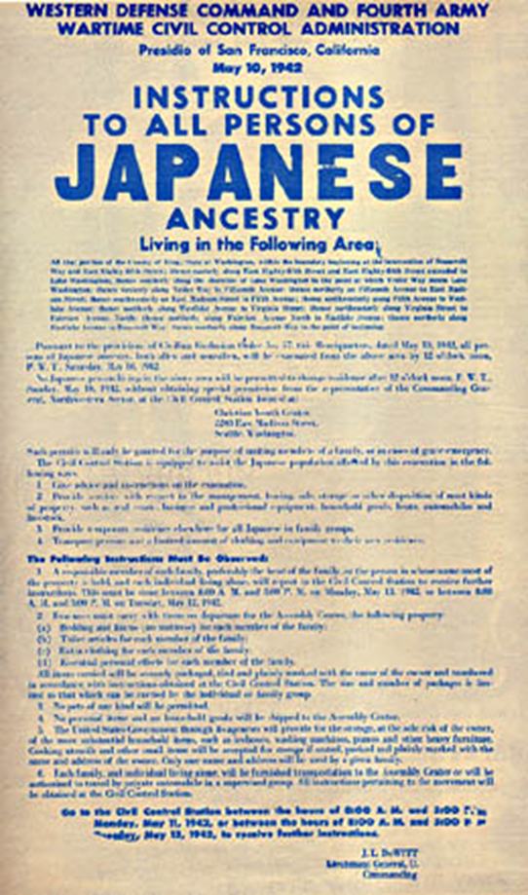
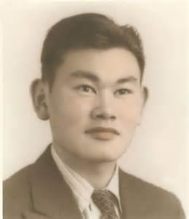
At the time of the Japanese-American internment during WWII, no exceptions had yet been established for the 4th or 5th amendments, and yet, executive order 9066 was signed and executed without congressional opposition. Additionally, the Supreme Court ruled against Fred Korematsu (6 – 3) when he launched a legal challenge to the Japanese relocations and internment, asserting that they were unconstitutional.
Korematsu launched this challenge after he was ordered to leave his home and relocate to an internment camp, something that would cost him his job, and in all likelihood, his home as well – and all when he had done nothing wrong.
Korematsu also insisted that because he had been ordered to internment without a fair trial, or being informed of accusations or convictions against him, that his 6th amendment rights had been violated also. Finally, he asserted that the internment orders were racially motivated, not given out of military necessity, which he argued were a violation of his 14th amendment rights

Slide 7
Visit the following website to learn what exceptions to 4th amendment rights have been added since 1946
http://www.uscourts.gov/about-federal-courts/educational-resources/about-educational-outreach/activity-resources/what-does-0

Slide 8
The Ni’ihau incident
December 7 - 13, 1941:
One of the Pearl Harbor bombers crash landed on the Hawaiian island of Ni’ihau
The pilot was taken into custody by local authorities, but was allowed to stay with three Japanese Americans until he could be handed over to military authorities
The pilot managed to convince his captors to help him escape, resulting in the deaths of the pilot and one of the Japanese Americans who had sheltered him
Within less than four months, Roosevelt had passed Executive Order 9066 despite a U.S. Naval intelligence report which stated that suspicions of any threats to American security from Japanese Americans was virtually groundless (this report was suppressed by the prosecution during the Korematsu case).
Many government and military officials began to express fears in the wake of the incident that Japanese Americans could be persuaded to betray the United States for the Japanese cause.

