Slide 1
Introduction to the 1960s
Major Themes and Key Terms

Slide 2
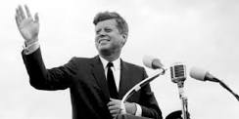
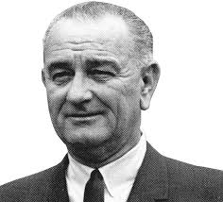
Kennedy, Johnson & The Cold War
John F. Kennedy: New Frontier
Space programs
Economic stimulus
Addressing poverty
Civil rights
Programs cut short by Kennedy’s assassination
Cold War Conflict: Cuban Missile
Crisis
Major Themes:
Kennedy and Johnson enacted various domestic reforms to improve quality of life in America, with varying levels of success
Americans began to become increasingly distrustful of government.
Vietnam and Cold War foreign policy
Kennedy assassination
America came frighteningly close to nuclear war with Cuba/Russia
America escalated the Vietnam War under Johnson, consistent with the “Containment” policy
Lyndon B. Johnson: The Great Society
War on poverty
Healthcare
Civil rights
Education
Housing
Immigration
Environment
Warren Court (various liberal reforms)
Cold War Conflict: Launch and escalation of Vietnam War

Slide 3
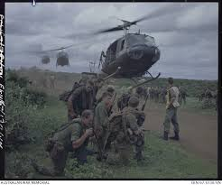
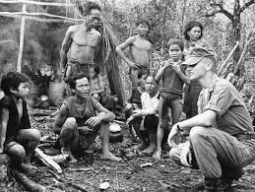
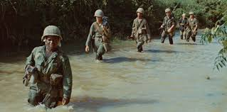
The Vietnam Years
American involvement in Vietnam began with financial support for the French colonial effort, and later, for the South Vietnamese (under Eisenhower and Kennedy)
Gulf of Tonkin Resolution: Granted sweeping powers to the U.S. President to conduct a war without the oversight of Congress.
America became directly involved in the Vietnam War under Johnson, and escalated the conflict from 1965 – 1968
“War of Attrition”: wear out your enemy gradually in a series of small-scale actions
War quickly degenerated into a frustrating stalemate
American military officials continued to spread the idea that we were “winning the war in Vietnam”.
Public outcry against the human costs of the war erupted at home (anti-war movement largely championed by the Boomers)
Vietnam left a painful legacy
58,000 battle deaths, 303,000 wounded; Vietnam veterans treated differently than other veterans had been before when they arrived home
Americans became much more cautious about foreign policy
Americans became MUCH more cynical about their government
War Powers Act (president must inform Congress within 48 hours of sending forces into a hostile area without a declaration of war)

Slide 4
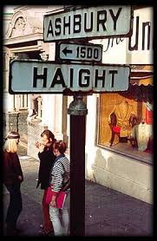
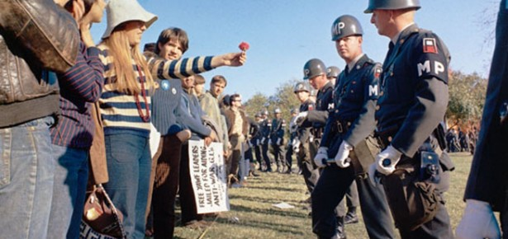
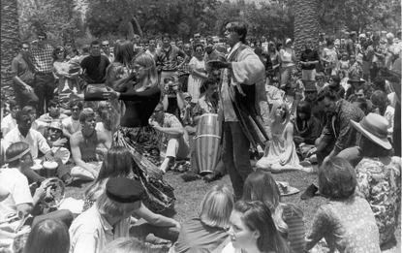
Counterculture
Anti-establishment, non-conformist attitude of the “beatniks” continued with the “hippie” movement:
Aimed to establish a new communal, collectivistic society characterized by peace and love
Elements of counterculture found strong resonance in the anti-war, civil rights, and feminist movements, and “hippies” could be found among all of these activist groups
While the lifestyle of those who embraced the counterculture proved to be short-lived, their philosophy would give rise to new attitudes about social behavior, lifestyle, dress and appearance
Conservatives would attack what they viewed as the “decadent” values of the counterculture, leading to the growth of a new conservative movement with the election of Nixon in 1968

Slide 5
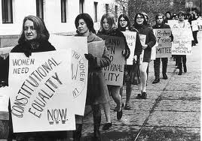
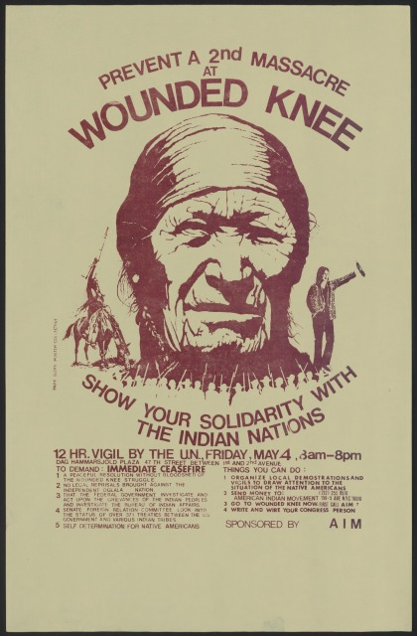
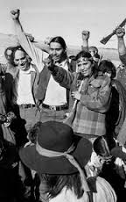
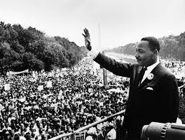
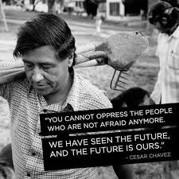
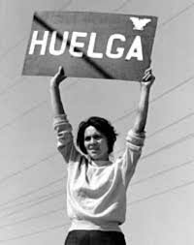
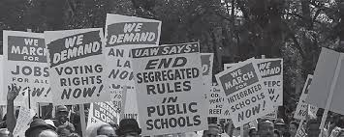
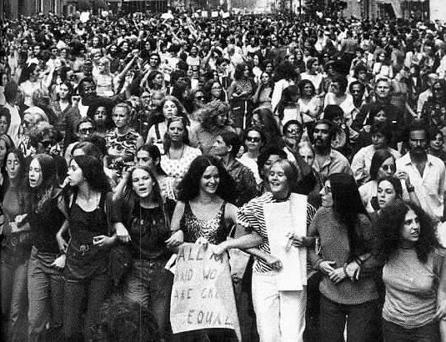
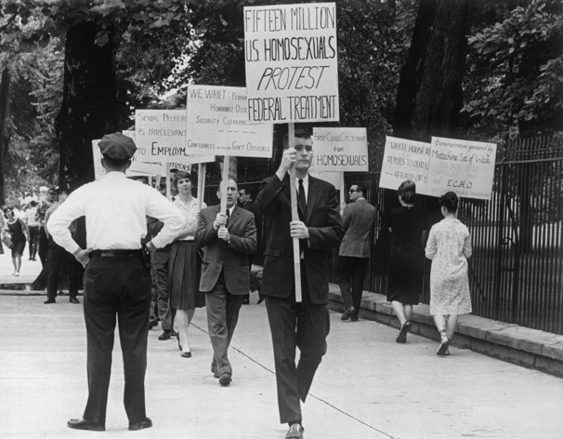
The Feminist, Civil Rights, and gay Rights and liberation movements
Through literature, protest, activism and engagement with Constitutional law, women of the 1960s and early 1970s sought to gain equal rights for women in America
Betty Friedan, author of “The Feminine Mystique” and co-founder of the National Organization for Women (NOW)
National Women’s Political Caucus, co-founded by Shirley Chisholm, Gloria Steinem, and Fannie Lou Hamer, among others
Equal Employment Opportunity Commission (EEOC) created to address discrimination based on race, religion, national origin and gender. Many feminists believe it doesn’t go far enough in addressing women’s equality:
Roe v. Wade
Equal Rights Amendment (ERA) – never passed

Slide 6
The LGBTQ community launched first a rights-centered movement
Mattachine Society, Daughters of Bilitis, Frank Kameny’s White House protest
This movement later became a liberation movement
Encouraged one another to “come out” and demand social acceptance
African Americans, Latino Americans, and Native Americans demanded equal rights and equal protection before the law. They achieved the passage of landmark legislation through engagement in various protest movements, some peaceful, some militant. The fight to end “de facto” inequality by changing hearts and minds continued into the following decades
Nonviolent Civil Disobedience
Dr. Martin Luther King Jr., Southern Christian Leadership Conference
SNCC (Student Nonviolent Coordinating Committee
Montgomery Bus Boycott, Freedom Riders, Selma Campaign, March on Washington
Black Power
Malcolm X, Nation of Islam and black separatism
Stokely Carmichael
Black Panthers

Slide 7
Landmark Civil Rights Legislation and Strategies
Civil Rights Act (1964) and Voting Rights Act (1965)
Affirmative Action
Labor Justice, Latino Civil Rights, and Brown Power
Cesar Chavez, United Farm Workers Union protests and boycotts
La Raza Unida
Brown Berets
Student walkouts for bilingualism and cultural heritage programs
Native American Sovereignty, Civil Rights, and Treaty Rights
American Indian Movement (AIM)
A conservative backlash to the feminist, gay rights, and civil rights movements emerged fully by the mid-70s, contributing to the establishment of a “New Right”, leading to the rise of a “conservative tide” which also continues to influence American politics today.
PBS, “The Sixties: The Years That Shaped a Generation” 0:00 – 15:00
www.youtube.com/watch?v=jTspDh6C3yY&list=PLrxAtYLtzob_w5x5wTT240logAgYSUnRt

