Slide 1
Introduction to the 1930s
The Great Depression, the new deal, and ideological change

Slide 2
Introductory Discussion Question:
Discuss the following within your group and share your ideas with the class:
In what ways do you think the 1930s would prove to be very different from the 1920s?
What sorts of things might have remained the same?

Slide 3
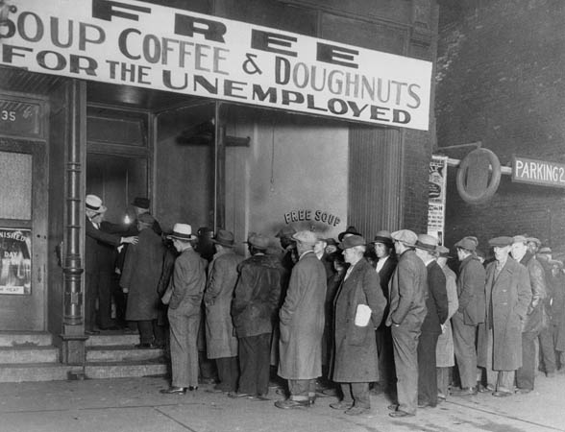
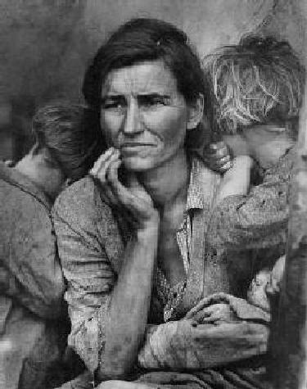
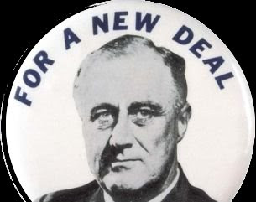
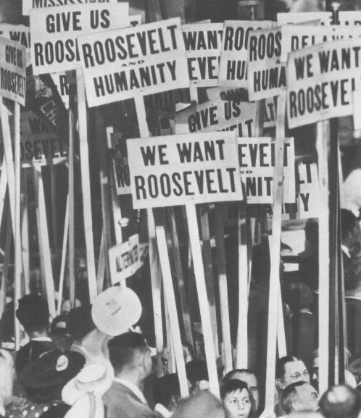
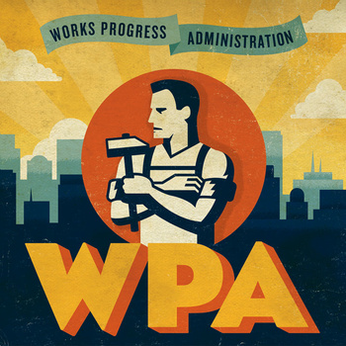
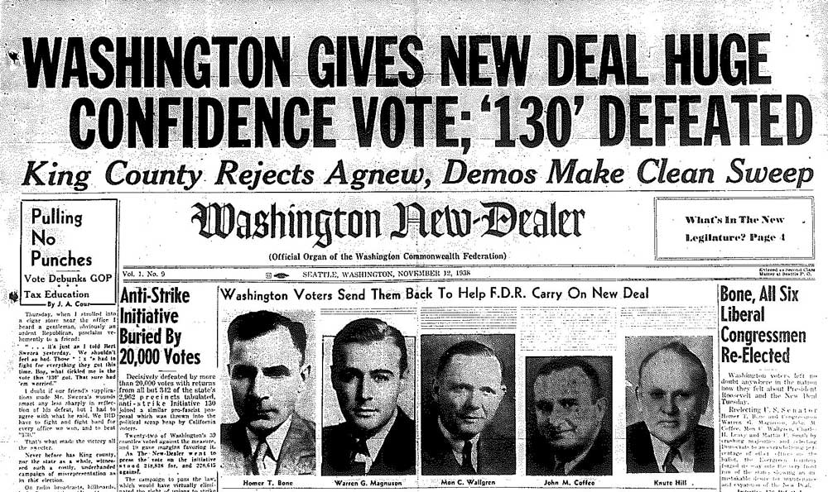
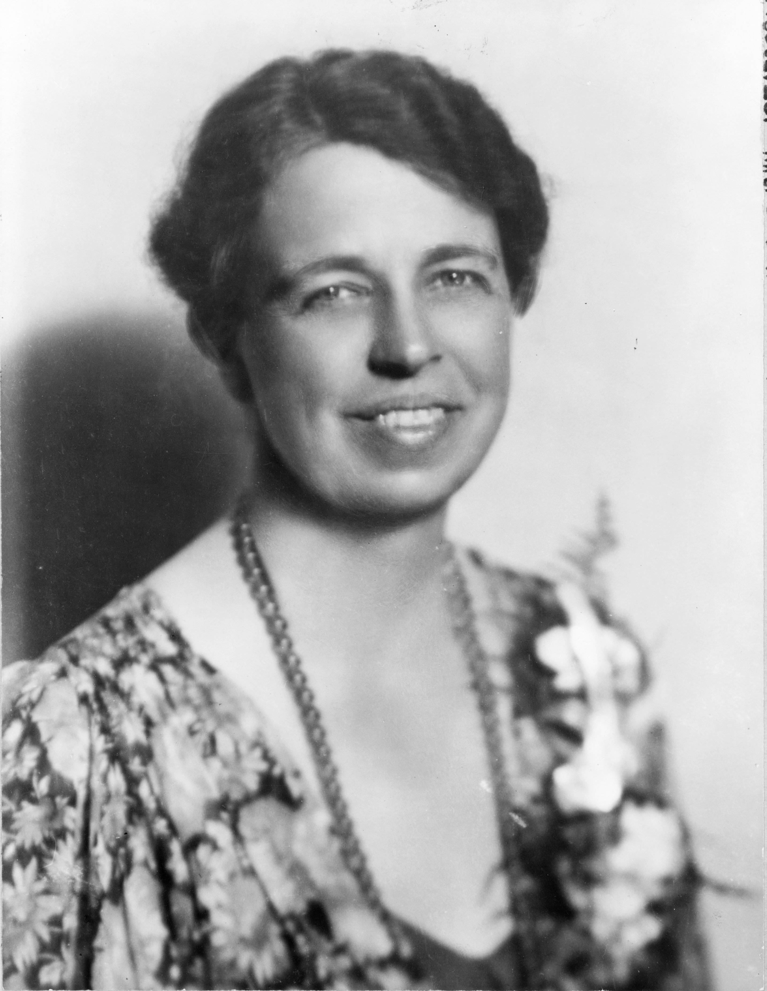
Major Themes
The decade of the 1930s saw the greatest financial crisis that both America and the world had ever seen up until that time. Its effects dramatically altered daily life, families, communities and society as a whole.
The New Deal brought hope and industry back to millions of Americans and permanently changed the way many people viewed the role of the government in society. Many Americans also opposed the New Deal, either because they felt it went “too far”, or “didn’t go far enough”.

Slide 4
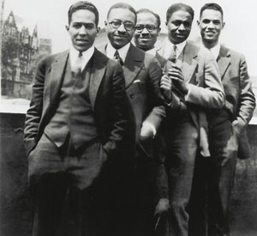
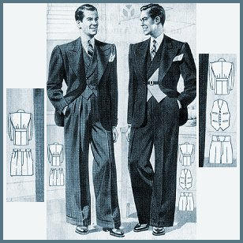
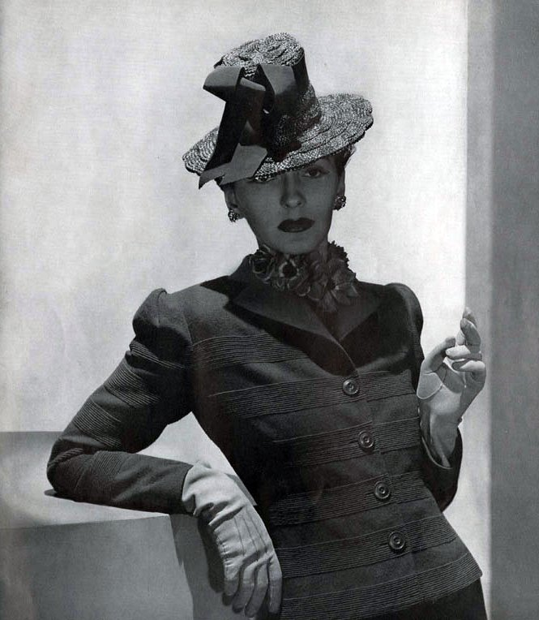
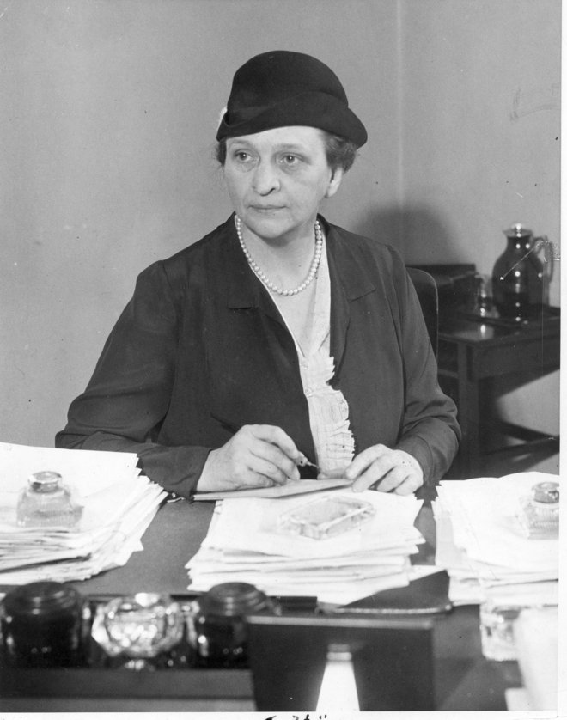
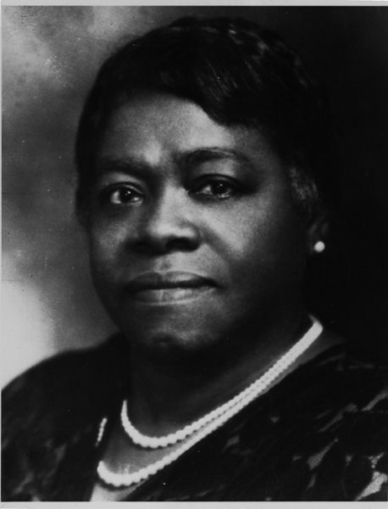
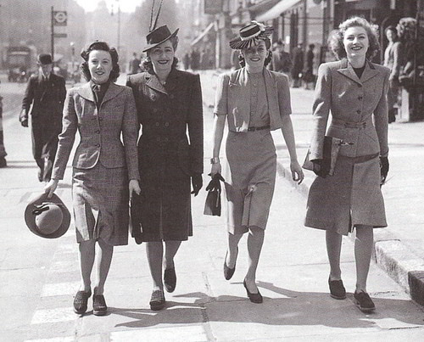
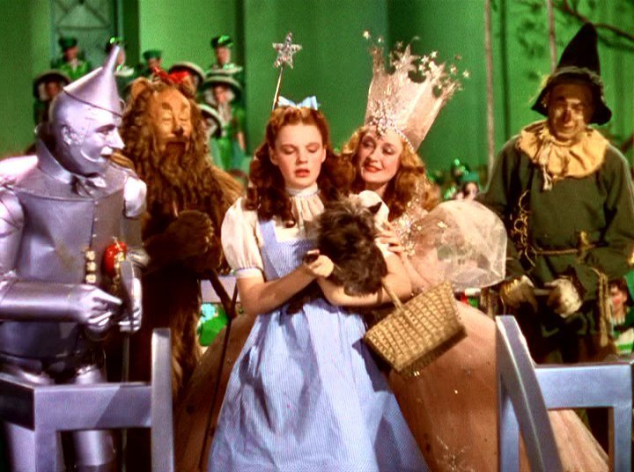
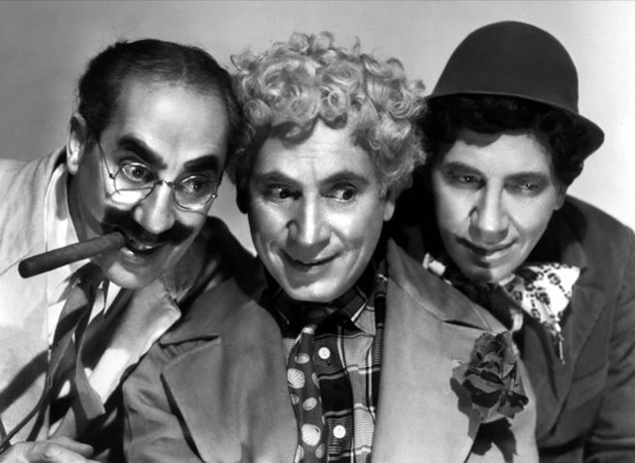
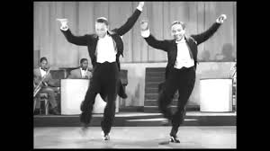
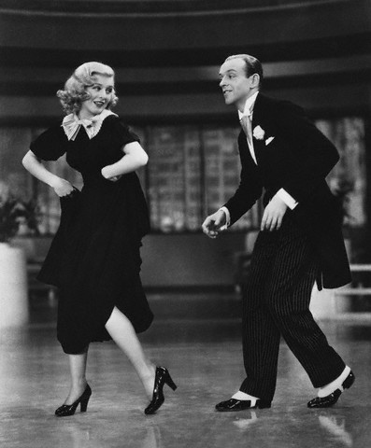
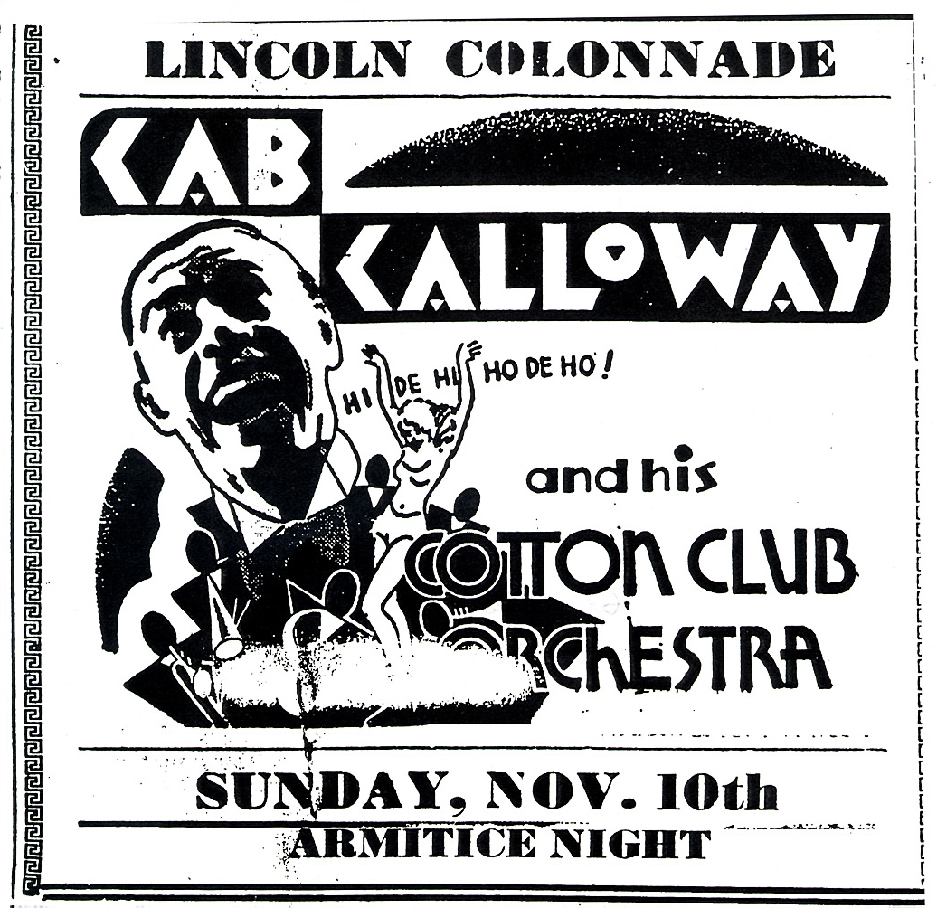
Major themes (cont’d)
Attitudes about politics, economics and social relations began to change. Ideas like socialism, and a heightened level of involvement by the federal government in the lives of ordinary Americans, and the responsibility of every American to be “part of the solution” became much more accepted.
Pop culture during the 1930s served as ‘escapism’ as well as entertainment. The grim reality of most people’s lives made them want to be entertained by movies, radio programs, music, and dancing.

Slide 5
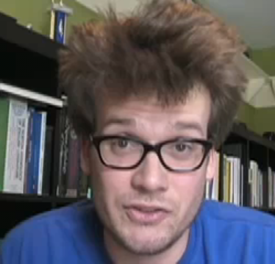
Crash course u.s. history: #33
Watch the following video and answer questions on the accompanying worksheet:
https://www.youtube.com/watch?v=GCQfMWAikyU
NOTE: YOU DO NOT NEED TO HAND IN THESE ANSWERS, JUST MAKE SURE YOU HAVE THEM IN YOUR NOTEBOOK FOR STUDYING PURPOSES.

