Slide 1
Immigration, Urbanization and Technological Advancement
(1870 – 1900)

Slide 2
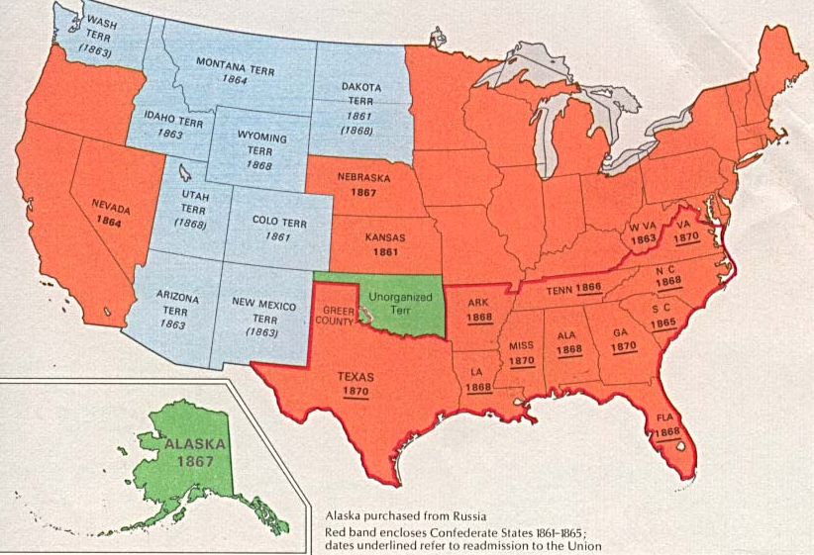
USA in the Gilded Age: 1870-1900
The North:
As a result of the industrial revolution, the Northeast U.S. experienced mass immigration, & urbanization

Slide 3
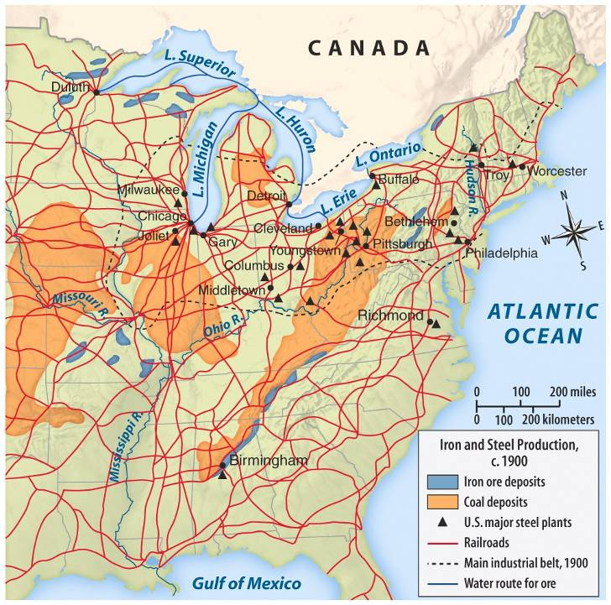
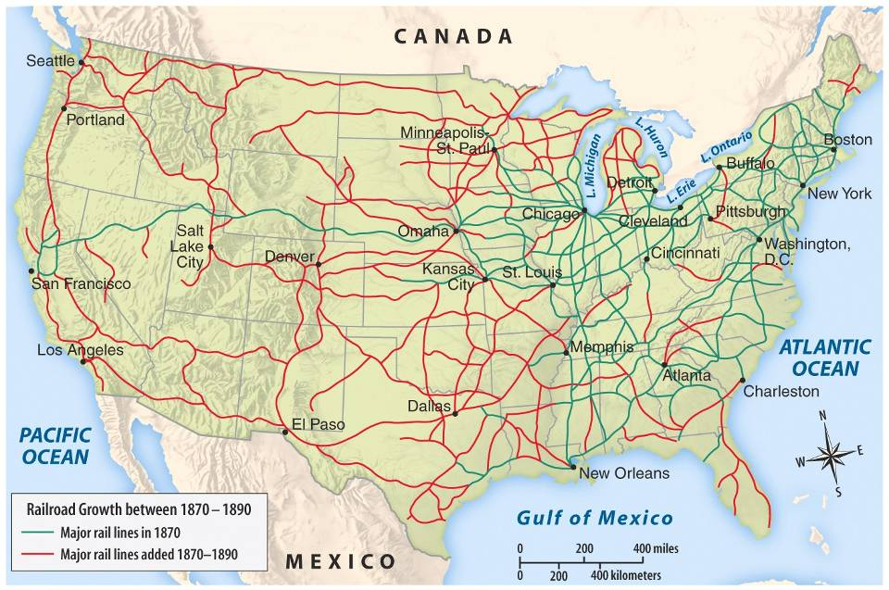
America became the world’s leader in railroad, steel, & oil production. Began to attract many immigrants looking for work, and perhaps a better life.

Slide 4
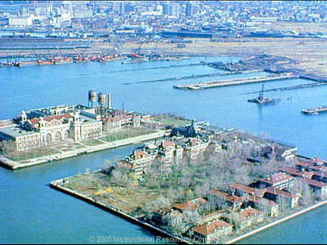
After 1892, Ellis Island was the primary receiving port for European immigrants. Asian immigrants were primarily processed at Angel Island in the San Francisco Bay.
During the Gilded Age…
-Ellis Island: 500,000 immigrants per year
12 million between 1892 and 1954
-Angel Island:
Spotty records - little more than 1 million between 1910 and 1940
https://www.youtube.com/watch?v=5rz5whByOts
https://www.youtube.com/watch?v=eH2hllmZdRg
Notes:
Ellis Island a primary U.S. immigration port.
An aerial view of Ellis Island, which served as a primary U.S. immigration port from 1892 to 1954. From 1855 to 1892, immigrants who reached New York had arrived by ferry at Castle Garden, where many of the admission procedures were designed to protect immigrants from exploitation and hardship. The explosion of immigration in the 1880s created the need for a more systematic processing center for the millions of newcomers. The Bureau of immigration, created in 1891, had a changed responsibility: to develop admission procedures that would weed out undesirable immigrants. New facilities were needed to carry out the required inspections, and Congress in 1890 authorized the construction of a new processing center on an abandoned Civil War munitions storage site close to the New Jersey shore. The original wooden building burned in 1897, and was replaced by a complex of red brick buildings completed in 1901.

Slide 5
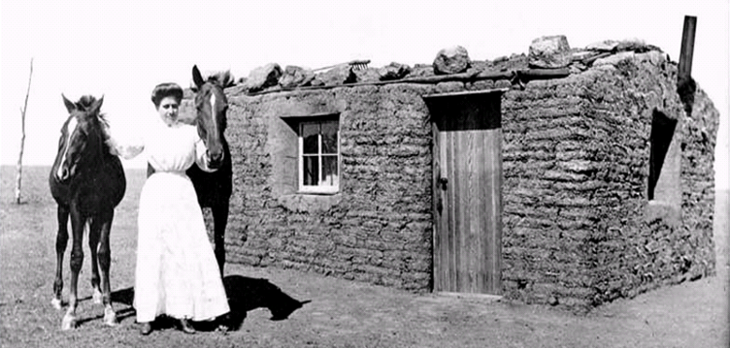
Government supports settlement
In 1862, the U.S. government created the Homestead Act which encouraged farmers to settle in the West by offering 160 acres of land to families who committed to living there for at least 5 years.
A pioneer sod house

Slide 6
“Go west, young man!”
Between 1862 and 1900, about 600,000 families responded to the opportunity offered by the HOMESTEAD ACT.
The West was very diverse. By 1900, between 40% and 50% of settlers were foreign-born (mostly Irish, German and Mexican) and western residents included approximately 40,000 EXODUSTERS (black Southerners who left the post-Reconstruction South for Kansas, and later, for the West)
Settlers/farmers, however, faced similar issues that Native Americans did: competition with speculators, companies meant that ultimately, only 10% of the land was actually settled by the families for whom it was intended. Additionally, not all plots were of equal value or quality
1889 – Government strengthened the Homestead Act to try to encourage more family settlement (relaxed restrictions on “sooners”, opened up 2 million acres in Oklahoma territory for settlement). Unfortunately, this land was taken from Native Americans in the Indian Appropriations Act.
Oklahoma Land Rush of 1889: Began at 12 noon on April 22. 50,000 people showed up to claim land!
https://www.youtube.com/watch?v=h3BQg9qeT3c
"At twelve o'clock on Monday, April 22d, the resident population of Guthrie was nothing; before sundown it was at least ten thousand. In that time streets had been laid out, town lots staked off, and steps taken toward the formation of a municipal government.“ -Harper’s Weekly

Slide 7
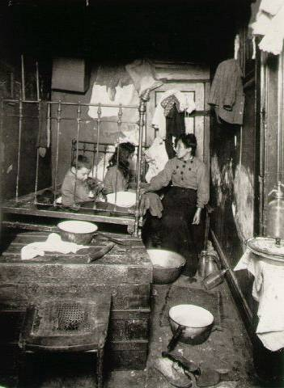
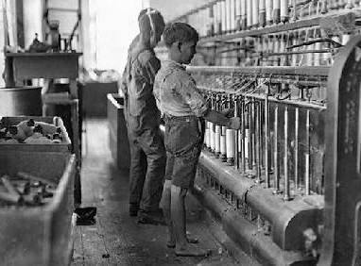
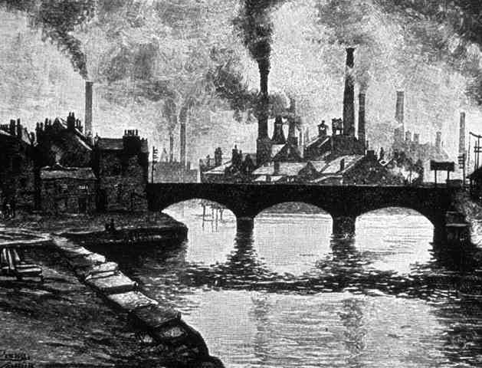
Working & Living Conditions in Urban Areas

Slide 8
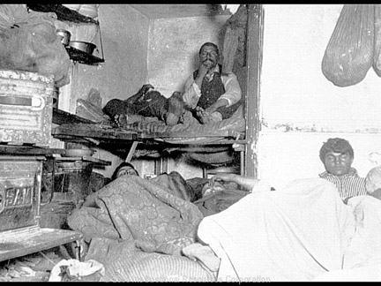

Slide 9
Populations in the United States
1870: U.S. population is 38,558,371
1900: U.S. population reaches 76,212,168
Urban population increased from 10 million to 54 million between 1870 – 1929
19th century technology boom led to increased industrial strength and many new jobs for unskilled laborers
Massive immigration soon overwhelmed city resources and infrastructure

Slide 10
Early Urban Problems
Inadequate housing
Poor water quality
Poor sanitation
Crime
Major fire risk

Slide 11
Technological or Engineering-based Solutions
Mass transit (streetcars by 1870s), subways by 1890s
Water filtration, 1870’s (and chlorination by 1908)
Sanitation (development of sewer lines)
Skyscrapers (Louis Sullivan – Wainwright Building (1891)
Suspension bridges
Urban planning (Daniel Burnham, Architect/Urban Planner)
Reform-Based Solutions
-Settlement houses: temporary shelter and services primarily for homeless or recent immigrant women and children.

Slide 12
Other Impressive Technological Advancements and Innovations: It’s starting to look a lot like the 20th century!!
Double-sided, high-speed printing press (1890)
Daily news was more current and more regularly distributed
Airplanes and flight (Orville and Wilbur Wright – 1903)
A revolution in transportation and military possibilities
Automatic photography and the hand-held camera (George Eastman – 1888)
“Democratized” the camera, made it easier to use, required no skill, and made photography much more efficient
Photography and images exploded in public life and media

