Slide 1
Gavrilo Princip: Exploring Historical Figures

Slide 2
Introduction:
It would have been incomprehensible, at the turn of the nineteenth century, to believe that the actions of one man could set in motion a series of events that would reverberate through history for the next nine decades. Yet when Gavrilo Princip (1894-1918) stepped in front of the automobile carrying Archduke Franz Ferdinand and his wife, the Duchess Sophie, putting two bullets into their bodies and killing both, that is precisely the path on which he sent the world.

Slide 3
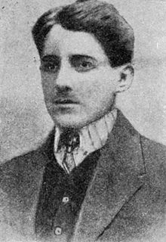
Early Life
Born in Ottoman-controlled Serbia, in what is now known as Bosnia
Very poor family
Attended school in Sarajevo, excelled classmates from richer backgrounds
Began to become radicalized in his mid-teens, during his high school years

Slide 4
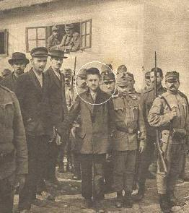
Radicalization
After leaving school, Princip joined the “Young Bosnians”, and shortly afterwards, the “Black Hand”.
By 1912, Princip was receiving training as a terrorist. In spite of his continually ill health, he was considered very promising by the organization’s leader, Major Tankosic, who considered Princip to be a strong personality with good leadership qualities.
In addition to the militia and firearms training, and the indoctrination he received, the lessons he learned as a result of his association with these organizations is clear from a statement given at his trial:
"I am a Yugoslav nationalist, aiming for the unification of all Yugoslavs, and I do not care what form of state, but it must be free from Austria.“
It began to become clearer to Gavrilo that the only way to achieve this goal was to eliminate a major Austro-Hungarian official, or member of the Hapsburg royal family

Slide 5
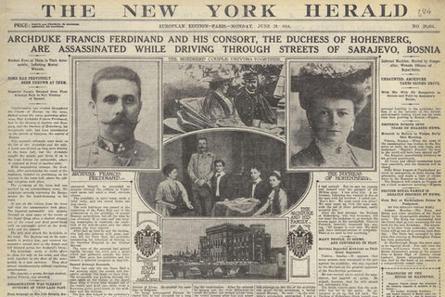
The Assassination
During the 2-year period leading up to the assassination, relations between Austria-Hungary and Serbia became more and more critical
When it was learned that Archduke Franz Ferdinand would visit Sarajevo to review the army, Gavrilo was handpicked by General Tankosic to lead the assassination attempt - largely owing to his leadership abilities, strong character, and marksmanship.
Princip led a team which included five other black hand members, but due to pure circumstance, it was Princip himself who carried out the assassination
He attempted suicide twice after he was taken into custody

Slide 6
The Trial
Princip, like his co-conspirators, remained loyal to the Black Hand throughout the trial:
Princip expressed no remorse for the crime, with the exception of the death of the Duchess, whom he said he did not mean to shoot.
He was found guilty, but the fact that Gavrilo was 19 years old at the time of the assassination meant that he could not be executed. He was sentenced to 20 years in prison – the maximum penalty allowed by law.

Slide 7
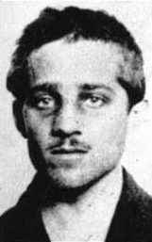
Imprisonment and Death
It was known that Princip was tubercular before entering prison
He was kept primarily in solitary confinement, with the exception of visits to the prison hospital for tuberculosis treatment. The disease spread to his bones, leading to the need for an amputation of his arm.
He died of skeletal tuberculosis April 28, 1918 and was secretly buried in an unmarked grave.

Slide 8
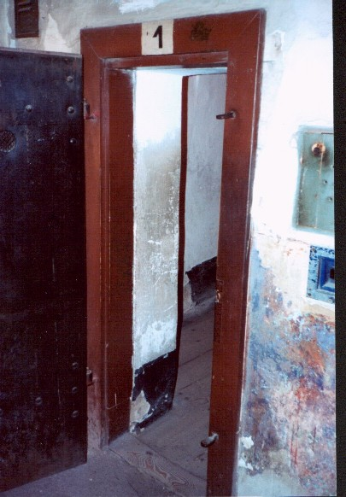
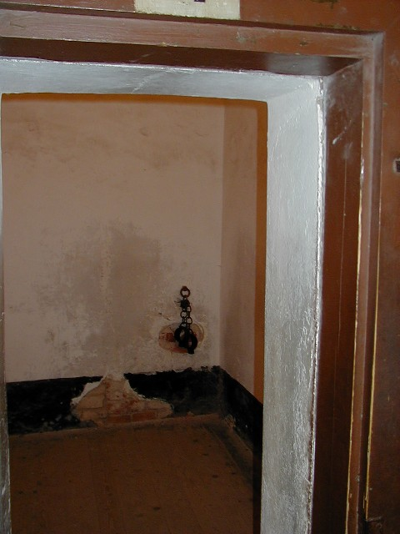

Slide 9
A Century of Warfare
The whole of the twentieth century was sent into a tailspin as a result of two bullets fired from the gun of Gavrilo Princip. The "war to end all wars," World War I, concluded with the Treaty of Versailles, an agreement so punitive to Germany that its reaction fostered the rise of Nazism and led to World War II. The division of Europe at the end of World War II aided in the rise of Soviet Russia and the Communist bloc and resulted in Cold War tensions that persisted until the fall of Communism in the late 1980s and the dissolution of the Soviet state in 1991.

Slide 10
Discussion Questions
Do you view Gavrilo Princip as a freedom fighter? A terrorist? A manipulated child? A foolish young man? Having received some biographical information on him, what opinion of him have you formed?
In what ways are you personally able to empathize with Gavrilo Princip? (Remember, empathizing is NOT the same as sympathizing.)
In what ways can delving into an exploration of people’s motivations enrich our understanding of history?

