Slide 1
Feminism & Gay Liberation
Conflict and Activism
Changing Attitudes Toward:
Gender, Sexuality, Identity, Roles and Rights

Slide 2
Scavenger Hunt:
Collect information from textual sources posted at various locations around the classroom and in the hallway to help answer the following questions:
Questions:
Identify factors that led to the rise of the women’s movement and the gay liberation movement in the 1960s.
What challenges did women and LGBT populations face in the course of these movements?
What lasting impact was created by these movements?

Slide 3
Treatment of American LGBT populations 1940s – 1950s
Targeting of Businesses: the closing of gay bars and businesses that promoted social gathering of the gay community
Anti-gay sex laws
Employment rights infringement
FBI moral perversion investigations and blacklisting: invasion of privacy and harassment
Federal employment restrictions: Eisenhower dismisses “sexually perverse” federal employees
Homophile Movement: Politically moderate and assimilationist movement aimed at spreading awareness of and “normalizing” gay relationships.
Kinsey Reports: begins open discussion about human sexuality which begins to fight stereotypes including those around homosexuality.
Gay Liberation Movement: Politically more radical movement of the 60s which shared commonalities with the Black Power and Women’s Liberation Movements.

Slide 4
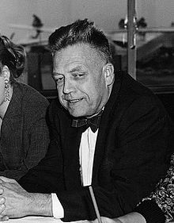
Alfred Kinsey
Biologist (Entmology, Zoology, Sexology) Founded Institute for Sex Research at Indiana University
Kinsey Reports: provoked controversy and were seen as a preview and logical basis for the later sexual revolution of the 60s, which subsequently influenced the women’s liberation and gay liberation movements
“Sexual Behavior in the Human Male” (1948)
“Sexual Behavior in the Human Female” (1953)
Kinsey Scale: used in research to describe a person’s sexual orientation based on their responses and experiences in a questionnaire at a given time of life

Slide 5
Kinsey reports:
Men: 11.6% of males aged 20–35 were given a rating of 3 for this period of their lives. The study also reported that 10% of American males surveyed were "more or less exclusively homosexual for at least three years between the ages of 16 and 55 (in the 5 to 6 range).
Women: 7% of single females aged 20–35 and 4% of previously married females aged 20–35 were given a rating of 3 for this period of their lives. 2% to 6% of females, aged 20–35, were given a rating of 5 and 1% to 3% of unmarried females aged 20–35 were rated as 6.
Rating | Description
0 | Exclusively heterosexual
1 | Predominantly heterosexual, only incidentally homosexual
2 | Predominantly heterosexual, but more than incidentally homosexual
3 | Equally heterosexual and homosexual
4 | Predominantly homosexual, but more than incidentally heterosexual
5 | Predominantly homosexual, only incidentally heterosexual
6 | Exclusively homosexual
X | No socio-sexual contacts or reactions

Slide 6
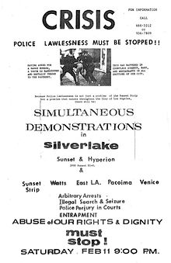
The Beginning of the Gay Liberation Movement (later known as “Gay Rights Movement”)
Early conflicts:
“Black Cat Riot” (L.A. 1966)
“Compton’s Café Riot” (San Francisco, 1966)
“Stonewall Riots” (New York City, 1969)
sparked the creation of gay rights organizations like GLF (Gay Liberation Front) and PRIDE (Personal Rights in Defense & Education) who staged protests and demonstrations to raise awareness
Also led to the creation of new publications like “The Advocate” (now a nationally syndicated publication exploring news and issues relevant to the LGBT community)

Slide 7
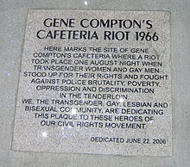
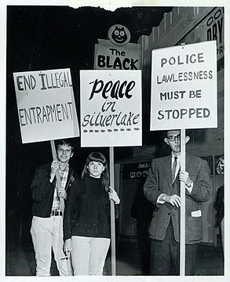

Slide 8
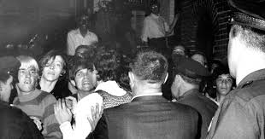
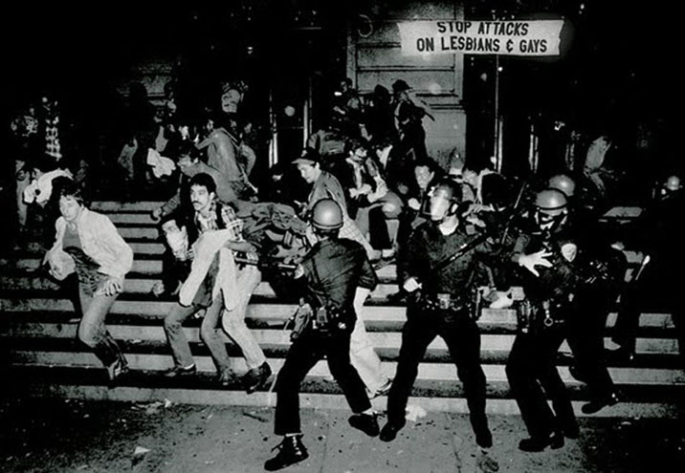
Stonewall Riots (1969)
Police raid on gay bar in New York’s Greenwich Village becomes an aggressive riot, forcing police to barricade themselves and several arrestees inside the Stonewall Inn to defend themselves from angry civilians. The initial raid was followed by subsequent protests and clashes with police over several days. Marked the beginning of the modern “Gay Liberation Movement”.
On the first anniversary of the Stonewall Riots, the first Gay Liberation Marches (later known as Gay Pride Parades) would be held for the first time in cities across the country.

Slide 9
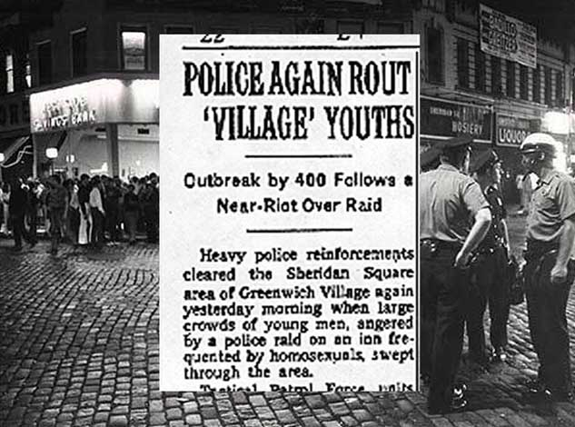

Slide 10
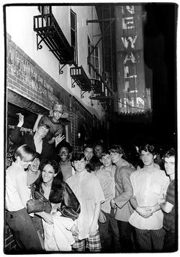
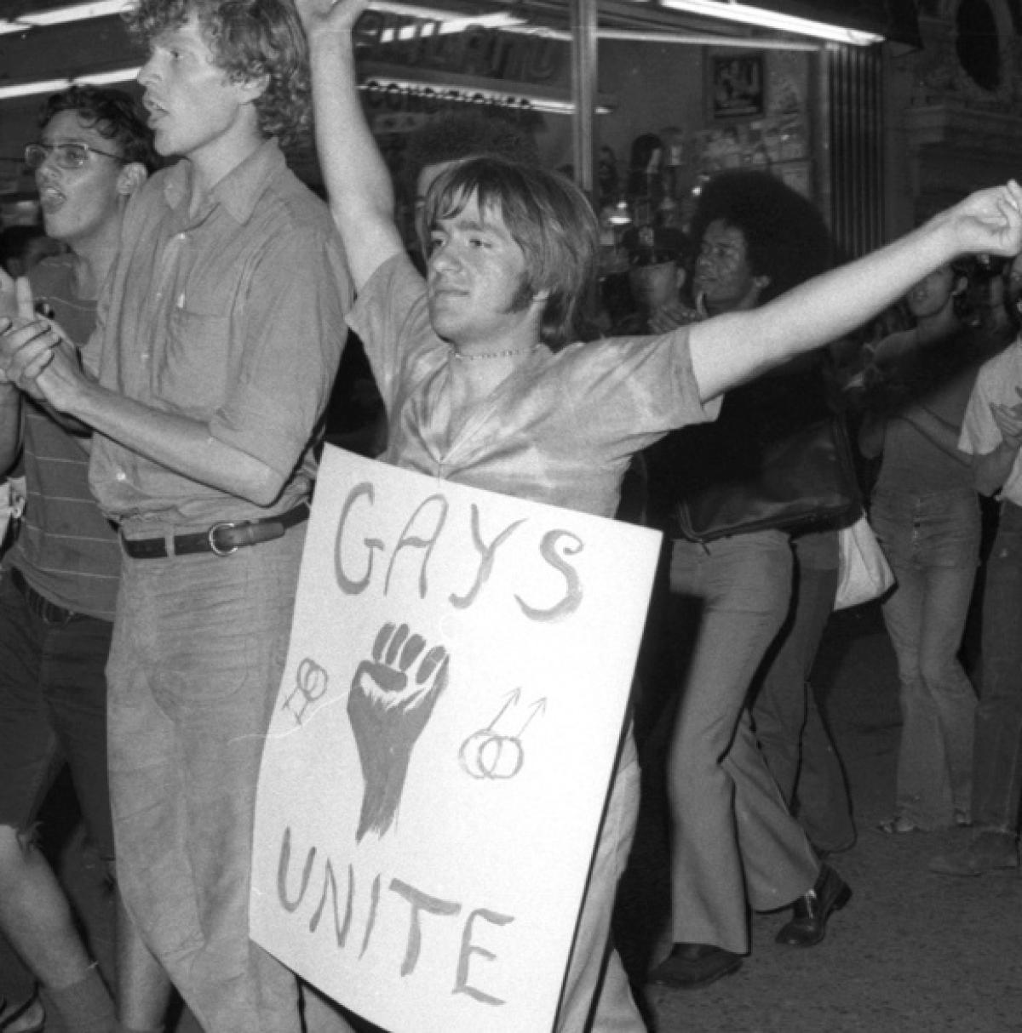
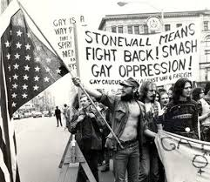
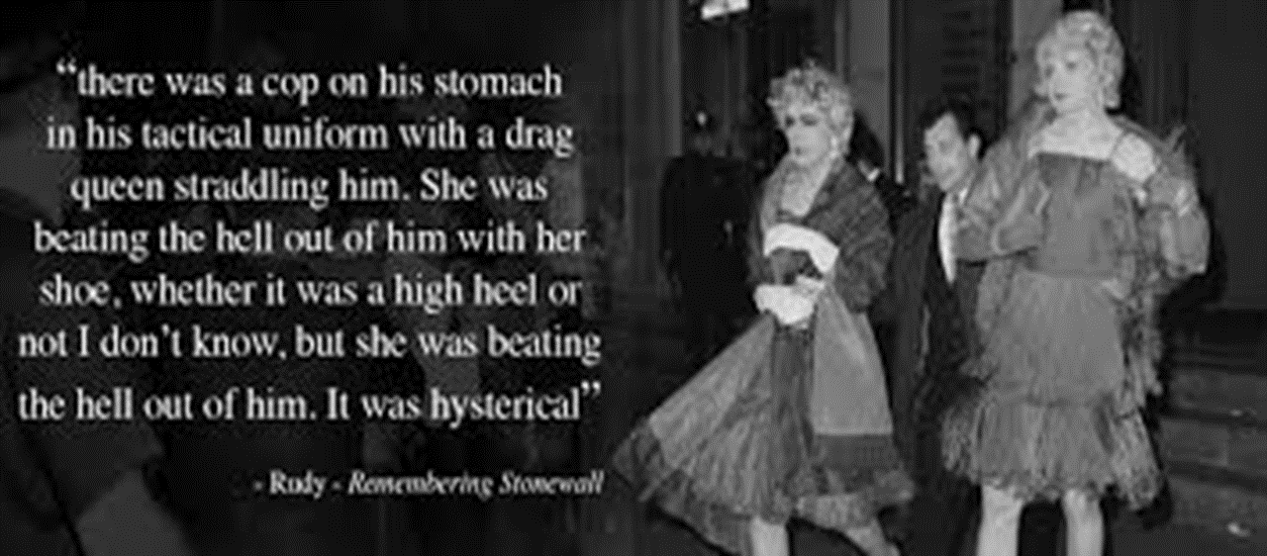

Slide 11
Women Fight For Equality
Main Idea: Through literature, journalism, activism, protests, marches and engagement with Constitutional law, women confronted social and economic barriers in American society

Slide 12
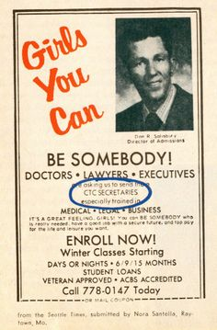
Women in the Workplace
More and more women were entering the workplace in the 1940s, 50s, and 60s
However, many inequalities still existed
Many jobs were considered men’s or women’s jobs – women’s jobs typically paid less (clerical work, domestic servants, retail sales, social work, teaching, nursing)
Women were paid far less than men, even when performing the same work
Women were seldom promoted to management positions, regardless of education, experience, or ability
Kennedy’s administration commissioned a report that publicized these inequalities and alerted many women to them

Slide 13
Women Shut Out
At the same time, women often tried to join movements for equality and freedom (civil rights, anti-war)
Women in these organizations were typically not allowed to assume leadership roles, and were ignored when they raised concerns
In response to this, many women began to organize groups of their own and share their problems with discrimination.

Slide 14
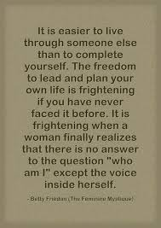
“Is this all?”
In 1957, Betty Friedan wrote The Feminine Mystique
Described a sense of dissatisfaction prevalent among primarily white, middle-class women
The book focused on the contradiction that seemed apparent to many: though society seemed to say that women could obtain fulfillment through home, family, and child-rearing, many women who did were still unsatisfied with their lives
Ignited “second wave of feminism”
Feminism – belief that women should have economic, political, and social equality with men

Slide 15
Movement’s Gains and Losses
Like the Gay Liberation Movement, the Women’s Movement gained strength and inspiration after the civil rights movement
Civil Rights Act of 1964 - Prohibited discrimination (race, religion, national origin and gender)
Equal Opportunity Employment Commission (to address claims of discrimination): many women argued that it didn’t adequately address women’s grievances
NOW – National Organization for Women
Pursue women’s goals including child-care and ending discrimination in hiring

Slide 16
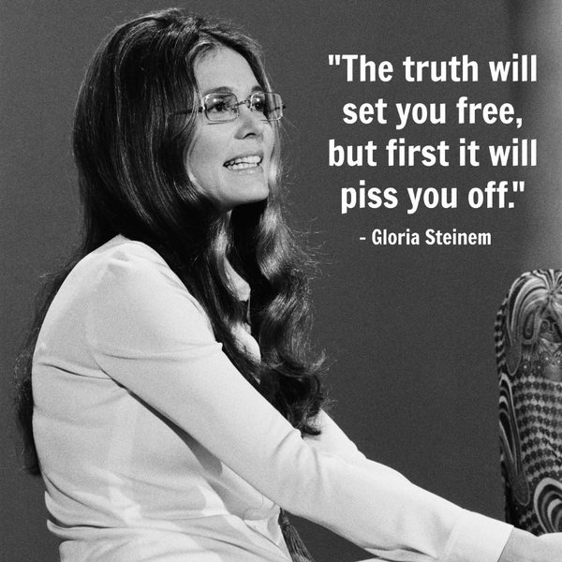
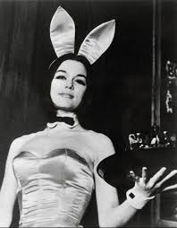
Other Sections of the Movement
The movement had many diverse portions that all worked differently
New York Radical Women – staged a demonstration outside the Miss America Pageant
Threw bras, girdles, wigs, and other “women’s garbage” into a trash can, crowned a sheep Miss America
Gloria Steinem – journalist and activist, helped form the National Women’s Political Caucus, encouraged women to seek political office
Created a new women’s magazine called “Ms.”: examined issues from a feminist perspective
Steinem’s undercover work as a “Bunny” at the Playboy Mansion (1963); highlighted massive sexism and exploitation in employment.

Slide 17
The Movement Grows
As the women’s movement grew, its members began to question all sorts of social norms
Women’s physical appearance as a job qualification (flight attendants, secretaries, etc)
Girls exclusion from traditionally male sports
Some stopped changing their last names for marriage
Many legal changes supported the movement
1972 – Congress passed a ban on gender discrimination in any education program supported by federal money
Congress also expanded financial assistance for daycare for women
Griswold v. Connecticut (1965): Allowed for the legalization of birth control for married couples (struck down the Comstock Law on grounds that it violated Constitutional right to privacy
Roe v. Wade (1973): Allowed for the legalization of abortions during the first trimester

Slide 18
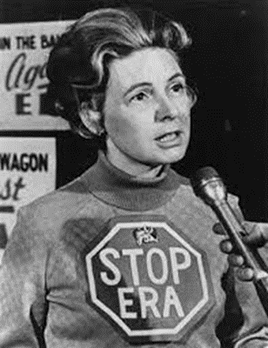
Response to the Movement
Congress passed the Equal Rights Amendment in 1972 (Constitutional guarantee of women’s equality)
This amendment to the Constitution still needed to be ratified by at least 38 states to go into effect
However, the amendment scared many people
Conservative Phyllis Schlafly, along with other anti-feminist groups, felt this would lead to many bad changes
Women drafted into the military
End of laws protecting homemakers
The end of a husband’s responsibility to provide

Slide 19
Conservative Opposition
Conservative opponents of the Equal Rights Amendment organized new “pro-family” movements (pro-life, grassroots initiatives)
This movement became part of the New Right:
The New Right began to build support among conservatives to oppose some of the aims of the women’s movement (ERA, Roe v. Wade)
ERA is struck down:
The New Right continued to organize opposition to the Equal Rights Amendment, and support for it began to waver
By 1977, only 35 of the 38 states necessary for ratification of the ERA ratified it
In June of 1982, the amendment reached its deadline for ratification and failed

Slide 20
Legacy of the Movement
The women’s movement still had many lasting impacts that exist today
Attitudes toward women’s education, careers and traditional roles began to change
Career opportunities for women began to expand, especially in educated and managerial positions, the wage gap begins to slowly close
Women also gained political power by being elected to high political office
Women’s issues also became a centerpiece of political issues, and continue to be so to this day

