Slide 1
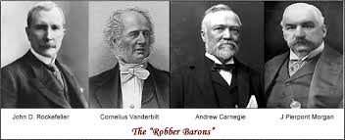
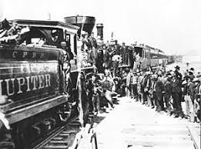
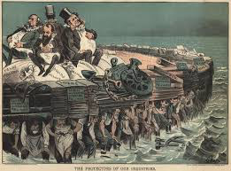
The Gilded Age
The Expansion of Business and Industry
Part 3

Slide 2
Question of the Day:
To what extent would you say that the early labor movements of the Gilded Age were “successful”?

Slide 3
John Green’s “Crash Course U.S. History #23”
https://www.youtube.com/watch?v=r6tRp-zRUJs

Slide 4
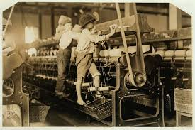
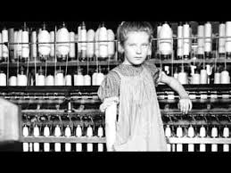
Labor Unions Emerge
In the face of exploitation and unsafe working conditions, industrial laborers joined together to try to persuade employers and legislators to make changes:
12 hour days
No vacation, sick leave
No unemployment compensation
No compensation for injuries sustained on the job
About 35,000 laborers died each year in work-related accidents
Wages were better in the North than in the South, and among the best in the industrialized world, but American families STILL could not survive unless everyone held a job, including women and children
Between 1890 and 1910, number of women in the workforce doubles (4 million to 8 million)
20% of boys and 10% of girls under 15 years of age held full-time jobs
Average wages for unskilled or sweatshop labor (garment industry)
Men: $498/yr OR $1.62/day
Women: $267/yr OR $0.87/day
Children: $81/year OR $0.27/day

Slide 5
Unions Go on Strike!
The Great Strike of 1877: Workers on the B&O Railroad protested their second wage cut in two months. Stopped freight and passenger traffic for over a week. Federal troops ended the strike after several state governors complained that the strike was impeding interstate commerce.
Effect: Employers and government prevailed over the strikers by force; set a pattern for the next half century of labor movements
The Haymarket Affair: protesting police brutality against striking workers. In a bomb attack by an unknown assailant, several police officers were killed and several workers died when the remaining police fired into the crowd
Effect: Began to turn the public against the labor movement

Slide 6
Unions Go on Strike!
The Homestead Strike: Employees at Carnegie Steel went on strike to protest a wage cut. Carnegie Steel hires “Pinkertons” to guard “scabs”. Pitched battle ensues, leaving 3 detectives and 9 workers dead. Nearly half a century would pass before steelworkers would go on strike again.
Effect: Further damaged the reputation of the labor movement and union members in general.
The Pullman Company Strike: In response to the Panic of 1893, Pullman laid off more than half of its workforce and cut wages by 25 – 50%, yet failed to lower rents on company housing or prices in the company store. Eugene Debs (President of the American Railway Union) asked for arbitration, which was refused. The ARU helped the strikers start a boycott. Strike turned violent after Pullman hired strikebreakers.
Effect: Debs was jailed, Pullman fired most of the strikers, and the railroads blacklisted many others to prevent them from working in the railroad industry
Employers and Government Pressure Unions
Large, united underclass of people frightened employers
Found a way to turn the Sherman Anti-trust Act against workers –just had to say that the strike interferes with interstate trade!
Refused to recognize unions, forced new employees to sign “yellow dog” contracts (promise not to join a union)
In spite of these challenges, there were a few concessions in unionized industries over time. Between 1890 and 1915, wages in skilled jobs rose fro $17.50 - $24.00 per week and the average workweek fell from 55 hours to 49 hours

