Slide 1
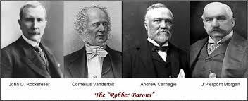
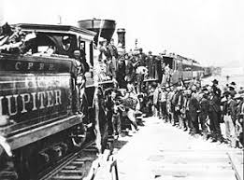
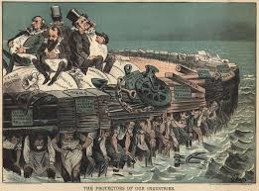
The Gilded Age
The Expansion of Business and Industry
Part 2

Slide 2
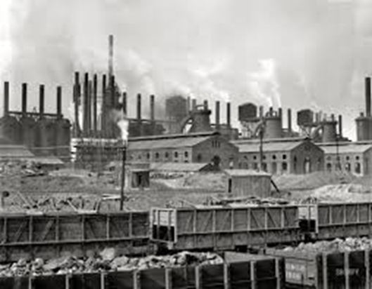
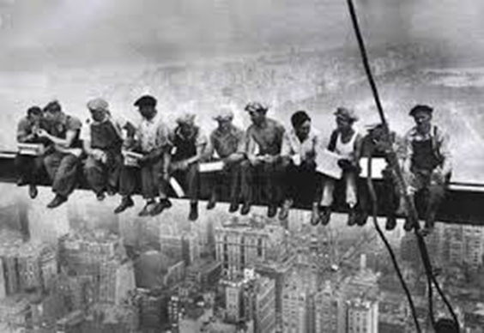
Question of the Day:
What were the advantages and disadvantages of the expansion of industry and business during the Gilded Age?

Slide 3
The Panic of 1893
Railroad overbuilding, shaky financing, corporate embezzlement and fierce competition caused the Panic of 1893 – the worst economic crisis in American history up to that point, lasting 4 years
Philadelphia & Reading Railroad and National Cordage Company, two of the country’s largest employers, collapsed, causing panic in the stock market
Financial firms began calling in loans from business owners who had “overextended themselves”, triggering a series of business failures in the most lucrative industries: railroads, banks and steel mills
15,000 businesses closed
Unemployment soared to 20-25%, homelessness surged

Slide 4
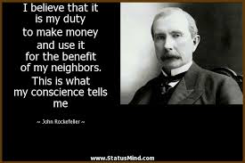
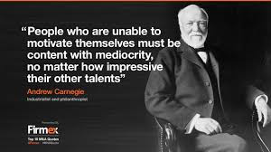
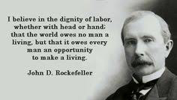
“Robber Barons” or “Captains of Industry”?

Slide 5
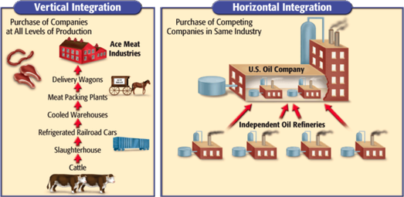
Business Tactics
Streamline production processes (greater efficiency & lower costs)
Streamline administrative processes (latest accounting techniques)
Sell products at a loss until you beat your competitors out of the market, then raise your prices
Engage in philanthropy
Rockefeller created and endowed the University of Chicago, various arts venues, several hospitals and medical centres
Carnegie donated 90% of his wealth to charity upon his death; his fortune is still supporting various charities to this day
Mergers & Acquisitions (horizontal and vertical integration)
Using these two types of mergers, Carnegie and Rockefeller were able to rise to the top of their industries and join the ranks of the world’s richest men

Slide 6
The “Haves” & the “Have-Nots”
Social Darwinism and Business: Riches are a sign of God’s favor, in recognition of one’s honest work ethic. Therefore, poor people must be lazy or inferior, and thus deserve their lot in life.
By 1880, Rockefeller’s Standard Oil controlled 90% of the business in the U.S.
Congress passes Sherman Antitrust Act: has little effect until Teddy Roosevelt’s presidency
This business boom during the Gilded Age bypassed the South, keeping its economy in a stagnant stranglehold
Labor unions began to grow rapidly; by 1900, over 2 million Americans were unionized….

