Slide 1
Economics in the 1920s
Boom and Bust

Slide 2
Major Themes
The American economy, like many aspects of American life in the 1920s, may be characterized as one of contradiction
While prosperity and excess seemed to be providing tremendous growth, this growth was unsustainable and would only truly be reflected in the SHORT TERM
A number of factors that might be seen as part of the “boom” of the 1920s actually contributed to the onset of the Great Depression
Production outpacing demand (leading to an ongoing cycle of falling prices and lost jobs)
Hire purchase (massive extension of credit for new consumer goods)
Tariffs (designed to protect American industry but in fact contributed to long-term decline)
America: the banker of the world (increased linkage and dependency between the American economy and the economies of Europe)

Slide 3
America’s Assets Following WWI
The USA was rich in raw materials such as coal, iron ore, and oil, and had much fertile land
It was the world’s leading industrial nation
It’s population, made up of many different groups seeking new jobs were hard working and ambitious
The early 1900s had seen the movement from rural and agricultural to urban and industrial

Slide 4
Production Outpaces Demand
All over America, excess was the name of the game
Production surged during World War I, and after a short abatement during a recession at the end of the war, America resumed manufacturing and production at the same level as before
This meant that we were making too much of everything, and demand began to drop which meant prices began to fall
Falling prices meant that companies couldn’t pay as many employees and laid them off. Layoffs meant that unemployed workers couldn’t afford to purchase goods, and prices fell further, leading to MORE layoffs
And so on…..

Slide 5
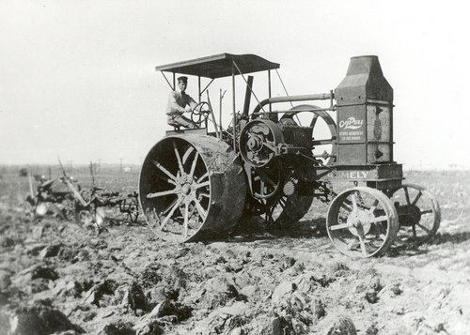
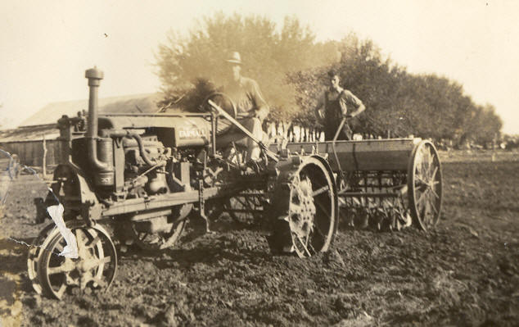
Farming
The War Industries Board (WIB) opened up 40 million extra acres of farmland during World War I to boost food production for the war effort
Increased mechanization and automation reduced available jobs
Overproduction led to falling prices
Farmers laid off workers, many finally lost their farms
Forced to travel to cities to find jobs
Over-farming of the Great Plains stripped away nutrient-rich soil, decreasing the amount of arable land available. Combined with severe drought, this eventually led to the “Dust Bowl” of the 1930s, arguably the worst agricultural/ecological disaster in American history.

Slide 6
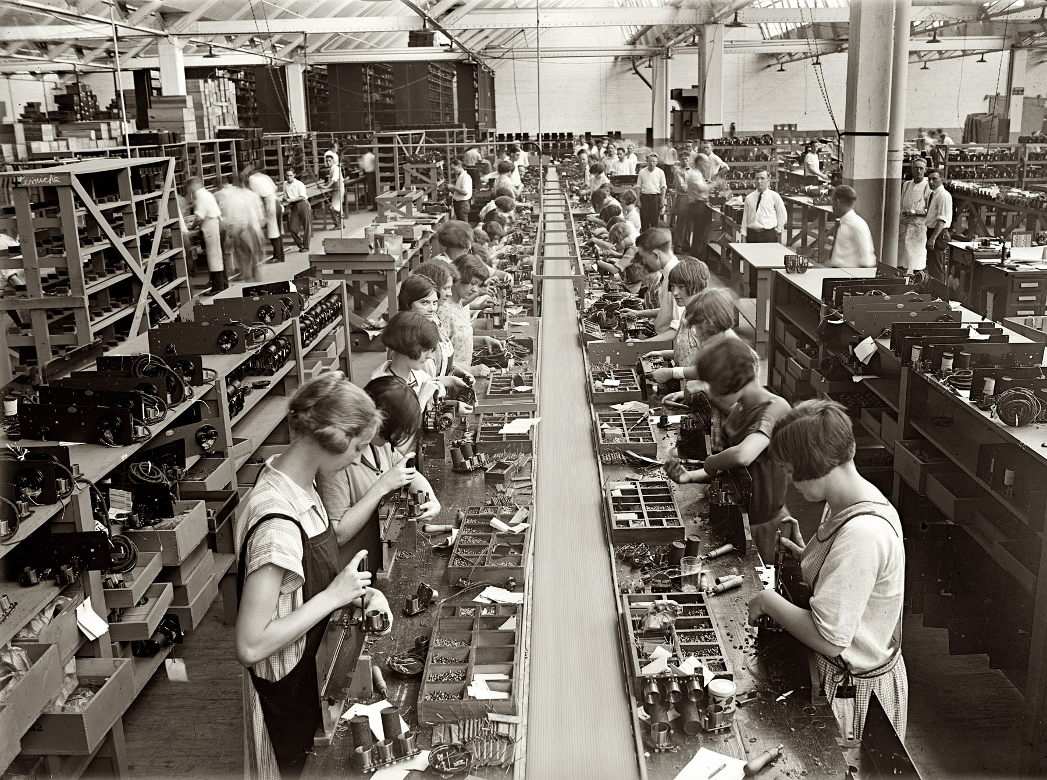
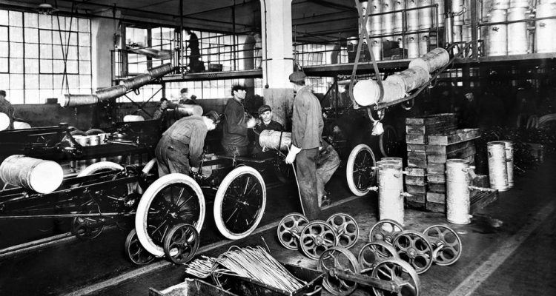
Manufacturing
Widespread adoption of the “Assembly Line” model meant that production soared
By the late 1920s, the U.S. was producing 85% of the world’s cars and 40% of its manufactured goods
Approximately 75% of all manufactured goods were bought using HIRE PURCHASE agreements during the 1920s…

Slide 7
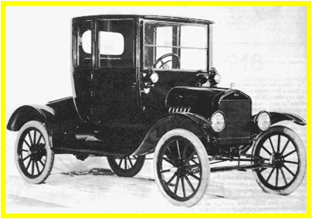
Hire Purchase
The consumer boom was encouraged by the easy availability of credit.
Pioneered by car companies, HIRE PURCHASE agreements enabled consumers to buy the goods they wanted with a small deposit, and then pay the rest off in weekly or monthly installments. 6 out of 10 cars were bought this way during the 1920s.

Slide 8
President Coolidge received a letter from a business owner, detailing his concerns about what he felt was a “fundamental weakness of America’s superficial economic prosperity”…
The business owner related this conversation he’d recently heard on a train:
“Have you an automobile yet?”
“No, I talked it over with John and he felt we could not afford one.”
“Mr. Budge who lives in your town has one and they are not as well off as you are.”
“Yes I know. Their second installment came due, and they had no money to pay it.”
“What did they do? Lose the car?”
“No, they got the money and paid the installment.”
“How did they get the money?”
“They sold the cook-stove.”
“How could they get along without a cook-stove?”
“They didn’t. They bought another on the installment plan.”

Slide 9
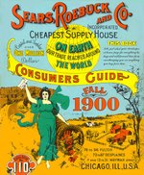
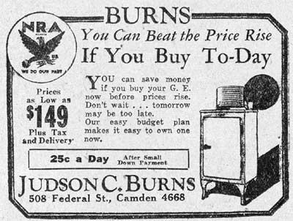
Advertising/Marketing
The advertising industry boomed, with billboards, magazine ads and radio commercials
Combined with the over-extension of credit, it created an economic climate which encouraged the view that EVERYONE could and should have the “American standard of living”.
Another marketing tool was the MAIL ORDER CATALOGUE e.g. Sears, Roebuck Catalogue
People were able to buy these new goods because credit was available, and because both working-class and middle-class incomes rose by an overall average of around 9% during the 1920s whilst prices remained the same or fell.

Slide 10
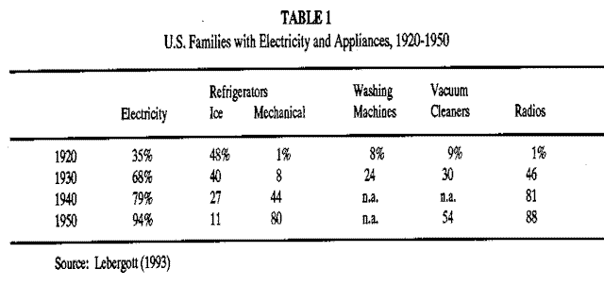
PROSPERITY IN THE USA IN THE 1920S
In just ten years there was a huge increase in production. It has been called the ‘SECOND INDUSTRIAL REVOLUTION’. It was a boom in CONSUMER GOODS, that is goods, which people bought and used themselves.
GOODS
FIGURES OF SALES IN 1919*
FIGURES OF SALES IN 1929*
% INCREASE OF SALES
CARS
9 million
26 million
289%
TELEPHONES
10 million
20 million
100%
RADIOS
60,000
10 million
1667%

Slide 11
Industries in Trouble
Some staple industries that had long been instrumental to the U.S. economy were “quietly” in trouble: seeing lower profits than in several decades.
Coal mining and oil (electricity replaces coal heat and gas lights)
Lumber and construction (less and less new housing built)
Railroads (automobiles and air travel begin to replace train travel and shipping)

Slide 12
Government Policies
Throughout the 1920s, the government aimed to play as small a part in economic life as possible. This is known as LAISSEZ FAIRE economics
The policy was to give big business what it wanted: no regulation or interference
Economists and policy makers believed that if taxes were low, people would have more money to spend and companies would have more money to invest (later known as “trickle-down economics”)
Problems:
Government support programs didn’t exist (which they can’t without a healthy tax base) which meant that losing your job was disastrous for your family
Unions were extremely weak during the 1920s
Corporations were the strongest they had ever been and the least regulated they had ever been
Employers were allowed to use violence to break strikes, and to refuse to employ union members.
Unions were excluded altogether from the auto industry – a major urban industrial employer.
Employers were able to keep wages low and working hours long, at a time when profits were increasing rapidly.
Accelerated the growing gap between rich and poor, worsening the eventual impact of the Great Depression.

Slide 13
Finance and Banking Industry
Both banks and individuals over-extended themselves with loans and credit throughout the decade
Banks often lent more money than they actually had in their vaults
It was not uncommon for individuals, seduced by the possibility of “getting rich quick”, to put up their houses for a loan to invest in the stock market
BUYING ON MARGIN – Many stock traders and investors used this banking practice (paying a small percentage of the stock’s value as a down payment, and borrowing the rest, using the asset itself as collateral)
Major problem: There was virtually nothing of value backing these transactions, and the government placed no controls upon the finance and banking industry….
Moreover, there was more money on loan in the U.S. (8.5 billion) than actual cash circulating throughout the U.S. (5 billion)

Slide 14
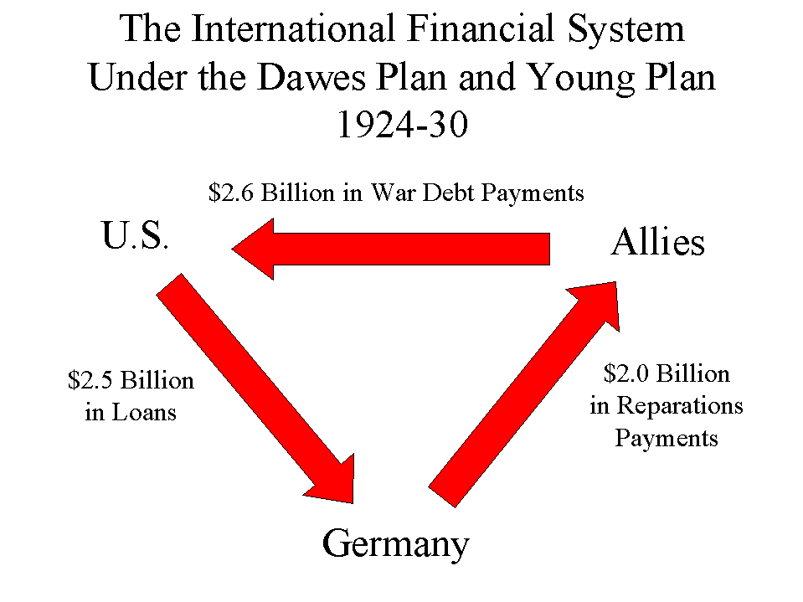
America and the World Market During the 1920s
The American Dollar was now the world’s strongest currency after WWI (replacing the British pound)
The Allies owed the U.S. approximately 12 billion dollars
Increased tariffs meant they couldn’t sell their goods in the U.S. and therefore couldn’t raise the money to pay back their debts
Suggestion: Loan Germany the money they need to pay reparations. Circulating this money was meant to kick-start the economies of Europe.
Germany had unfortunately defaulted on their payments to the Allies during the first year, causing French armies to march in
To defuse the situation and get their money back, the U.S. implemented the DAWES PLAN and YOUNG PLAN
RESULT: HELPED AVOID INTERNATIONAL ECONOMIC COLLAPSE, BUT ALSO INEXTRICABLY TIED AMERICA’S ECONOMIC FATE TO THAT OF EUROPE

Slide 15
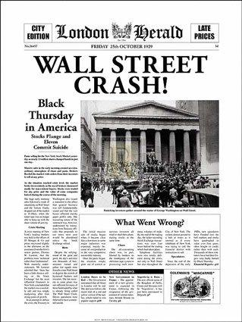
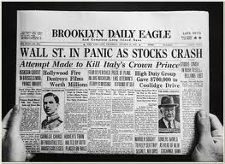
The Crash of ’29: Black Tuesday
The crash of the New York Stock Market was preceded by one that took place in England, one month previously (Clarence Hatry and Associates jailed for fraud and forgery)
Caused traders at the New York Stock Exchange to start trading more heavily. This was problematic not only because many were too nervous to buy these rapidly falling stocks, but also because the more frequently a stock is traded, the more its value decreases
Average trading day in the 1920s: 3.5 – 4 million stocks traded
October 29, 1929: 16 million stocks traded (the market lost $30 billion in 2 days - $14 billion on Black Tuesday alone)
Banking industry leaders and industrialists tried to salvage the situation with new investment, but confidence in the market was fading rapidly and “selling off” only increased for those who had bought on margin
However, it’s very important to note that the crash of ‘29, despite common misconceptions is NOT AN OVERRIDING CAUSE of the Great Depression. It definitely contributed, but it was also a SYMPTOM of the instability of 1920s economics
https://www.youtube.com/watch?v=RN7ftyZigYs&t=1202s

