Slide 1
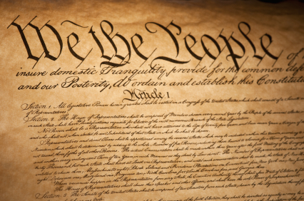
Amending the constitution

Slide 2
-Thomas jefferson
“Each generation is as independent as the one preceding…It has then, like them, a right to choose for itself the form of government it believes most promotive of its own happiness.”

Slide 3
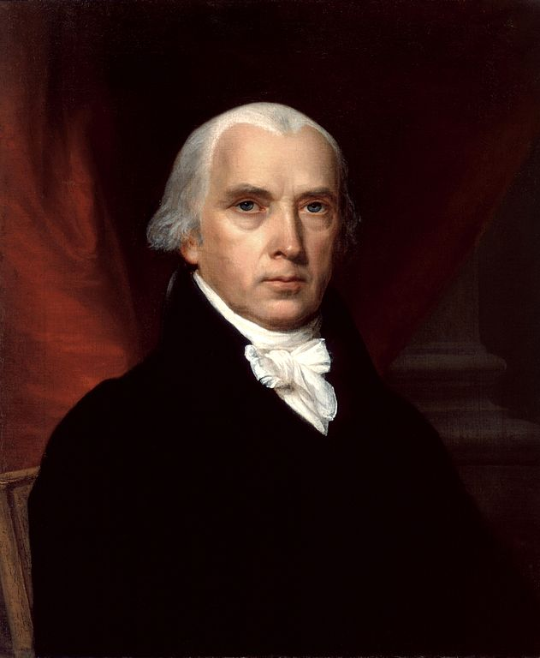
-James Madison
“Would not a Government so often revised become too mutable to retain those prejudices in its favor which antiquity inspires..? Would not such a periodical revision engender pernicious factions that might not otherwise come into existence?”

Slide 4
Amending the constitution
The power to amend (or change) the Constitution comes from Article 5
The founding fathers understood both:
Jefferson’s belief in freedom to make up-to-date, common sense laws, AND
Madison’s fears about the chaos that an easily changeable Constitution might lead to
They therefore DELIBERATELY made the Constitution very difficult to change

Slide 5
Passed amendments
More than 10,000 attempts to change the Constitution have been suggested or proposed in Congress
33 of these have been passed by Congress
Only 27 have been ratified by state legislatures with a supermajority (that is, three fourths, or 75% majority)

Slide 6
What is the process for amending the constitution?
Step 1: Amendment is PROPOSED (2 methods)
Step 2: Amendment is RATIFIED
Result: Amendment is added to the Constitution

Slide 7
Analyze the Constitution and Propose a Constitutional Amendment
Examine the Constitutional amendments closely:
Which two could you “absolutely not live without” and
why?
Which two do you think we could live without and
why? Would you propose an alteration to these
amendments, or propose new ones entirely?

