Slide 1
The 90s and the New Millennium: The Last Thirty Years Part 2

Slide 2
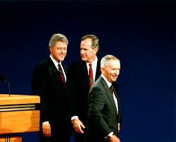
The Election of 1992
Clinton ran a more conservative campaign than a Democrat had in decades, understanding that he had to compete with Republican candidates in Reagan’s America.
“Tough on crime” stance (law and order strategy)
Reform of social programs (making welfare recipients work)
Lower taxes (capital gains and other business-related expenses)
Fiscal conservatism (balanced budget and reduction of the national debt)
Ross Perot (left-leaning “Reform Party”) splits the vote and makes Clinton appear more centrist.
Clinton’s charisma and talent for oration made him a competitive match for Bush, whose popularity had slipped precipitously since his tax increases and hasty withdrawal from the Gulf War.

Slide 3
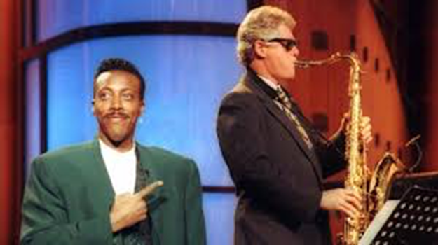
Clinton’s “Hits & Misses”
Foreign Policy: 1993 Oslo Accords (Israel recognized the legitimacy of the Palestinian Liberation Organization)
Yugoslavian Civil War: Clinton convinced NATO allies to intervene in the conflict
Tried to end the ban on gay people in the military; had to compromise with Congress – “don’t ask don’t tell” policy
1993 Health Care Initiative: Hillary Clinton spearheaded a proposal for universal, single-payer health care (rejected by Congress)
Welfare Reform: Personal Responsibility & Work Opportunity Act (1996)
Strong economic record: Unemployment was less than 4% at the end of Clinton’s presidency, GDP was up, there was little to no inflation, the national debt was reduced, and the federal budget even saw a surplus!

Slide 4
Globalization and the “Dot-com” Boom
Brand new lingo enters the English language in the 1990s: “outsourcing” and “downsizing”
In a global economy in which the manufacturing industry was dying and being replaced by less secure, lower-paying service jobs, most of the people prospering were part of the “knowledge” economy.
The IT or “dot-com” industry exploded in the 1990s, producing the longest and most lucrative economic expansion in American history.
https://www.thebalance.com/us-gdp-by-year-3305543
A new wave of manufacturing jobs were created. Because the manufacturing costs of producing for this industry would’ve made products prohibitively expensive if produced in the United States, the manufacturing jobs were often “outsourced” to countries where labor was cheaper.
Many companies outside of the tech industry in the 90s began to follow similar patterns, “outsourcing” their labor and more expensive manufacturing processes to cut costs and “downsizing” their American staff for the same reason.

Slide 5
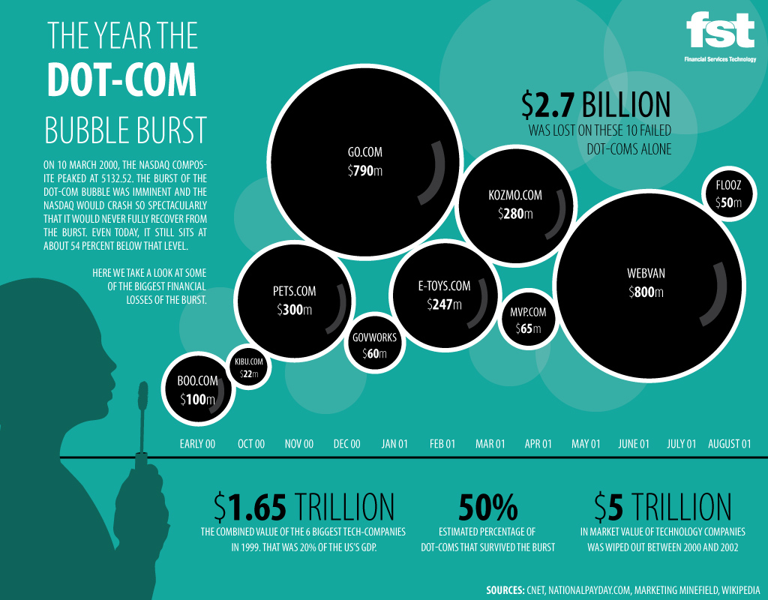

Slide 6
Crash Course U.S. History #45“The Clinton Years” 11:17 – 15:37 What are the main features of what John Green called “The Culture Wars?”
https://www.youtube.com/watch?v=-rboN6F2g-k&t=628s

Slide 7
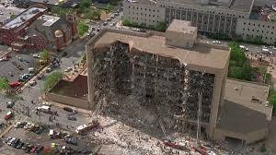
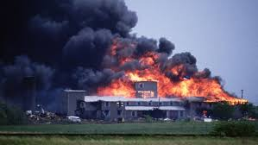
Mass Violence and Domestic Terrorism Begin to Climb
The violent crime wave which began in the 80s and peaked in the mid-90s gave way to more disturbing incidences of mass violence and domestic terrorism.
Concurrently, the police at both the state and federal levels had begun in the 80s to become more heavily militarized. This gave law enforcement the ability to respond to perceived threats at levels of violence that were unprecedented.
1993 World Trade Centre Bombing: Perpetrated by Al Qaeda-affiliated attackers, a truck bomb was driven into the parking garage of the North Tower, and the intent was to bring the tower down in such a way that it would crash into the South Tower, bringing both down. The bombing failed to achieve its objective, but 6 were killed and over 1000 injured.
Ruby Ridge: shootout by the ATF and the FBI at the Weaver family home in Texas (Randy Weaver suspected of stockpiling and modifying weapons for automatic capability)
The Waco Siege: An eschatological cult called the Branch Davidians, led by David Koresh, resisted an FBI and ATF-led siege on their compound for 51 days. The siege featured multiple incidences of armed standoff, and ended in an outbreak of fire. 76 people died in the Waco siege including Davidians, federal agents, and Koresh himself.
The Oklahoma City Bombing: Planned and executed by Timothy McVeigh and Terry Nichols, this bombing of the Oklahoma City federal offices killed 168 people, and was later identified to have been motivated by anger over the previous two sieges (Ruby Ridge and Waco). McVeigh and Nichols were sympathetic to the militia movement (a far-right, armed paramilitary group), which today, has nearly 60,000 members nationwide.
Columbine: In 1999, 17-year olds Eric Harris and Dylan Klebold perpetrated the Columbine High School Massacre, killing 13 people and wounding 24 more before committing suicide.

Slide 8
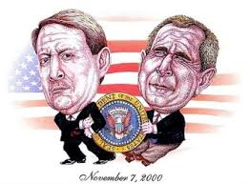
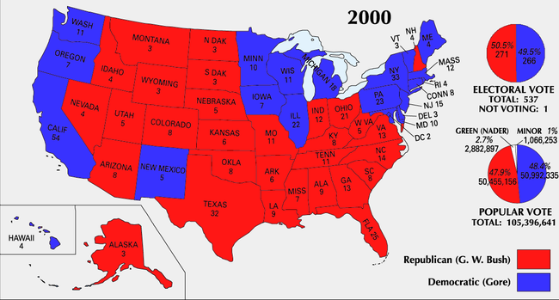
The Election of 2000
Election Night Confusion
Democrats nominated Clinton’s Vice President Al Gore
Republicans nominated Texas governor George W. Bush
Ralph Nader of the Green Party promoted environmental and liberal causes
It was an extremely close race. Florida’s electoral votes were the deciding factor in who would win the presidency
As votes were counted, the lead shifted repeatedly between Gore and Bush
Bush won by a very narrow margin, which triggered an automatic recount
Dispute Rages in Florida
The recount gave Bush a narrow win, but there were alleged voting irregularities in several counties that could’ve changed the outcome
https://www.nytimes.com/2000/11/10/us/2000-campaign-florida-vote-democrats-tell-problems-polls-across-florida.html
The Gore campaign requested a manual recount in 4 Democratic counties
The Battle Moves to the Courts
Republicans sued to stop manual recounts; court battles began (Bush v. Gore)
Supreme Court votes to stop recounts: due to the “lack of uniform standards” in such an unprecedented situation
Bush got all of the electoral votes from Florida (where his brother Jeb Bush was governor), and won the presidency

Slide 9
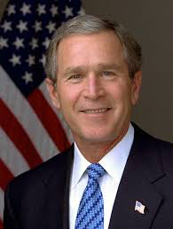
Bush’s “Hits and Misses”
Educational Reform: Implemented the NCLB (No Child Left Behind) criteria at the federal level, making it mandatory for all state education departments
Increased funding for AIDS research and aid to countries particularly hard hit by the disease
No successful terrorist attacks carried out on U.S. soil after 9/11
Medicare drug benefit
Extended tax cuts to all, but especially the wealthiest
Created TARP (Troubled Asset Relief Program) which “bailed” out the banks, insurance companies, and mortgage brokers in the wake of the 2008 financial crash.

Slide 10
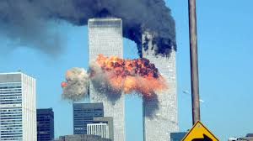
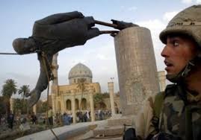
Bush’s presidency began with historically defining events, the effects of which would long outlast his presidential term…
9/11: On September 11, 2001, 4 airplanes were hijacked by terrorists affiliated with a political and religious extremist, anti-American group known as Al Qaeda, and were used to attack the World Trade Centre in Manhattan, and the Pentagon.
The events of 9/11 launched the United States into a War on Terror, which involved:
the creation of new anti-terrorist agencies (Homeland Security) and legislation (the Patriot Act – allowed surveillance and wiretapping of suspected terrorists without a warrant, and the NDAA – National Defense Authorization Act which allowed for civilians, including U.S. citizens to be taken into military detention and imprisoned indefinitely without due process for suspicion of terrorism)
The War in Afghanistan (2001 – Present)
The 2nd Iraq War and the overthrow of Saddam Hussein (2003 - 2011)
The capture and killing of Osama Bin Laden (2011)
Destabilization and the creation of a power vacuum in sections of the Middle-East that has led to the rise of violent sectarian conflict between various religious and ethnic groups, and the rise of violent, anti-Western, Islamic fundamentalism.
https://www.youtube.com/watch?v=mHjH1sl1o9s

Slide 11
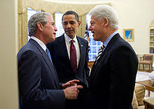

Slide 12
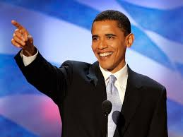
The Obama Years Crash Course U.S. History #47 https://www.youtube.com/watch?v=lUfh2ebjLOg
In your view, what were Obama’s biggest “hits” and “misses”?
Create a two-column chart in your notes and note a few observations in each one
How do you think Obama compares to previous presidents?
In your opinion, what was his most important impact on the presidency and on the country in general?

