Slide 1
The 90s and the New Millennium: The Last Thirty Years -Political polarization -Foreign policy shifts post-Cold War -Increasing global connectedness -Technology, information and media profusion -Economic change, growth, and income inequality

Slide 2
Political Polarization
While historians have argued that the rise of the “conservative tide” during the 70s and 80s continues to grow today, many have also noted a corresponding backlash from liberals and the left against some of the goals of the conservative movement. It is certainly true that throughout the 90s and the New Millennium, many of the old questions were taken out to be interrogated once again:
What should the role and size of government be?
What should America’s role on the world stage be?
How can a “more perfect union” be created?
Are we living up to the standards and values set out in the Constitution? And which interpretation of the Constitution?
Since different segments of American society continued to answer these questions differently, the “pendulum” continued to swing, and in the last 30 years, with increasing frequency from conservative to liberal, then back again over the last few presidencies. Examine the following chart: (timeline of political party dominance)
President | Senate Dominance | House Dominance
Ronald Reagan – 1981 - 1989 (R) | Republican | Democrat
George H.W. Bush – 1989 – 1993 (R) | Democrat | Democrat
Bill Clinton – 1993 – 2001 (D) | Republican | Split (Republicans win in ‘95)
George W. Bush – 2001 – 2009 (R) | Split (dominant party changes during 3 mid-term elections) | Split (Democrats win in ‘07)
Barack Obama – 2009 – 2017 (D) | Democrat | Republican
Donald Trump – 2017 – Present (R) | Republican | Republican
In the 2018 midterm election, the Democrats took back the House and gained seats in the Senate as well, although Republicans still hold the majority by two seats.

Slide 3
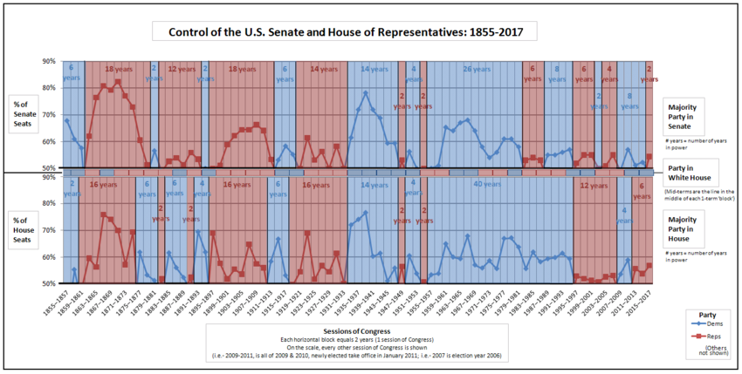

Slide 4
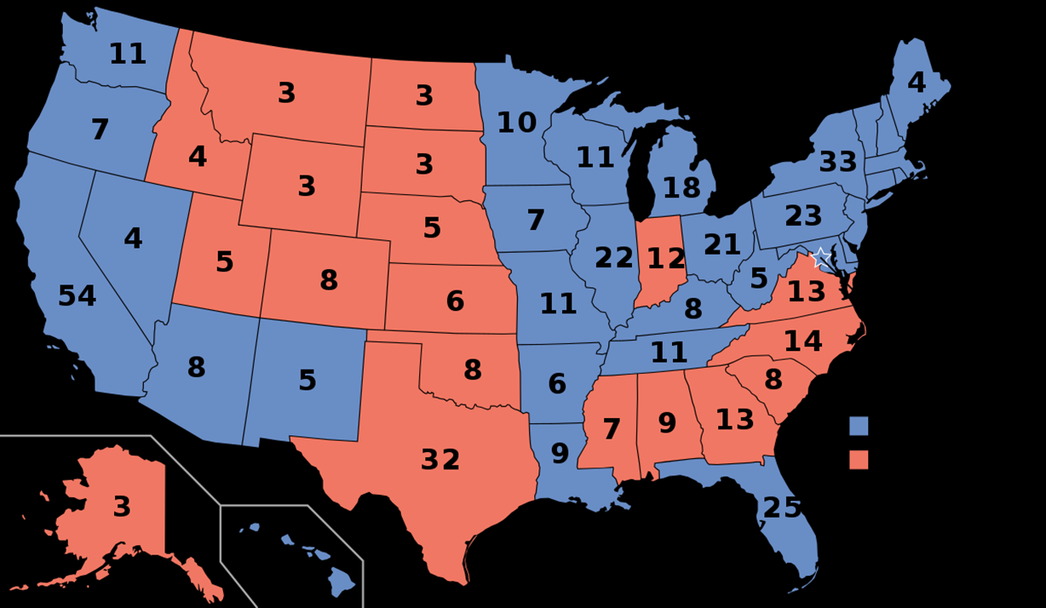
This “pendulum” trend AND the continuing rise of the “conservative tide” can also be observed in electoral maps of the most recent presidential elections 1992 1996

Slide 6
The 2016 Election

Slide 7
An overwhelmingly Republican-leaning electorate does not necessarily indicate the absence of a Democratic voting bloc, and vice versa..…
Key Issues:
Gerrymandered voting districts
“Gutting” of the Voting Rights Act (removing federal supervision requirements)
Incarcerated, formerly incarcerated cannot vote (except in Florida)

Slide 8
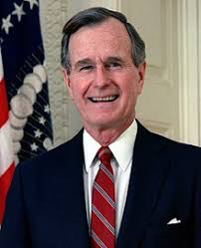
The Bush (41) Presidency
The 1988 Presidential Election
Most middle-class Americans were economically comfortable by the end of Reagan’s presidency, attributing that comfort to Reagan and Bush
Republican candidate George Bush maintains adherence to Reagan’s conservatism
promised “no new taxes”
campaigned on the “tough on crime” (law and order) strategy
Favored the capital punishment, emphasized the importance of 2nd Amendment rights, used the “Willie Horton” ad as part of the Southern Strategy
presented an image of traditional family values and patriotism
Advocated against abortion, pushed for prayer and recitation of the Pledge of Allegiance in schools
Won 53% of the popular vote and 426 electoral votes
Bush’s electoral victory seen as conservative mandate (clear voter support for a conservative agenda)
http://www.youtube.com/watch?v=LToAmI4r6ms

Slide 9
The Gulf War
Iran-Iraq War left Iraq’s leader, Saddam Hussein, with great war debt
In 1990, Iraq invaded Kuwait to annex the country and appropriate its oil resources, threatening U.S. oil supply in Kuwait AND potentially neighboring Saudi Arabia. Kuwait’s invasion was also a violation of the U.N. charter, established after WWII.
Bush & Secretary of State James Baker organized an international coalition
1991, Operation Desert Storm liberates Kuwait from Iraq
Victory parades greet returning soldiers
Under 400 Coalition casualties; 100,000 Iraqi deaths
In spite of widespread opinion that the First Iraq War was a “military success”, Bush was criticized by more conservative war hawks for not toppling Saddam Hussein and withdrawing as soon as Kuwait was free and secure.
http://www.youtube.com/watch?v=l2TQ8a4LK3A

Slide 10
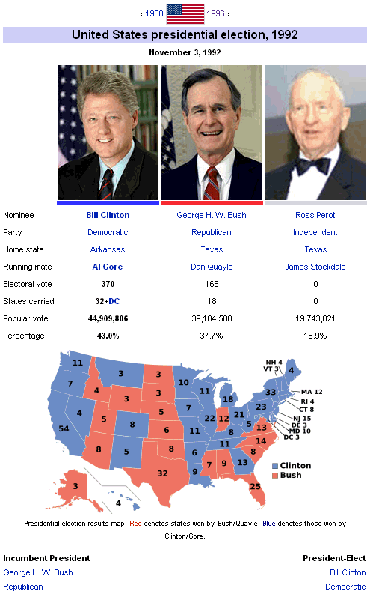
A Second Term?
Bush’s candidacy was hurt by the rising deficit from Reagan’s presidency, and the burgeoning recession of 1990–1992
Forced into a compromise with the Democrat-dominated Congress to raise taxes (top tax brackets, estate tax, capital gains tax) despite campaign promise not to do so
In the immediate aftermath of the Gulf War, Bush had a historic approval rating of 89%. By 1992, his approval rating had dropped from a high of 76% to below 40% and he had lost the support of the Republican party for good.

