Slide 1
Economics in the 1970s
Stagflation & the Energy Crisis

Slide 2
Between1967 & 1973, the demand in the U.S. economy began to stagnate, and inflation & unemployment increased. This condition is known as STAGFLATION, which had several causes:
-Increasing automation
-Competition with foreign trade
-Growing adult population (of working age)
-The “Nixon Shock”
-The OPEC oil embargo against the U.S. and its allies

Slide 3
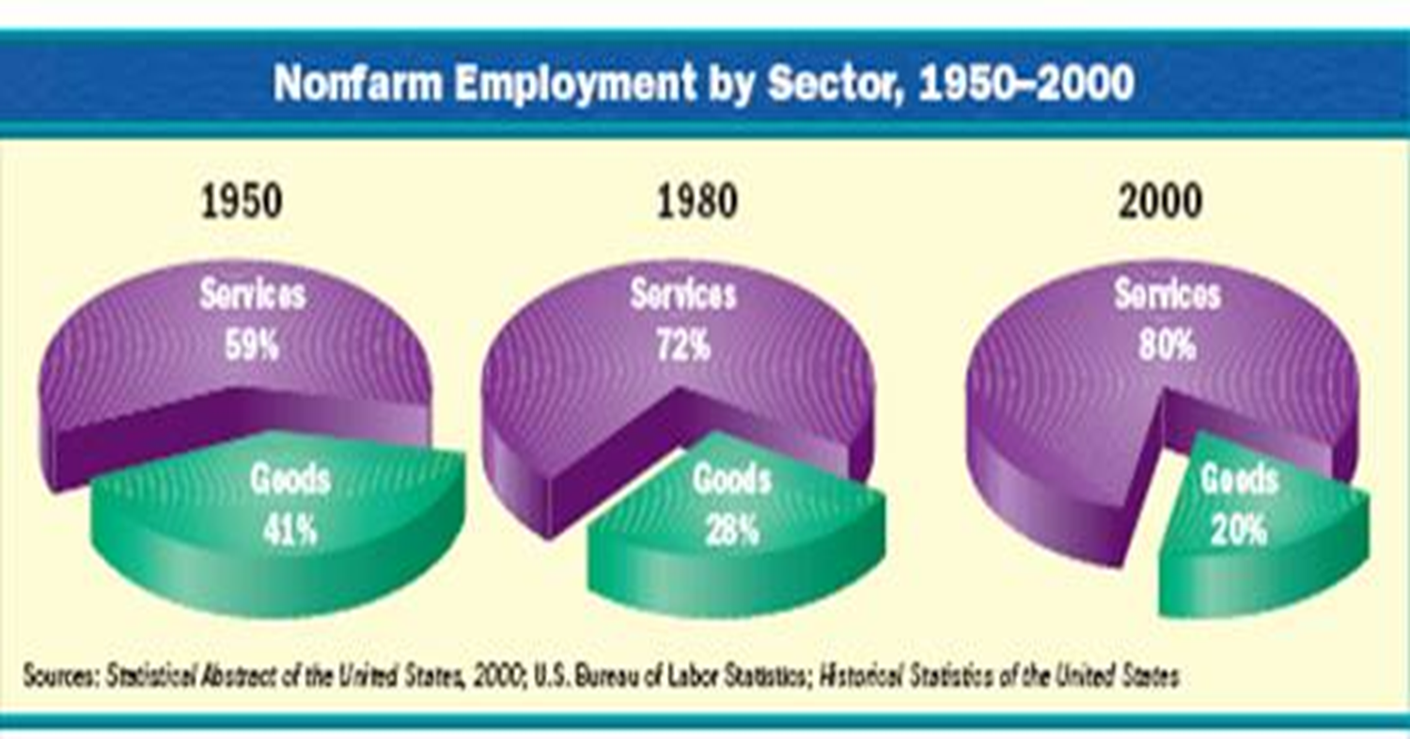
Causes of the Economic Woes of the 70s
The growth of automation caused a decrease in manufacturing jobs over time, increasing unemployment significantly. The majority of unskilled and semi-skilled manufacturing workers were absorbed into the service industry.
The service industry is still criticized for less-than-fair working conditions, wages, benefits, and job protection.

Slide 4
Unemployment also increased because trade competition intensified. As the West German, South Korean, and Japanese economies began to boom in the 70s, this made it harder for Americans to sell their goods overseas. As trade fell, more workers were laid off.
The nation also had trouble finding jobs for millions of baby boomers many of whom had already reached working age.

Slide 5
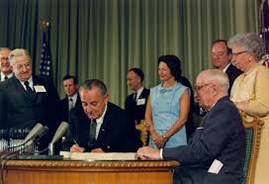
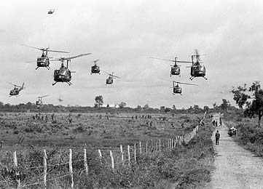
Inflation increased for several reasons. First….
More government spending on social programs during the 60s (the Great Society), and on the war in Vietnam caused deficit spending, which as we know, increases the national debt.
An increase in the national debt…
-drives up interest rates which…
-slows the economy which…
-drives up prices leading to inflation

Slide 6
Second, the “Nixon Shock”
The “Nixon Shock” occurred when the Nixon administration pulled out of the Bretton Woods Accord in 1971. This was an international financial agreement reached toward the end of World War II between the U.S., Canada, Western Europe, Australia, and Japan.
The agreement, among other provisions, required that member countries stabilize their exchange rates to no more than 1% potential variation by tying it to gold (Gold Exchange Standard)
When the U.S. pulled out of the accord, the dollar finally became a true fiat currency (free-floating), and quickly, other member nations followed suit.
Anticipating that the world market would be unpredictable for a time, the U.S. and other nations printed more money reserves, ultimately causing a depreciation in their currencies.
The depreciating U.S. currency compounded the existing inflation and economic stagnation.

Slide 7
Third, was the nation’s dependency on foreign oil. The U.S. received much of its oil from Middle Eastern countries.
Most of these countries belonged to a cartel called OPEC (Organization of Petroleum Exporting Countries).

Slide 8
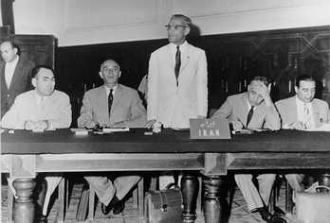
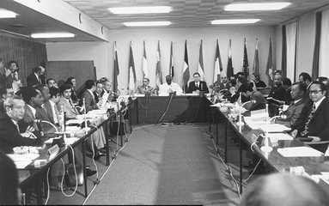
-During the late 1960’s, OPEC gradually began raising oil prices, largely by purposely limiting supply. A great deal of resentment, largely over geopolitical issues (Western support of Israel; economic and resource domination by the West) fueled this increase, but it was modest (no more than 2% per year). -Then, when the Bretton Woods nations pulled out of their agreement in 1971, the oil payments to OPEC shrank significantly due to devalued currencies. -OPEC responded by mandating that payments be made on the Gold Exchange Standard, driving up oil prices and causing the first “oil shock”.
1st OPEC Conference, Baghdad, September 10–14, 1960. At the time, OPEC consisted of 12 countries, largely from the Middle East, but also from Latin America, Africa, and Southeast Asia

Slide 9
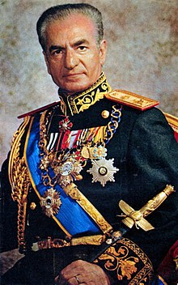
Mohammad Reza Pahlavi, The Shah of Iran
"Of course the price of oil is going to rise... Certainly! And how!... You've [Western nations] increased the price of the wheat you sell us by 300 percent, and the same for sugar and cement... You buy our crude oil and sell it back to us, refined as petrochemicals, at a hundred times the price you've paid us... It's only fair that, from now on, you should pay more for oil. Let's say ten times more."

Slide 10
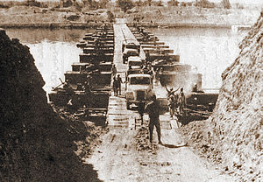
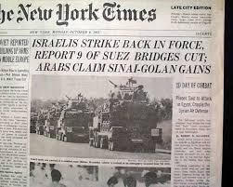
Then, in 1973, the Second Arab-Israeli War broke out, with Israel against Egypt & Syria
The Nixon administration sent military aid to its ally, Israel. Meanwhile, the Soviets backed the Egyptians and Syrians.

Slide 11
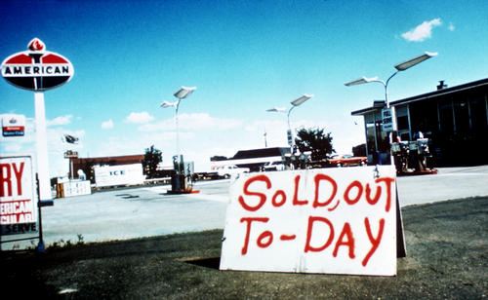
The OPEC nations sided with Egypt & Syria, and imposed an oil embargo on the U.S. and other Western countries.
Between October of ’73 & March ’74, motorists faced long lines at the gas pumps, sold-out gas stations, exorbitant prices, and some factory, business, and schools closures.

Slide 12
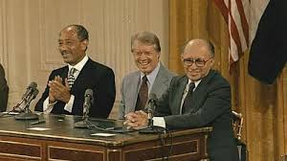
Nixon and his top foreign policy minister, Henry Kissinger, undertook efforts toward energy independence for the U.S. and diplomatic measures to persuade Israel to withdraw from Egypt and Syria.
Kissinger proposed increased research and funding into renewable and nuclear energy, and the development of domestic fossil fuel extraction
Kissinger’s diplomatic efforts convinced Israel to withdraw from Egyptian Sinai and the Syrian Golan Heights
When OPEC started selling oil to the U.S. again, the price had quadrupled, from $3 per barrel to $12 per barrel.
The oil embargo was the first time that international sanctions had ever been placed on the U.S.
Four years later, President Jimmy Carter would foster and oversee the Camp David Accords between Egypt and Israel, a formal peace that resulted in the first recognition of Israel’s statehood by an Arab nation.

