Slide 1
Pop Culture in the 70s and 80s
Fashion, Television, Movies & Music

Slide 2
Fashion
The 70s
The 80s
Bell bottoms
Everyone in pants!
Jeans are the new teenage uniform
Striking, bold looks
Many 60s trends remain:
Bright colors
Loud prints
Short “mod” skirts and longer, more flowy “hippie”-style skirts
Bright, neon or fluorescent colors
Pastel color block outfits
“Flashy” fabrics
Shoulder pads (women)
Workout gear
Teased, crimped or blown-out hair
The Rat-Tail
The Mullet

Slide 3
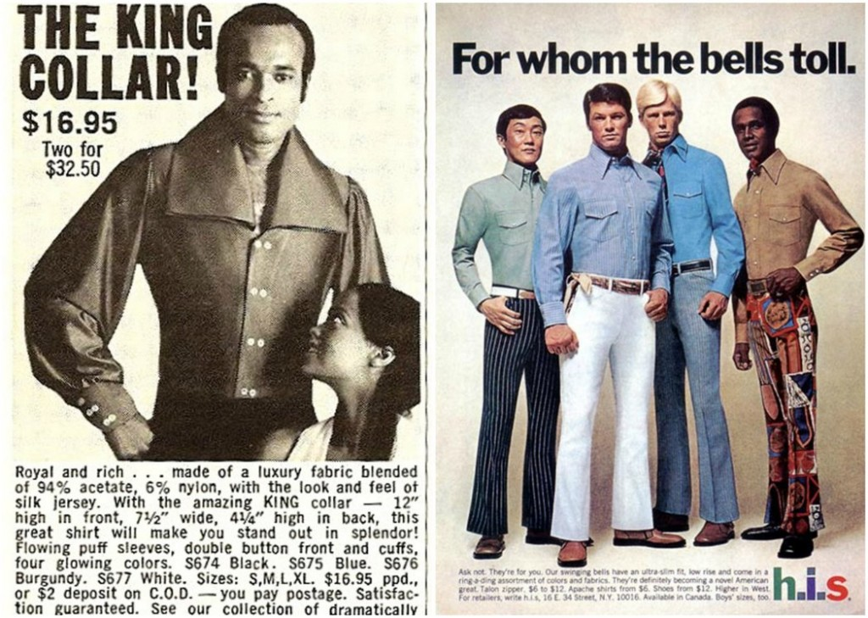

Slide 4
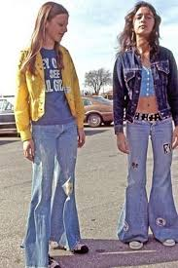
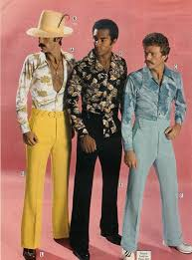
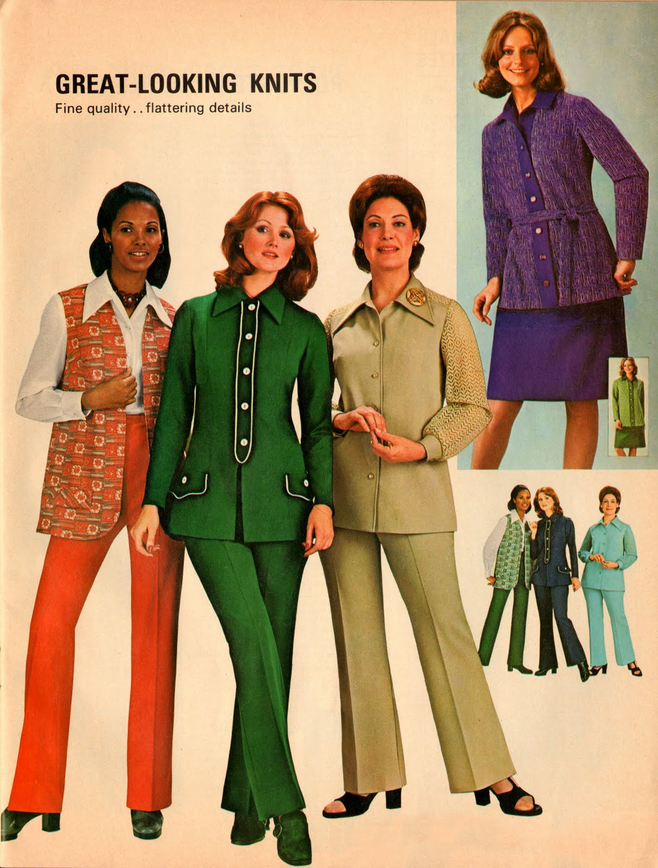
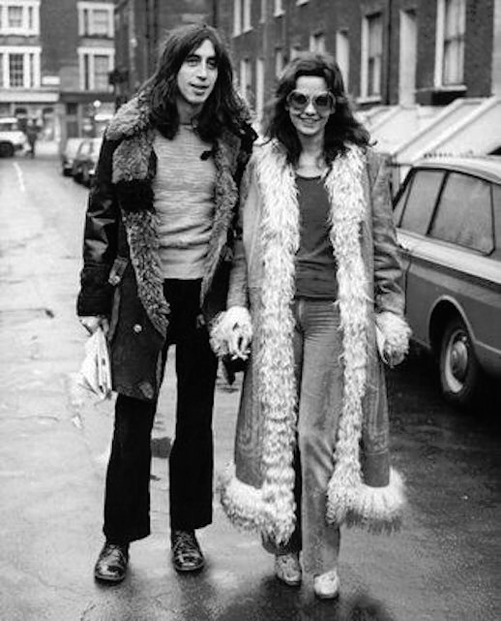
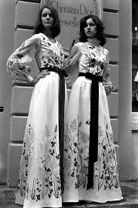

Slide 5
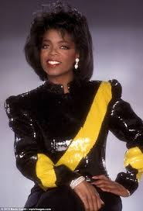
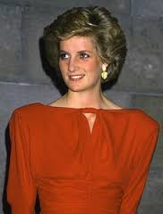
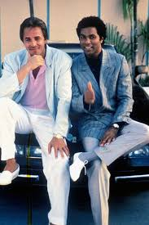
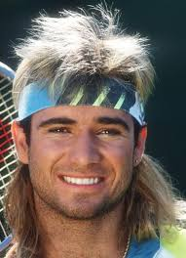
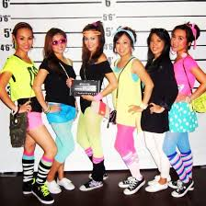
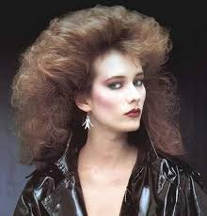

Slide 6
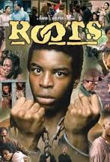
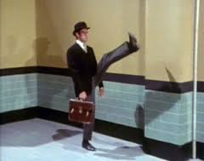
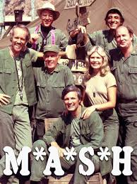
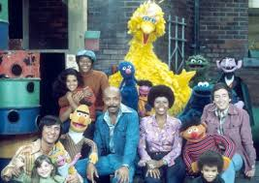
Television in the 70s
Moviegoing audiences shrink still further in the 70s as more people stay home and watch television
“Subscription” TV emerges – with HBO!
Sketch comedy comes of age!
Saturday Night Live
Monty Python’s Flying Circus
Conservative elements long to return to a “simpler” time
Happy Days: https://www.youtube.com/watch?v=6W6y7YhHdVE
Little House on the Prairie
The Waltons
Much more diversity and effort to reflect social trends (civil rights, feminism, anti-war movement)
Roots (100 million watched): https://www.youtube.com/watch?v=TSJUgws9M-E&list=PLNqwHBvKkXKqkbAFry_5HqKg0xnLuYq3M
Good Times
Laverne & Shirley: https://www.youtube.com/watch?v=mRmKzxhMzwo
The Mary Tyler Moore Show
The Jeffersons: https://www.youtube.com/watch?v=L09qnRfZY-k
All in the Family: https://www.youtube.com/watch?v=oV5LQcmuGg8
Sesame Street
M.A.S.H.

Slide 7
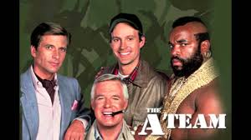
Television in the 80s
Americans began watching more television than EVER before: average of 7 hours per day
Children often “raised” by television: Cartoons began to target kids directly for advertising
Sensationalism: Primetime soap-operas
Dallas (originates the cliffhanger – who shot J.R.?)
Dynasty
The final episode of M.A.S.H. (123,000,000)
Most watched TV event in history next to several Super Bowls
“Cable TV” appears, giving viewers more choice
Law enforcement dramas:
Magnum P.I., 21 Jump Street, Miami Vice, The A-Team, Hill Street Blues
https://www.youtube.com/watch?v=LBIgXhiOpeQ
Sitcoms Evolve:
The Cosby Show
Cheers
Whole channels dedicated to sports (ESPN appears)
MTV emerges: first major television network to focus exclusively on youth culture: https://www.youtube.com/watch?v=djV11Xbc914
Daytime Talk shows: Phil Donahue, Oprah Winfrey (explore relevant social and political issues)
Talk shows degenerate toward the end of the decade: Geraldo Rivera, Jerry Springer
Conservative Values:
The Wonder Years
Family Ties
Full House

Slide 8
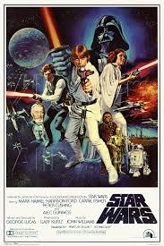
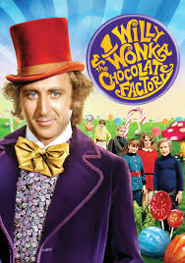
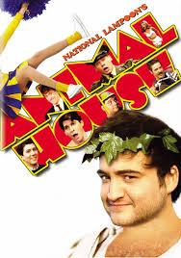
Movies in the 70s
Most popular genres:
Horror – “Halloween” (1978), “Jaws” (1975), “The Exorcist” (1973), “Carrie” (1976)
Science Fiction – “Star Wars: A New Hope” (1977), “Alien” (1979)
Gritty Dramas – Taxi Driver (1976) A Clockwork Orange (1971) One Flew Over the Cuckoo’s Nest (1975), The Godfather –Parts 1 & 2 (1972 – 1974)
https://www.youtube.com/watch?v=B34sntIgI4g
Action/Adventure – Mad Max (1979), Logan’s Run (1976)
For those not into violence or sci-fi…
Musicals, Comedy & Fantasy (oh my!) – “Willy Wonka & the Chocolate Factory” (1971), “Grease” (1978), The Rocky Horror Picture Show (1975), Animal House (1978), Annie Hall (1977), Monty Python & the Holy Grail (1976)
https://www.youtube.com/watch?v=7oKPYe53h78
A brand new genre: the Sports Drama
Sylvester Stallone pioneered a new type of film when he wrote, directed and starred in “Rocky” (1976)
https://www.youtube.com/watch?v=_YYmfM2TfUA

Slide 9
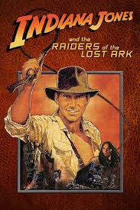
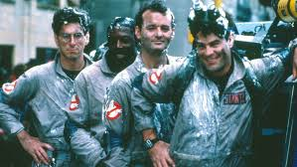
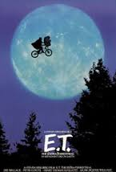
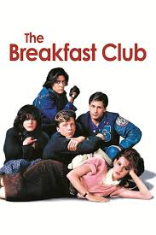
Movies in the 80s
The Movie “Franchise” Begins – The Indiana Jones Trilogy, Star Wars continues.. (The Empire Strikes Back & Return of the Jedi), Back to the Future (parts 1, 2 and 3), Ghostbusters, Mad Max continues…
Back to the Future: https://www.youtube.com/watch?v=Psxktpxkc6o
Violence in film increases to levels which both fascinate and alienate many – Scarface (1983), Nightmare on Elm Street (1984), Friday the Thirteenth (1980),
Action Movies - Terminator (1984), Die Hard (1988)
The “Teen Film” Becomes Its Own Distinct Genre – Ferris Bueller’s Day Off (1986), The Breakfast Club (1985), Fast Times At Ridgemont High (1982)
Ferris Bueller’s Day off: https://www.youtube.com/watch?v=0KFVLWX7eEY&t=26s
The “Coming of Age” Story – “E.T.” (1982), “The Goonies” (1985), “Stand By Me” (1986)

Slide 10
Music in the 70s
Rock Music Evolves
(Metal, Punk, and “Prog” Rock Emerge)
“Dance” Music Returns
(“Discos” pioneer a new style of electronic music)
Rock takes on a “harder”, and in some cases, a more “experimental” edge
The “single” diminishes in importance and the “album” becomes much more important
60s musicians who were influenced by the British Invasion (Joplin, Hendrix, The Doors) gave way to musicians like Black Sabbath, Led Zeppelin, Arrowsmith, and Queen
In the late 70s, a new British Invasion landed in the U.S. – PUNK!
“Anarchy in the U.K.” – The Sex Pistols (1977)
https://www.youtube.com/watch?v=qbmWs6Jf5dc
“Iron Man” - Black Sabbath (1970): https://www.youtube.com/watch?v=8aQRq9hhekA
“Prog” Rockers: David Bowie, Frank Zappa, Pink Floyd
“Ziggy Stardust” – David Bowie (1970):
https://www.youtube.com/watch?v=3qrOvBuWJ-c
Initially, disco (and its cooler cousin, “funk”), featured a full orchestra. As the decade wore on, DJs became more and more like composers and songwriters, allowing disco to become increasingly electronic
This sassy, fun, upbeat, pop music had people “going dancing” once again for the first time in nearly two decades
“Dancing Queen” – Abba (1976)
https://www.youtube.com/watch?v=xFrGuyw1V8s
“Superstition” – Stevie Wonder (1972)
https://www.youtube.com/watch?v=0CFuCYNx-1g

Slide 11
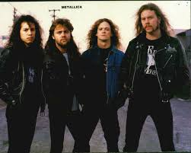
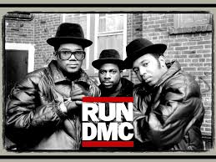
Music in the 80s
Pop Music Explodes! – Michael Jackson, Prince, Madonna, Janet Jackson, Whitney Houston (pop stars now more strongly emphasize dance as a major aspect of performance)
The Return of the “Single”: If the late 60s and 70s were the era of the “Album”, then the 80s was the era of the “single”. Pop movement swells with numerous “One Hit Wonders” – “Take on Me” (A-Ha), “Never Gonna Give You Up” (Rick Astley)
https://www.youtube.com/watch?v=dQw4w9WgXcQ
Music assumes a stronger focus on both the DJ and the electronic composer (use of synthesizers creates new wave of electronic pop
The Music Video Becomes a Standard – any hit song could be that much more hard-hitting with an amazing music video
Metal Matures: The harder rock and punk of the 70s influences a new generation of musicians – Slayer, Pantera, Metallica
Hair Metal: Guns n’ Roses, Van Halen, Twisted Sister
https://www.youtube.com/watch?v=1w7OgIMMRc4
Hip Hop & Rap Are Born – “Rapper’s Delight” (Sugarhill Gang – 1979), “The Message” (Grandmaster Flash, 1981)
https://www.youtube.com/watch?v=mcCK99wHrk0
https://www.youtube.com/watch?v=PobrSpMwKk4
The genre would grow throughout the 80s with many more artists: Biz Markie, Slick Rick, LL Cool J, Run-DMC, Public Enemy, NWA.

