Slide 1
Pop Culture in the 70s and 80s
Fashion, Television, Movies & Music

Slide 2
Fashion
The 80s
The 70s
Bell bottoms
Everyone in pants!
Jeans are the new teenage uniform
Striking, bold looks
Many 60s trends remain:
Bright colors
Loud prints
Short “mod” skirts and longer, more flowy “hippie”-style skirts
Bright, neon or fluorescent colors
Pastel color block outfits
“Flashy” fabrics
Shoulder pads (women)
Workout gear
Teased, crimped or blown-out hair
The Rat-Tail
The Mullet

Slide 3
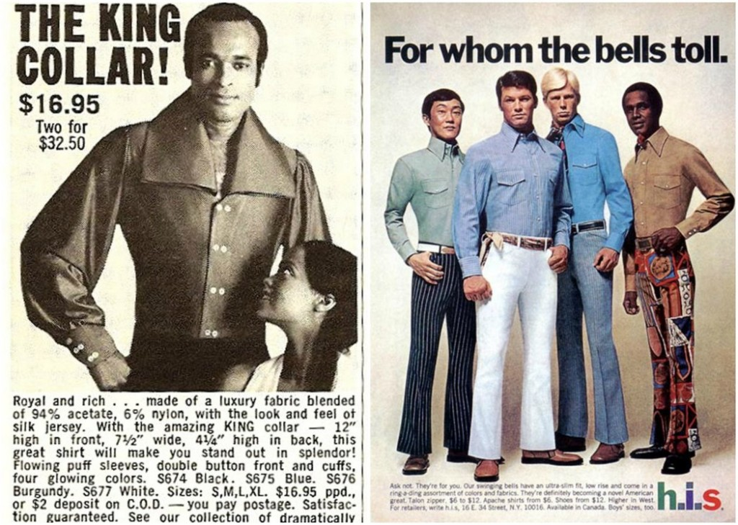

Slide 4
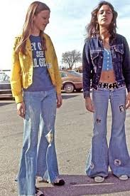
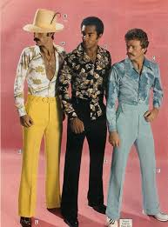
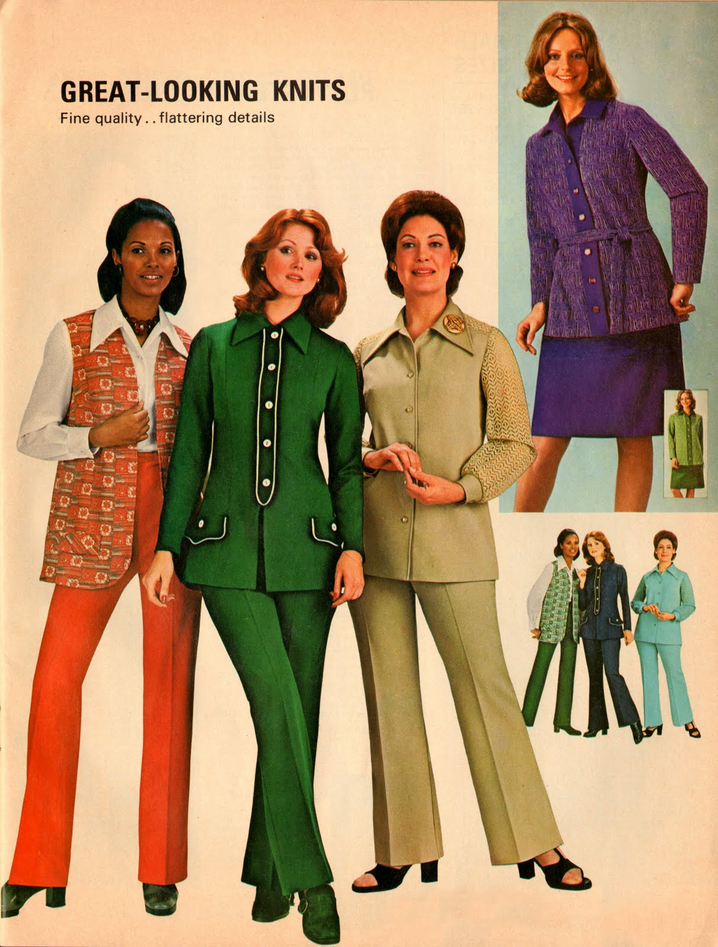
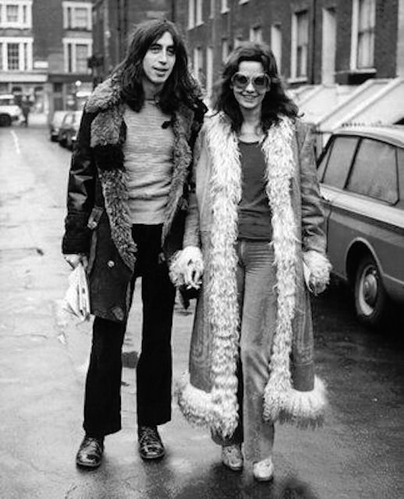
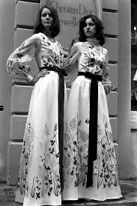

Slide 5
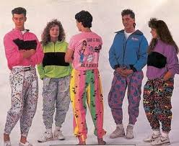
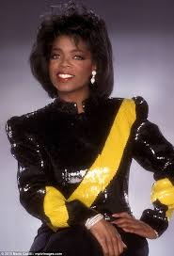
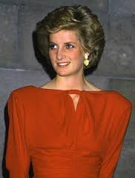
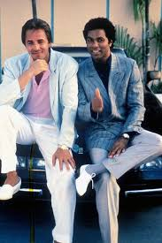
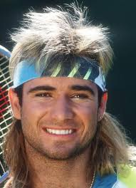
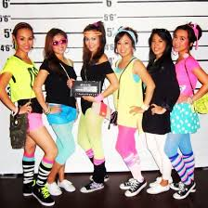
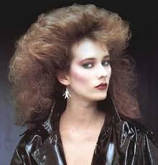

Slide 6
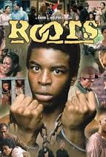
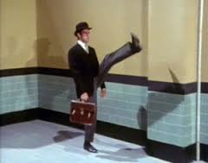
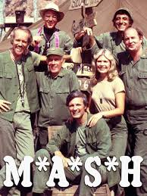
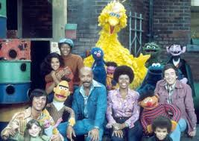
Television in the 70s
Moviegoing audiences shrink still further in the 70s as more people stay home and watch television
“Subscription” TV emerges – with HBO!
Sketch comedy comes of age!
Saturday Night Live
Monty Python’s Flying Circus:
Conservative elements long to return to a “simpler” time
Happy Days: https://www.youtube.com/watch?v=6W6y7YhHdVE
Little House on the Prairie
The Waltons
Much more diversity and effort to reflect social trends (civil rights, feminism, anti-war movement)
Roots (100 million watched): https://www.youtube.com/watch?v=TSJUgws9M-E&list=PLNqwHBvKkXKqkbAFry_5HqKg0xnLuYq3M
Good Times
Laverne & Shirley
The Mary Tyler Moore Show
The Jeffersons: https://www.youtube.com/watch?v=L09qnRfZY-k
All in the Family: https://www.youtube.com/watch?v=m6ev_kqWGBs
Sesame Street
M.A.S.H.

Slide 7
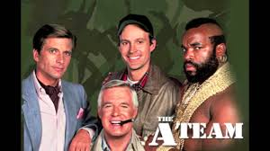
Television in the 80s
Americans begin watching more television than EVER before: average of 7 hours per day
Children often “raised” by television: Cartoons begin to target kids directly for advertising
Sensationalism: Primetime soap-operas
Dallas (originates the cliffhanger – who shot J.R.?)
Dynasty
Moonlighting (first primetime romance – Bruce Willis! (of all people to be designated a heart-throb!)
The final episode of M.A.S.H. (123,000,000)
Most watched TV event in history next to several Super Bowls
Cable appears giving viewers more choice
Law enforcement dramas:
Magnum P.I., 21 Jump Street, Miami Vice, The A-Team, Hill Street Blues
Sitcoms Evolve:
The Cosby Show: https://www.youtube.com/watch?v=rO35dhxNjYI
Cheers
Whole channels dedicated to sports (ESPN appears)
MTV emerges: first major television network to focus exclusively on youth culture: https://www.youtube.com/watch?v=ZPEwluSNzgc
Daytime Talk shows: Phil Donahue, Oprah Winfrey (explore relevant social and political issues)
Talk shows degenerate toward the end of the decade: Geraldo Rivera, Jerry Springer
Conservative Values:
The Wonder Years
Family Ties
Full House

Slide 8
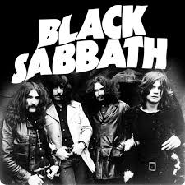
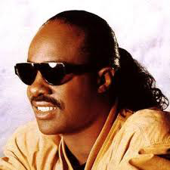
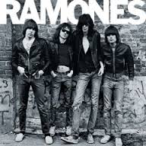
Music in the 70s
Toward the end of the 60s, rock n’ roll becomes “harder”
Joplin & Hendrix give way to Led Zeppelin, Black Sabbath and Kiss – METAL emerges
Black Sabbath’s “Iron Man”
https://www.youtube.com/watch?v=5s7_WbiR79E
Soul and blues fuse with DISCO and become: FUNK
Stevie Wonder’s “Superstition”
https://www.youtube.com/watch?v=0CFuCYNx-1g
British music continues to influence American music
The punk movement begins in Great Britain: The Sex Pistols: “Anarchy in the UK” & “My Way”
https://www.youtube.com/watch?v=qbmWs6Jf5dc
https://www.youtube.com/watch?v=Sv5DdTIKk48
Punk becomes decidedly more “pop” once it crosses the Atlantic and reaches the U.S.
https://www.youtube.com/watch?v=JBN1CkyRzmE

Slide 9
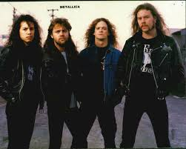
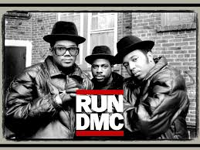
Music in the 80s
Pop Music Explodes! – Michael Jackson, Prince, Madonna, Janet Jackson, Whitney Houston (pop stars now more strongly emphasize dance as a major aspect of performance)
The Return of the “Single”: If the 60s and 70s were the era of the “Album”, then the 80s was the era of the “single”. Pop movement swells with numerous “One Hit Wonders” – “Take on Me” (A-Ha), “Never Gonna Give You Up” (Rick Astley)
https://www.youtube.com/watch?v=dQw4w9WgXcQ
Music assumes a stronger focus on both the DJ and the electronic composer (use of synthesizers creates new wave of electronic pop: “Whip It” (Devo), “Blue Monday” (New Order)
https://www.youtube.com/watch?v=9GMjH1nR0ds
The Music Video Becomes a Standard – any hit song could be that much more hard-hitting with an amazing music video (Michael Jackson music videos always incredibly impressive)
“Beat It” – https://www.youtube.com/watch?v=oRdxUFDoQe0
“Smooth Criminal” - https://www.youtube.com/watch?v=h_D3VFfhvs4
Metal Matures: The harder rock and punk of the 70s influences a new generation of musicians – Slayer, Pantera, Metallica
Hair Metal: Guns n’ Roses, Van Halen, Twisted Sister
https://www.youtube.com/watch?v=1w7OgIMMRc4
Hip Hop & Rap Are Born – “Rapper’s Delight” (Sugarhill Gang – 1979), “The Message” (Grandmaster Flash, 1981)
https://www.youtube.com/watch?v=mcCK99wHrk0
https://www.youtube.com/watch?v=PobrSpMwKk4
The genre would grow throughout the 80s with many more artists: Biz Markie, Slick Rick LL Cool J, Run-DMC, Public Enemy, NWA.

Slide 10
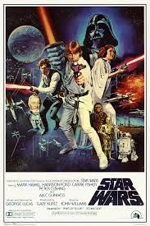
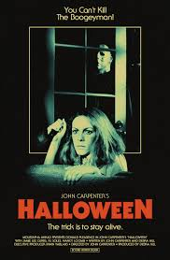
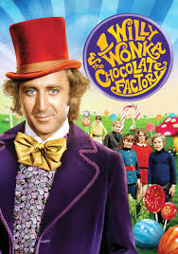
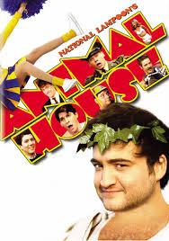
Movies in the 70s
Most popular genres:
Horror – “Halloween” (1978), “Jaws” (1975), “The Exorcist” (1973), “Carrie” (1976)
Science Fiction – “Star Wars: A New Hope” (1977), “Alien” (1979)
Gritty Dramas – Taxi Driver (1976) A Clockwork Orange (1971) One Flew Over the Cuckoo’s Nest (1975), The Godfather –Parts 1 & 2 (1972 – 1974)
https://www.youtube.com/watch?v=B34sntIgI4g
Action/Adventure – Mad Max (1979), Logan’s Run (1976)
For those not into violence or sci-fi…
Musicals, Comedy & Fantasy (oh my!) – “Willy Wonka & the Chocolate Factory” (1971), “Grease” (1978), The Rocky Horror Picture Show (1975), Animal House (1978), Annie Hall (1977), Monty Python & the Holy Grail (1976) https://www.youtube.com/watch?v=F41SSqJx2tU
A brand new genre: the Sports Drama
Sylvester Stallone pioneered a new type of film when he wrote, directed and starred in “Rocky” (1976)
https://www.youtube.com/watch?v=_YYmfM2TfUA

Slide 11
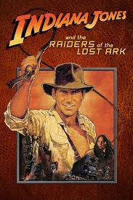
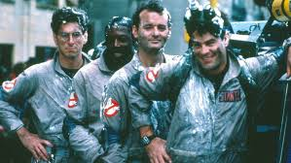
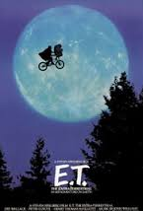
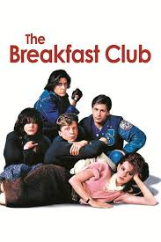
Movies in the 80s
The Movie “Franchise” Begins – The Indiana Jones Trilogy, Star Wars continues.. (The Empire Strikes Back & Return of the Jedi), Back to the Future (parts 1, 2 and 3), Ghostbusters, Mad Max continues…
Back to the Future: https://www.youtube.com/watch?v=Psxktpxkc6o
Violence in film increases to levels which both fascinate and alienate many – Scarface (1983), Nightmare on Elm Street (1984), Friday the Thirteenth (1980),
Action Movies - Terminator (1984), Die Hard (1988)
The “Teen Film” Becomes Its Own Distinct Genre – Ferris Bueller’s Day Off (1986), The Breakfast Club (1985), Fast Times At Ridgemont High (1982)
Ferris Bueller’s Day off: https://www.youtube.com/watch?v=0KFVLWX7eEY&t=26s
The “Coming of Age” Story – “E.T.” (1982), “The Goonies” (1985), “Stand By Me” (1986)

